Slide 1

New English File
Intermediate
Session 13

Slide 2
Unit 4
Part A
1 VOCABULARY

Slide 3
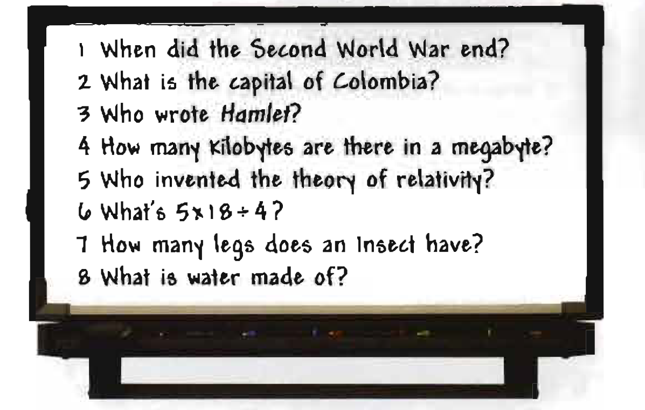
Education
Match the questions with the school
subjects.
Chemistry ____
Geography ____
History ____
Information Technology ____
Literature ____
Maths ____
Physics ____
Biology ____
8
2
1
4
3
6
5
7

Slide 4
Verbs
Complete each sentence with a verb.
behave /cheat / do / fail / learn / leave / pass / revise / start / study / take
1. When she was at school, she used to ___ for hours every evening. 2. I must ___ tonight. I have an exam tomorrow. 3. Our history teacher was terrible. We didn’t ___ anything. 4. If you don’t ___ homework, you can’t watch TV later. 5. The teacher was angry because some of the pupils had tried to ___ in the exam. 6. If you want to be a doctor, you have to ___ a lot of exams. 7. In the UK children ___ school when they are four and can’t ____ before they are 16. 8. I hope I’m going to___ my exams. My parents will be furious if I___ . 9. He was a rebel at school. He used to ___ very badly.
study
revise
learn
do
cheat
take/do
start
leave
pass
fail
behave

Slide 5
Places and people
Guess the words.
A school paid for by the government which gives free education. ___________
A non-government school where you have to pay. ___________
A school for very young children, e.g. 3. ___________
A school for young children, e.g. from 4-11. ___________
A school for older children, e.g. 11-18. ___________
A school where pupils live, eat, and sleep. ___________
State school
Private school
Nursery school
Primary school
Secondary school
Boarding school

Slide 6
A school where the teachers are often priests or nuns. ___________
The 'boss' of a school. ___________
A senior university teacher. ___________
A person who is studying at a college or university. ___________
A child who is at school. ___________
A person who has finished university and has a degree (e.g. in economics). ___________
Religious school
Head teacher
Professor
Student
pupil
Graduate

Slide 7
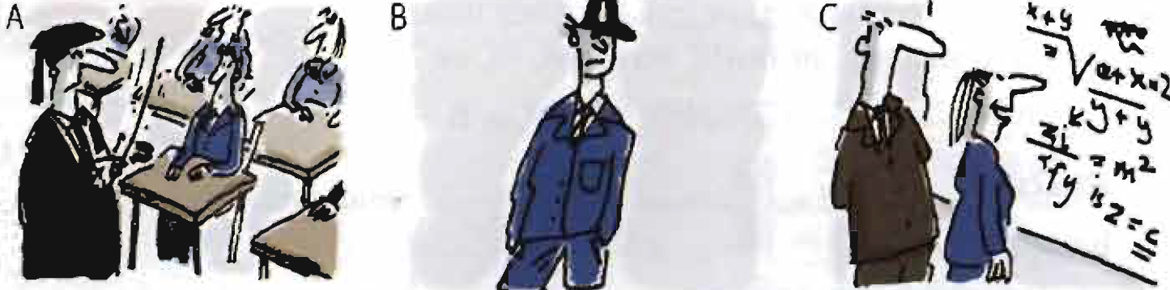
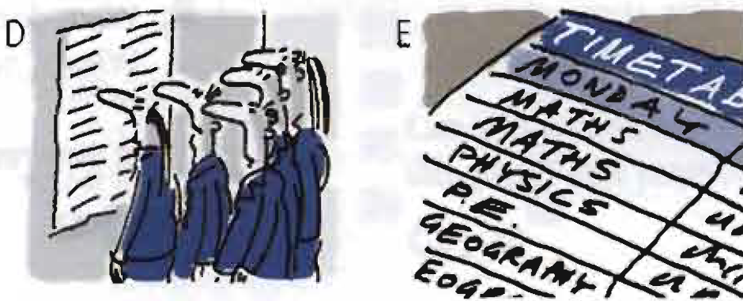
School life
Match the sentences and pictures.
We have to wear a horrible uniform! ____
The discipline here is very strict. ____
My timetable’s terrible this term! ____
I love maths. It’s my favourite subject. ____
look! The exam results are on the notice board. ____
B
A
E
C
D
Exam results can be given as marks (usually out of 10 or 100) or as grades (A, B> C, etc.).

Slide 8
Unit 4
Part A
2 READING

Slide 9
Read the text and put the phrases A-H in the correct places.
A. A crowd of pupils are watching. B. However, the pupils are totally involved.
C. He's friendly with the pupils but not too friendly.
D. When I was the same age as these children I had never used a computer.
E. It’s a magical moment and the most effective class I have seen. F. ‘Are you really in our class?’
G. One boy says he has chips every day. H. Phones that ring in class are confiscated until the end of the week
French
My first lesson is French. I am in a class of thirteen year-olds. Outside the classroom some girls start interrogating me. 1____ ‘How old are you?’ 'How old do you think I am?’ I reply. 'Well, you're not 13!’ First we have a listening test which I find difficult. I get 14 out of 20. Not bad. Then we make revision lists on the computer. 2 ____ Now every pupil has one.
Maths
As we wait outside the maths classroom a teacher tells me to do up the top button of my shirt. The maths teacher uses an interactive whiteboard which has graphics and video, but the pupils don't look very interested in the lesson. A mobile rings and the owner hurries to switch it off. 3____
History
Mr Fishleigh (S the history teacher. He doesn't have any problems controlling the noise level (other teachers do). 4____ . He talks to them as if they were adults and gets their attention in return.
F
D
H
C

Slide 10
A. A crowd of pupils are watching. B. However, the pupils are totally involved.
C. He's friendly with the pupils but not too friendly.
D. When I was the same age as these children I had never used a computer.
E. It’s a magical moment and the most effective class I have seen. F. ‘Are you really in our class?’
G. One boy says he has chips every day.
H. Phones that ring in class are confiscated until the end of the week
Lunch
In the canteen we can choose between traditional and fast food. Burger and chips is the most popular meal. 5____.
Information and communication technology
We are designing spreadsheets for mobile phone sales and I cannot imagine a more boring lesson. 6____ Most children have Internet access at home and the school has a website where parents can see what homework their children have and when they have to give it in .
G
B

Slide 11
A. A crowd of pupils are watching. B. However, the pupils are totally involved.
C. He's friendly with the pupils but not too friendly.
D. When I was the same age as these children I had never used a computer.
E. It’s a magical moment and the most effective class I have seen. F. ‘Are you really in our class?’
G. One boy says he has chips every day.
H. Phones that ring in class are confiscated until the end of the week
Religious education
The teacher introduces US to meditation. We sit cross-legged an our desks and try to (ill our minds with blackness and think positively about people who we have been thinking negatively about. For 15 minutes the children sit, eyes closed, in total silence. When they leave the class they are slightly dazed :
'Incredible!’ 'Amazing!’ 'We should do this in maths!’
7____
The bell goes. End of school for the day.
As we leave there is a fight at the school gates. 8____'If anyone hits anyone, I’ll call the police,' says a teacher.
E
A

Slide 12
Guess the meaning of the highlighted words in the text.
interrogating = asking questions in an aggressive way
do up = fasten a button (or shoe laces)
in return = in exchange
canteen = a communal dining room, e.g. in a school or factory
spreadsheets = a computer programme used for financial planning
give it in = give something to somebody in authority, e.g. a teacher
slightly dazed = (a bit) unable to think clearly
bell = a metal object shaped like a cup that makes a ringing noise when you move it

Slide 13
Unit 4
Part A
3 GRAMMAR

Slide 14
First conditional and future time clauses + when/until …
first conditional sentences: if(or unless) + present simple, will/won't + infinitive
If you don’t do more work, you’ll fail the exam.
He’ll be late for work if he doesn’t hurry up.
She won’t get into university unless she gets good grades.
Use the present tense (NOT the future) after if in first conditional sentences.
Unless= if .. not
I won’t go unless she invites me. = I won't go if she doesn’t invite me.
You can also use an imperative instead of the will clause, e.g.
Come and see us next week if you have time.

Slide 15

future time clauses
As soon as you get your exam results, call me.
We’ll have dinner when your father gets home.
I won’t go to bed until you come home.
I’ll have lunch before I leave.
After I finish university, I’ll probably take a year off and travel.
Use the present simple (NOT the future) after when, as soon as, until, before, and after to talk about the future.
as soon as = at the moment when,…
I’ll call you as soon as I arrive.

Slide 16
Complete with a word or expression from the list.
After as soon as before if unless until when
_____________ we have dinner, we could go for a drink.
I must write the date in my diary __________ I forget it.
Let’s wait under the tree _____________ it stops raining.
This job is very urgent so please do it _____________ you can.
We won't get a table in the restaurant _____________ we don’t book.
I’ll pay you back _______________ I get my first salary.
I can't go _____________ you pay for my ticket. I'm broke.
They’ll be really happy _____________ they hear your news.
I want to go on working _____________ I’m 60. Then I’ll retire.
I must renew my passport _____________ I go to New York.
_____________ you work harder, you won’t pass the final exam.
After
before
until
as soon as
if
when/as soon as
unless
when
until
before
Unless

Slide 17
Complete with the present simple or will.
I’ll give him your message when I see him. (see)
Don’t forget to turn off the lights before you __________ (leave)
Go to bed when the film __________.(finish)
They ____________ married until they find a place to live. (not get)
If I see Emma, I __________ her you are looking for her. (tell)
I’ll call you as soon as I __________ at the hotel. (arrive)
You won’t be able to park unless you __________ there early. (get)
As soon as it stops raining, we __________ out. (go)
She won’t like curry if she __________ spicy food. (not like)
Don’t write anything until I __________ you. (tell)
When she finds out what he’s done, she ________furious. (be)
leave
finishes
will not get
will tell
arrive
get
will go
doesn’t like
tell
will be

Slide 18
{{ Thank You }}

