Slide 1

Damascus University
Medical Preparatory English

Slide 2


New English File
Upper-intermediate
Term 2 – Session 1

Slide 3
Would you get out alive? P.52
4A
a. How do you think most people react in a life or death disaster situation?
A. They panic and become hysterical.
B. They act coolly and calmly.
C. They 'freeze' and can't do anything.
b. Read How humans behave when the worst thing happens, and check your answer to the question above. Then answer the questions below.
1. What two reasons are given to explain why a lot of people freeze in a crisis?
2. Is it possible to predict how people will react in a crisis?

Slide 4
How to get out alive
How humans behave when the worst thing happens...
We ALWAYS THINK 'it will never happen to me‘ but disasters can strike any time anywhere – from hotel fires to train crashes to terrorist attacks. How would you cope if the unthinkable happened?
According to experts, people caught up in disasters tend to fall into three categories. About 10% to 15% remain calm and act quickly and efficiently. Another 15% completely panic, crying and screaming and obstructing the evacuation. But the vast majority (70%) of people do very little. They are 'stunned and confused,' says British psychologist John Leach.
Why is this? Research suggests that under great stress our minds take much longer to process information. So, in a crisis many people 'freeze‘ just at the moment when they need to act quickly. It also seems that a person's personality is not a good guide to how they might react – a normally decisive person may not act at all quickly in a crisis and vice versa. 'Most people go their entire lives without a disaster,' says Michael Lindell, a professor at Texas A&M University. 'So when something bad happens they are so shocked they just think, "This can't possibly be happening to me," instead of taking action.’
Now let’s check your answers.

Slide 5
Would you get out alive? P.52
4A
a. How do most people react in a life or death disaster situation?
A. They panic and become hysterical.
B. They act coolly and calmly.
C. They 'freeze' and can't do anything.
b. Answer the questions below.
What two reasons are given to explain why a lot of people freeze in a crisis?
Because in a crisis our minds take longer to process information, people can’t take a decision about what to do. People also often refuse to believe that the disaster is happening to them.
2. Is it possible to predict how people will react in a crisis?
No, because people’s normal personality is not a good guide to how they will react in a crisis.

Slide 6
Would you get out alive? P.52
4A
Read A about a survivor of the World Trade Center (WTC), and B about a survivor from the Tenerife air crash. Answer these questions. Then go to check your answers.
A
Where was Elia on 11th September 2001?
How did she react when the plane hit the World Trade Center?
What saved her life?
How quickly did she leave?
How could more lives have been saved?
B
Where was Paul Heck on 27th March 1977?
How did the accident happen?
How could more passengers have survived?
Why did Paul Heck survive?
What previous experience influenced Paul?

Slide 7
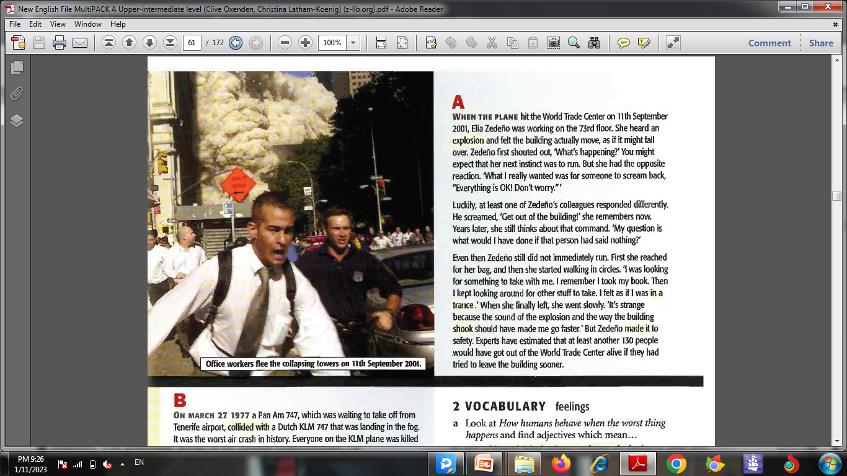
Office workers flee the collapsing towers on 11th September 2001.
A WHEN THE PLANE hit the World Trade Center on 11th September 2001,Elia Zederio was working on the 73rd floor. She heard an explosion and felt the building actually move, as if it might fall over. Zederio first shouted out, ‘What's happening?' You might expect that her next instinct was to run. But she had the opposite reaction. What I really wanted was for someone to scream back, "Everything is OK! Don't worry."
Luckily, at least one of Zedeno's colleagues responded differently. He screamed, 'Get out of the building!' she remembers now. Years later, she still thinks about that command. 'My question is what would I have done if that person had said nothing?'
Even then Zederio still did not immediately run. First she reached for her bag, and then she started walking in circles. 'I was looking for something to take with me. I remember I took my book. Then I kept looking around for other stuff to take. I felt as if I was in a trance.' When she finally left, she went slowly. 'It's strange because the sound of the explosion and the way the building shook should have made me go faster.' But Zederio made it to safety. Experts have estimated that at least another 130 people would have got out of the World Trade Center alive if they had tried to leave the building sooner.
Now let’s check your answers.

Slide 8
Would you get out alive? P.52
4A
Read A about a survivor of the World Trade Center and answer these questions.
1. Where was Elia on 11th September 2001?
Elia was working on the 73rd floor of the World Trade Centre.
2. How did she react when the plane hit the World Trade Center?
She first shouted out, ‘What's happening?'
3. What saved her life?
One of her colleagues screamed, ‘Get out of the building!’
4. How quickly did she leave?
She did not immediately run. First she took some stuff, then she finally left slowly.
5. How could more lives have been saved?
If they had tried to leave the building sooner.

Slide 9
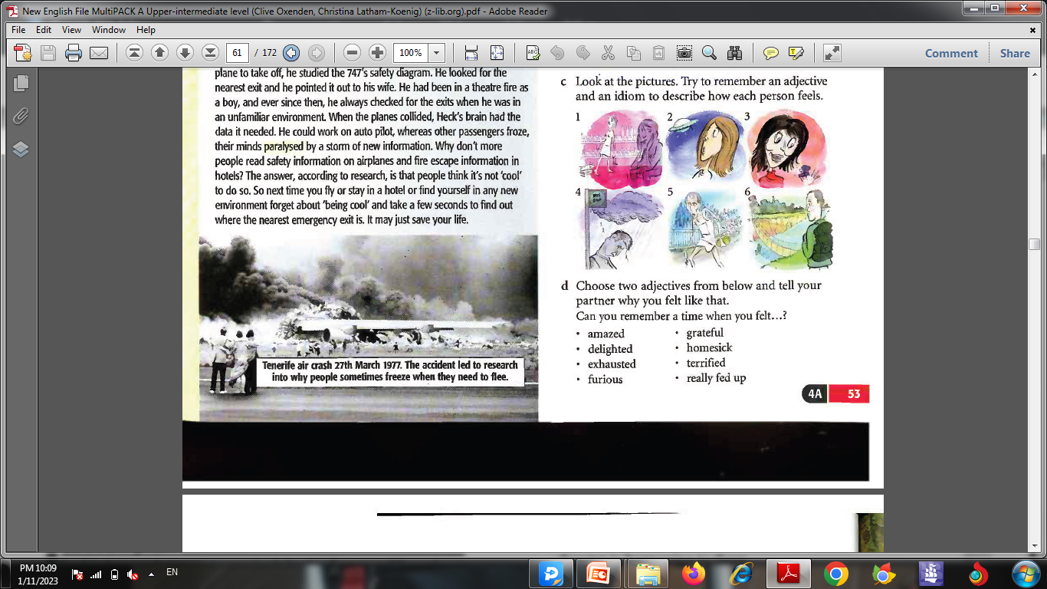
B ON MARCH 27 1977 a Pan Am 747,which was waiting to take off from Tenerife airport, collided with a Dutch KLM 747 that was landing in the fog. It was the worst air crash in history. Everyone on the KLM plane was killed but 62 passengers on the Pan Am plane survived. Many more would have survived if they had got off the plane immediately.
One of the survivors was 65-year-old Paul Heck. He led his wife Floy towards the exit and they got out just before the plane caught fire, just 60 seconds after the collision. Why Paul Heck and not others? In the hours just before the crash Paul did something highly unusual. While he was waiting for the plane to take off, he studied the 747's safety diagram. He looked for the nearest exit and he pointed it out to his wife. He had been in a theatre fire as a boy, and ever since then, he always checked for the exits when he was in an unfamiliar environment. When the planes collided, Heck's brain had the data it needed. He could work on auto pilot, whereas other passengers froze, their minds paralysed by a storm of new information. Why don't more people read safety information on airplanes and fire escape information in hotels? The answer, according to research, is that people
think it's not 'cool‘ to do so. So next time
you fly or stay in a hotel or find yourself
in any new environment forget about
'being cool' and take a few seconds to
find out where the nearest emergency
exit is. It may just save your life.
Tenerife air crash 27th March 1977.The accident led to research into why people sometimes freeze when they need to flee.
Now let’s check your answers.

Slide 10
Would you get out alive? P.52
4A
Read B about a survivor from the Tenerife air crash. Answer these questions.
1. Where was Paul Heck on 27th March 1977?
He was on Pan Am 747,which was waiting to take off from Tenerife airport.
2. How did the accident happen?
A Pan Am 747,which was waiting to take off from Tenerife airport, collided with a Dutch KLM 747 that was landing in the fog.
3. How could more passengers have survived?
If they hadn’t frozen and had got off the plane immediately.
4. Why did Paul Heck survive?
Because he walked immediately towards the exit and got out just before the plane caught fire, just 60 seconds after the collision.
5. What previous experience influenced Paul?
He had been in a theatre fire as a boy, and ever since then, he always checked for the exits when he was in an unfamiliar environment.

Slide 11
Would you get out alive? P.52
4A
d. Read the whole article and mark the sentences true (T) or false (F).
Elia Zedeno’s first instinct was to run.
If her colleague hadn’t shouted, she might not have reacted how she did.
She took her time to leave because she didn’t know where the exit was.
Some people who died in the WTC could have survived.
The 1977 Tenerife air crash happened in bad weather conditions.
The Pan Am passengers had plenty of time to escape.
Heck always worried about how he would be able to escape from places.
People don’t read safety information because they aren’t worried about crashing.
e. Look at the highlighted words related to disasters. Try to work out
the meaning from the context of the ones you didn’t know.
Now let’s check your answers.

Slide 12
Would you get out alive? P.52
4A
1 Elia Zedeno’s first instinct was to run.
F. She didn’t run. She waited for someone to tell her everything was all right.
2 If her colleague hadn’t shouted, she might not have reacted how she did.
T
3 She took her time to leave because she didn’t know where the exit was.
F. She was looking for things to take with her.
4 Some people who died in the WTC could have survived. T
5 The 1977 Tenerife air crash happened in bad weather conditions. T
6 The Pan Am passengers had plenty of time to escape.
F . They had very little time. The plane caught fire after 60 seconds.
7 Heck always worried about how he would be able to escape from places. T
8 People don’t read safety information because they aren’t worried about crashing. F . Because they think it’s not ‘cool’ to do so.

Slide 13
Would you get out alive? P.52
4A
e. Look at the highlighted words related to disasters. Try to work out the meaning from the context of the ones you didn’t know.
evacuation = moving people from a place of danger to a safer place
explosion = the noun of explode, the action caused by sth such as a bomb
in a trance = a state in which you are thinking so much about something that you are doing that you don’t notice what is happening around you, like a hypnotized person
shook = past tense of shake = to move from side to side or up and down
made it = succeeded in doing sth, such as reaching a place in time.
collided with = crashed into
survivors = people who survive, do not die in an accident or terrorist attack
caught fire = started burning
paralysed = unable to move at all

Slide 14
VOCABULARY feelings p.53
Look at How humans behave when the worst thing happens and find adjectives which mean...
1. unable to think clearly or understand what’s
happening. ___________
2. not excited or nervous. ___________
3. very surprised by something unpleasant. ___________
4. so surprised that you can’t move or react. __________
Click to check your answers.
confused
calm
shocked
stunned

Slide 15
Feelings VOCABULARY BANK P. 151
1 Adjectives
a. Match the adjectives with the situations. (Click to check your answers)
confused disappointed glad or pleased grateful homesick
lonely nervous offended relieved shocked
How would you feel if..
1 two people gave you completely opposite advice? confused
2 the police told you that your flat had been burgled? shocked
3 a friend helped you a lot with a problem? ………………
4 you thought you had lost your passport but then you found it?.…………….
5 you didn’t get a present you were hoping to get? ………………
6 you went to study abroad and were missing your family? ………………
7 you moved to a new town and didn’t have any friends? ………………
8 you were about to talk in public for the first time? ………………
9 your friend tells you she has just passed her driving test? ………………
10 a very good friend didn’t invite you to his party? ………………
grateful
relieved
disappointed
homesick
lonely
nervous
glad or pleased
offended

Slide 16
Feelings VOCABULARY BANK P. 151
1 Adjectives
Some adjectives describe a mixture of feelings, e.g.
fed up = bored or frustrated and unhappy (especially with a situation which has gone on too long)
I’m very fed up with my job.
I think I’m going to look for something else.
upset = unhappy and worried / anxious
She was very upset when she heard that her cousin had had an accident.

Slide 17
Feelings VOCABULARY BANK P. 151
b Match the strong adjectives with their definitions.
astonished delighted desperate devastated exhausted furious miserable stunned terrified thrilled
very surprised and unable to move or react stunned
extremely upset and shocked ___________
very pleased ___________
really tired ___________
very excited ___________
extremely scared ___________
really angry ___________
very surprised ___________ (or amazed)
with little hope, and ready to do anything to improve the situation ___________
very unhappy ___________ (Click to check your answers)
devastated
delighted
exhausted
thrilled
terrified
furious
astonished
desperate
miserable

Slide 18
Feelings VOCABULARY BANK P. 151
Remember you can’t use very, extremely, etc. with strong adjectives.
If you want to use an intensifier, use absolutely, e.g. absolutely astonished NOT very astonished.

Slide 19
Feelings VOCABULARY BANK P. 151
2. Idioms
a Look at the idioms in blue and try to guess their meaning.
1 I’m sick and tired of telling you to do your homework. Get on with it!
2 When I saw the burglar I was scared stiff.
3 He finally passed his driving test! He’s over the moon!
4 You look a bit down in the dumps. Has life been treating you badly?
5 I’m completely worn out. I just want to sit down and put my feet up.
6 When I saw her, I couldn’t believe my eyes. She looked ten years younger.
b Match the idioms and the feelings. (Click to check your answers)
A exhausted B (be) very surprised
C fed up D terrified
E sad, depressed F very happy
5
6
1
2
4
3

Slide 20
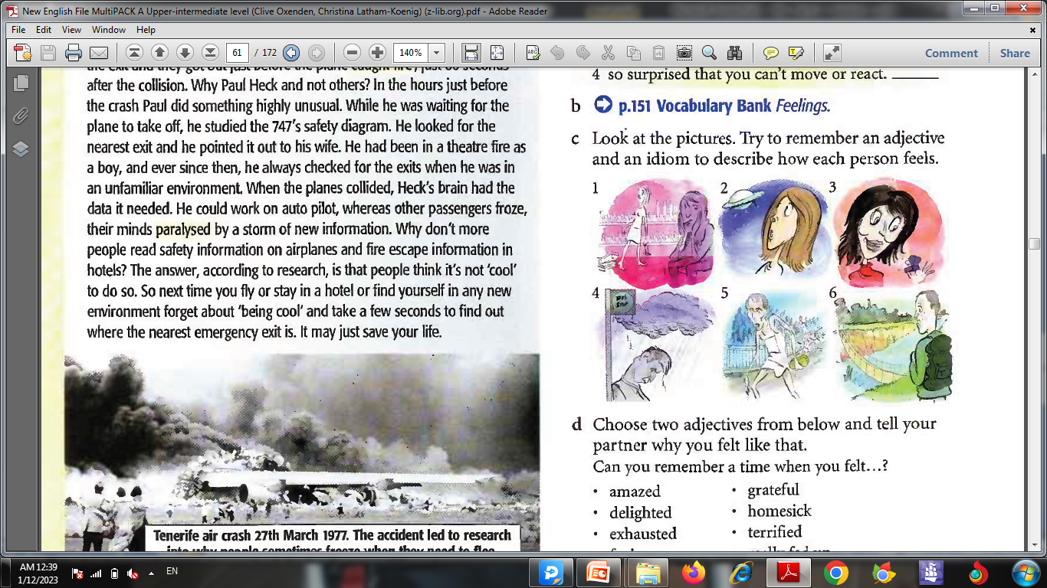
VOCABULARY feelings p.53
C. Look at the pictures. Try to remember an adjective and an idiom
to describe how each person feels. Click to check your answers.
fed up, sick and tired
astonished, couldn’t believe her eyes
delighted, over the moon
miserable, down in the dumps
exhausted, worn out
terrified, scared stiff

Slide 21
GRAMMAR unreal conditionals P.54
1 What would you do if your school caught fire?
2 What would you have done if you had been on the Pan Am plane in Tenerife?
a Look at 1 and 2 above and answer the questions.
Which one refers to a hypothetical situation in the past?
Which one refers to a hypothetical situation in the present or future? (Click to check your answers)
b Underline the verb forms. Which forms are they?
(Click to check your answers)
2
1
1 would + infinitive in the main clause, past simple in the jf-clause
2 would have + past participle in the main clause, past perfect in the if-clause

Slide 22
GRAMMAR unreal conditionals P.54
c. Try to complete 1- 4 below. (Click to check your answers)
What would do if you ____________ (be) in a hotel and the fire alarm went off in the middle of the night?
Another 130 people __________________ (get out) of the World Trade Center alive if they had tried to leave the building sooner.
Many more people would have survived if they _____________ (get off ) the plane immediately.
If a fire alarm went off at work, I _______________ (not pay) any attention.
were
would have got out
had got off
wouldn’t pay

Slide 23
GRAMMAR BANK 4A unreal conditionals P. 138
second conditional sentences: if + past simple, would / wouldn’t +Infinitive
1. If there was a fire in this hotel, it would be very difficult to escape.
I wouldn’t live in the country if I didn’t have a car.
Use second conditional sentences to talk about hypothetical or improbable situations in the present / future.
2. If you weren’t making so much noise, I could concentrate better.
In the if clause you can also use the past continuous. In the other clause you can use could or might instead of would,
3. If I were you, I’d make Jimmy wear a helmet when he’s cycling.
With the verb be you can use was or were for I, he, and she in the if clause, e.g. If he was / were here, he would know what to do.
However, in conditionals beginning If I were you... to give advice, always use were.

Slide 24
GRAMMAR BANK 4A unreal conditionals P. 138
third conditional sentences: if + past perfect, would / wouldn’t have + past participle
1. If you had studied more, you would have done better in the exams.
I wouldn’t have been late if I hadn’t overslept.
We use third conditional sentences to talk about a hypothetical past situation and its consequence.
2. He would have died if he hadn’t been wearing a helmet.
If they had known you were coming, they might have stayed longer.
You can also use the past perfect continuous in the if clause. You can use could have or might have instead of would have in the other clause.

Slide 25
GRAMMAR BANK 4A unreal conditionals P. 138
second or third conditional?
If you studied more, you would probably pass the exam.
If you had studied more, you would probably have passed the exam.
Compare the two conditionals.
1 = You don’t study enough. You need to study more.
2 = You didn’t study enough, so you failed.
We sometimes mix second and third conditionals if a hypothetical situation in the past has a present / future consequence,
e.g. He wouldn’t be so relaxed if he hadn’t finished his exams.

Slide 26
GRAMMAR BANK 4A unreal conditionals P. 139
a. Complete with a suitable form of the verb in brackets. Click to check.
If he hadn’t broken his leg, he would have played. (not break)
I ________________ you a present if I’d known it was your birthday. (buy)
If you ______________ to bed earlier, you wouldn’t have been so tired. (go)
I ________________ you some money if I had any. (lend)
If I _______________ someone’s wallet, I’d keep it. (find)
Joe wouldn’t have crashed if he ________________ so fast. (not drive)
We would have a dog if we ______________ in the country. (live)
If you’d looked after the plants, they ________________. (not die)
You ______________ the news if you’d been watching the TV. (hear)
They wouldn’t have bought the flat if they _______________ what the neighbours were like. (know)
If she ______________ more sociable, she’d have more friends. (be)
would have bought
had gone
would lend
found
hadn’t been driving / had driven
lived
wouldn’t have died
would have heard
had known
were / was

Slide 27
GRAMMAR BANK 4A unreal conditionals P. 139
b. Complete using a second or third conditional. Click to check.
I didn’t wait another minute. I didn’t see you.
If I’d waited another minute, I would have seen you.
1. Luke missed the train. He was late for the interview.
If Luke hadn’t missed the train, _______________
2. Rebecca drinks too much coffee. She sleeps badly at night.
If Rebecca didn’t drink so much coffee, _______________
3. It started snowing. We didn’t reach the top of the mountain.
If it hadn’t started snowing, ________________
4. Millie didn’t buy the jacket. She didn’t have enough money.
Millie would have bought the jacket if ________________
5. I don’t drive to work. There’s so much traffic.
I’d drive to work if _________________
6. Matt doesn’t speak German fluently. He won’t get the job.
If Matt spoke German fluently, ________________
he wouldn’t have been late for the interview.
she wouldn’t sleep badly at night.
we would have reached the top of the mountain.
she had had enough money.
there wasn’t so much traffic.
he would get the job.

Slide 28



