Slide 1

Damascus University
Medical Preparatory English

Slide 2


New English File
Upper-intermediate
Term 1 – Session 9

Slide 3
VOCABULARY crime and punishment p.37
3A
Match the words for people who steal with the definitions in the list. (Click to check)
pickpocket mugger burglar robber shoplifter thief
1. A ___________ is someone who breaks in and steals from a private house.
2. A ___________ is someone who breaks in and steals from e.g. a bank or business.
3. A ___________ is someone who steals something when he / she is in a shop.
4. A ___________ is someone who steals from you in the street, often without you noticing.
5. A ___________ is someone who uses violence to steal from you in the street.
6. A ___________ is the general word for someone who steals.
burglar
robber
shoplifter
pickpocket
mugger
thief

Slide 4
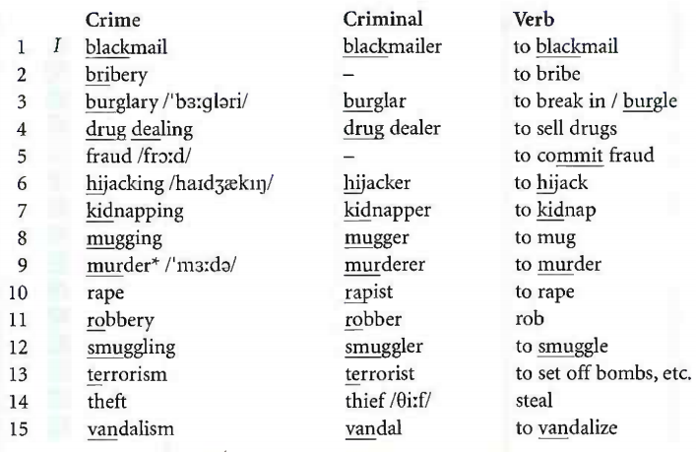
Crime and punishment Vocabulary Bank p.149

Slide 5
Crime and punishment Vocabulary Bank p.149
1. Crimes and criminals
Match the examples to the crimes in the chart. (Click to check)
A gang took a rich man’s son and asked the family for money. ___
She went to her ex-husband’s house and shot him dead. ___
A passenger on a flight made the pilot land in the desert. ___
After the party the man made the woman have sex against her will. ___
We came home from holiday and found that our TV had gone. ___
Someone tried to sell me some marijuana during a concert. ___
When the border police searched his car, it was full of cigarettes.___
Someone threw paint on the statue in the park. ___
He said he’d send the photos to a newspaper if the actress didn’t pay him a lot of money. ___
An armed man walked into a bank and shouted, ‘Hands up!’ ___
A man transferred company money into his own bank account. ___
A builder offered the mayor a free flat in return for a favour. ___
7
9
6
10
3
4
12
15
1
11
5
2

Slide 6
Crime and punishment Vocabulary Bank p.149
Crimes and criminals
M. Two men left a bomb in the supermarket car park. ___
N. Somebody stole my car last night from outside my house. ___
O. A man held out a knife and made me give him my wallet. ___
Notes
manslaughter = killing somebody illegally, but unintentionally.
assassination = murder of an important person, usually for political reasons (verb assassinate).
arson = deliberately making sth burn, especially a building.
13
14
8

Slide 7
Crime and punishment Vocabulary Bank p.149
2. What happens to a criminal
Complete the sentences. Fill in with the correct words. (Click to check)
arrested caught charged committed investigated questioned
1 Carl and Adam committed a crime. They murdered a man.
2 The police _____________ the crime.
3 Carl and Adam were _____________ on the way to the airport.
4 They were _____________ and taken to a police station.
5 The police _____________ them for ten hours.
6 Finally they were _____________ with murder.
charged = formally accused
investigated
caught
arrested
questioned
charged

Slide 8
Crime and punishment Vocabulary Bank p.149
acquitted court evidence guilty judge jury not guilty
proof punishment sentenced verdict witnesses
The trial
7 Two months later, Carl and Adam appeared in __________.
8 __________ told the court what they had seen or knew.
9 The _______(of 12 people) looked at and heard all the ________.
10 After two days the jury reached their __________.
11 Carl was found __________ . His fingerprints were on the gun.
12 The __________ decided what Carl’s __________ should be.
13 He __________ him to 10 years in prison / jail.
14 Adam was found __________ (they thought he was innocent).
15 There was no __________ that he had committed the crime.
16 He was __________ and allowed to go free.
court
Witnesses
jury
evidence
verdict
guilty
judge
punishment
sentenced
not guilty
proof
acquitted

Slide 9
Crime and punishment Vocabulary Bank p.149
Punishments
community service (doing some work to help society, e.g painting, cleaning, etc.)
a (€600) fine
six months in prison
a life sentence
capital punishment (the death penalty)

Slide 10
GRAMMAR Passive (all forms), it is said that..., he is thought to..., etc. P. 38
You are going to read two true crime stories.
In World Cup thief’s own goal complete the article with the verb in brackets in the past simple active or passive.
Then in Parrot held in prison, choose the right form.
Click to check your answers.

Slide 11
World Cup thief’s own goal p. 38
stole
A thief who ¹_________ (steal) a World Cup ticket from a woman’s hand bag ²___________ (catch) after he sat down to watch the game next to the victim’s husband.
Eva Standmann, 42, ³____________ (mug) as she was going to Munich stadium for the game between Brazil and Australia. The thief a 34-year-old man, ⁴__________ (discover) the ticket in her bag and he decided to use it.
But when he ⁵________ (take) the woman’s seat in the stadium, he ⁶_________ (meet) by her husband Berndt, 43, who immediately called the police on his mobile.
A Munich police spokesman said, ‘The thief ⁷_______ (find) the ticket in the bag and decided to watch the game. When he sat down next to his victim’s husband, officers on duty at the stadium ⁸_____________ (inform) of the situation and the thief ⁹______________ (arrest).
was caught
was mugged
discovered
took
was met
found
were informed
was arrested

Slide 12
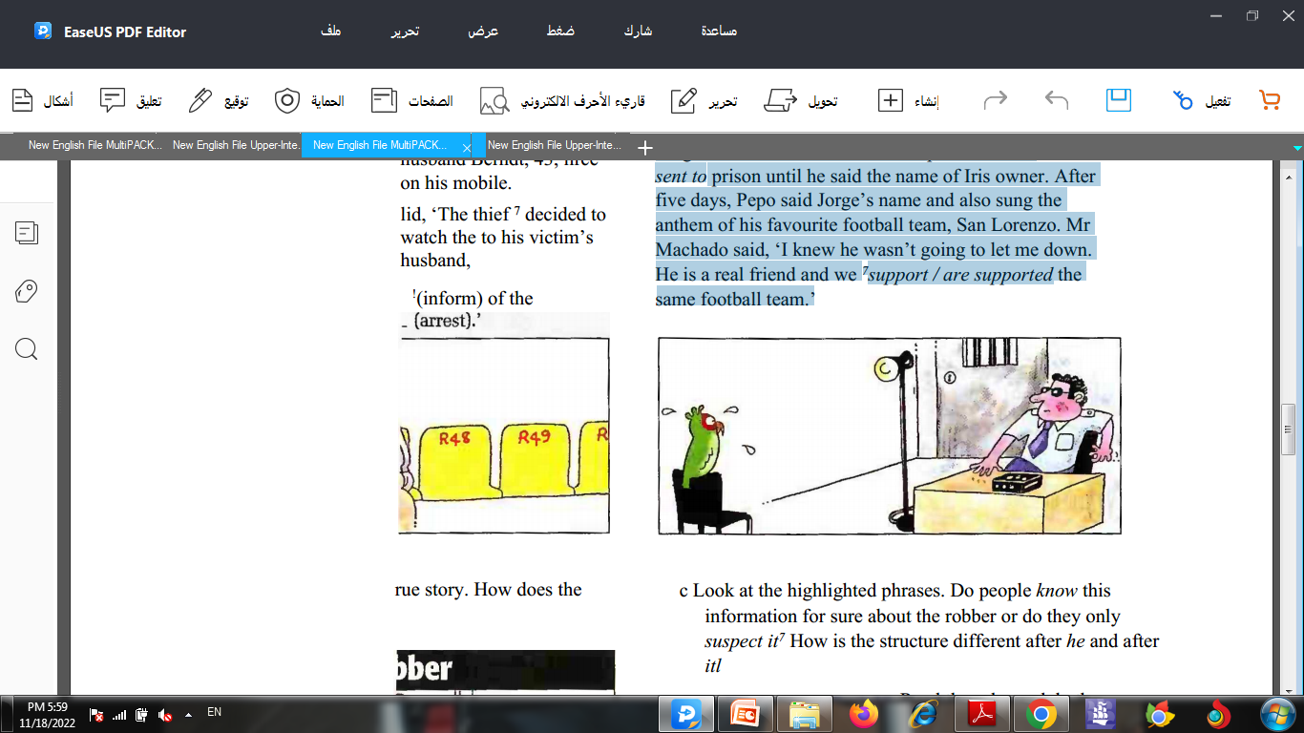
Parrot held in prison p. 38
A parrot has spent five days ¹interrogating / being interrogated by police in a prison in Argentina.
A judge ²ordered / was ordered the parrot, which ³calls / is called Pepo, ⁴to hold / to be held in custody until he told police who his real owner was. Two neighbours, Jorge Machado and Rafael Vega, were disputing who the bird ⁵belonged / was belonged to.
Judge Osvaldo Carlos decided the parrot should ⁶send / be sent to prison until he said the name of his owner. After five days, Pepo said Jorge’s name and also sang the anthem of his favourite football team, San Lorenzo. Mr Machado said, ‘I knew he wasn’t going to let me down. He is a real friend and we ⁷support / are supported the same football team.’

Slide 13
New grammar. Read another true story.
How does the hypnotist rob banks? p. 38
He hypnotizes cashiers and gets them to hand over money.
Hypnotic bank robber
Bank clerks in Moldova have been told by the police not to make eye contact with customers after a series of robberies. The robber is believed to be a trained hypnotist from Russia.
He is said to put cashiers into a trance before making them hand over tens of thousands of dollar’s worth of notes.
It is thought that the criminal begins talking to bank tellers and gradually hypnotizes them. After getting them to give him money, he then brings them back out of the trance and leaves them with no memory of handing over the cash. It is believed that the man has robbed at least three banks in the last month.

Slide 14
Hypnotic bank robber
Look at the highlighted phrases.
Do people know this information for sure about the robber or do they only suspect it? (Click to check)
How is the structure different after he and after it?
After it is said (thought / believed), etc. you use that +
a clause
After he is said (thought / believed), etc. you use to +
infinitive
NOTE: After I / you / we / they, you also use to + infinitive

Slide 15

3A passive (all forms), it is said that..., he is thought to..., etc. P. 136
The passive (all forms)
Use the passive when you want to talk about an action but you are not so interested in saying who or what does I did the action.
If you also want to mention the person or thing that did the action (the agent), use by.
e.g. Prison sentences are decided by judges.
However, in the majority of passive sentences the agent is not mentioned.
The form be (all forms) + past participle

Slide 16
3A passive (all forms), it is said that..., he is thought to..., etc. P. 136
The passive (all forms)
present simple Murderers are usually sentenced to life
imprisonment.
present continuous The trial is being held at the moment.
present perfect My car has been stolen.
past simple Jim was arrested last month.
past continuous The cinema was being rebuilt when it was set on fire.
past perfect We saw that one of the windows had been broken.
future The prisoner will be released next month.
The verdict is going to be given tomorrow.
infinitive with to People used to be imprisoned for stealing bread.
infinitive without to You can be fined for parking on a yellow line.
gerund He paid a fine to avoid being sent to jail.

Slide 17
3A passive (all forms), it is said that..., he is thought to..., etc. P. 136
it is said that...
This formal structure is used especially in news reports and on TV with the verbs know, tell, understand, report, expect, say and think. It makes the information sound more impersonal.
active They say that the company may close.
passive It is said that the company may close.
active People think that prices will go up.
passive It is thought that prices will go up.
You can use It is said, believed, etc. + that+ clause.

Slide 18
3A passive (all forms), it is said that..., he is thought to..., etc. P. 136
he is thought to...
active People say the man is in his 40s.
passive The man is said to be in his 40s.
active The police believe he has left the country.
passive He is believed to have left the country.
You can use
He, The man, etc. (i.e. the subject of the clause) + is said, believed, etc. + to + infinitive (e.g. to be) or perfect infinitive (e.g. to have been).

Slide 19
GRAMMAR BANK p. 137
Rewrite the sentences in the passive (without by).
(Click to check)
The police caught the burglar immediately.
The burglar was caught immediately.
Police closed the road after the accident.
The road …
Somebody has stolen my handbag.
My handbag...
The painters are painting my house.
My house …
They’ll hold a meeting tomorrow.
A meeting …
The road was closed after the accident.
My handbag has been stolen.
My house is being painted.
A meeting will be held tomorrow.

Slide 20
GRAMMAR BANK p. 137
5. The inspector fined them for travelling without a
ticket.
They …
6. The police can arrest you for drink-driving.
You …
7. Miranda thinks someone was following her last night.
Miranda thinks she …
8. They had sold the house five years earlier.
The house …
They were fined for travelling without a ticket.
You can be arrested for drink-driving.
Miranda thinks she was being followed last night.
The house had been sold five years earlier.

Slide 21
GRAMMAR BANK p. 137
b. Rephrase the sentences to make them more formal.
(Click to check)
People think the murderer is a woman.
It is thought that the murderer is a woman.
The murderer is thought to be a woman.
Police believe the burglar is a local man.
It …
The burglar …
2. People say the muggers are very dangerous.
It …
The muggers …
It is believed that the burglar is a local man.
The burglar is believed to be a local man.
It is said that the muggers are very dangerous.
The muggers are said to be very dangerous.

Slide 22
GRAMMAR BANK p. 137
3. Police think the robber entered through an open window.
It …
The robber …
4. Police say the murderer has disappeared.
It …
The murderer …
5. Lawyers expect that the trial will last three weeks.
It …
The trial …
It is thought that the robber entered through an open window.
The robber is thought to have entered through an open window.
It is said that the murderer has disappeared.
The murderer is said to have disappeared.
It is expected that the trial will last three weeks.
The trial is expected to last three weeks.

Slide 23
Grammar p. 38
Complete the newspaper crime story using the words in brackets. (Click to check)
Britain’s most polite armed robber
Police in Stockport in the UK are looking for a man who ¹_______________ (believe / be) Britain’s most polite armed robber.
The robber who always says ‘please’ and ‘thank you’ when he orders shop staff to give him the money in the till, ²___________ (say / be) a tall man in his early forties.
He wears a mask and washing-up gloves during robberies. It ³_________________________(think / he / rob) at least four shops in Stockport in recent weeks.
A police officer said, ‘He ⁴________________ (report / be) polite to his victims, but there is nothing polite about armed robbery. Last week this man used a knife to threaten shop staff. They were terrified. Saying ‘please’ and ‘thank you’ cannot change that.’
is believed to be
is said to be
is thought that he has robbed
is reported to be

Slide 24
Reading p. 39
What do you think would be an appropriate punishment for...?
a woman who abandoned some kittens in a forest
people caught speeding in a residential area
a man who was caught carrying a loaded gun in the street
some teenagers who vandalized a school bus
noisy neighbours who play rock music very loudly at all
hours
b. Read the first four paragraphs of the article. What sentence did Judge Cicconetti give these people? Why? Do you think his sentences would be more effective than yours?

Slide 25
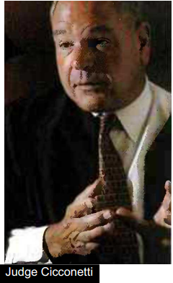
Making the punishment fit the crime
- Mike Cicconetti, a US judge with a difference
1 When Michelle Murray was arrested for abandoning some kittens in a forest she expected to get a fine or a short prison sentence. Instead she was sentenced to spend the night in the same cold, dark forest. In the end it was so cold that she only had to spend three hours in the woods, but Judge Mike Cicconetti had made his point. He wanted the 26-year-old Ohio housewife to feel the same pain and suffering as the animals she had abandoned, many of which later died.
2 Judge Cicconetti’s unusual ruling was just the latest example of his unique brand of 'creative justice' which has won him national acclaim, He was elected unopposed to serve another six years in Lake County, Ohio, last month, and this year won the presidency of the American Judges Association.
3 Cicconetti allows offenders to choose between jail, and an alternative, 'creative' sentence. For example, people accused of speeding are offered a choice t between having their licence suspended for 90 days, or having it suspended for a shorter period and spending one day working as a school crossing guard. The judge says that offenders who spend a day helping school children across the street never appear in his courtroom for speeding again.

Slide 26
Making the punishment fit the crime
- Mike Cicconetti, a US judge with a difference
4 The judge also sent a man who was caught with a loaded gun to the mortuary to view dead bodies and ordered teenagers who let down tyres on school buses to organize a picnic for primary school children. He has ordered noisy neighbours to spend a day of silence in the woods, or to listen to classical music instead of rock.
5 Cicconetti attributes his unusual approach to his tough family background. He
was the oldest of nine children and had to work part-time collecting rubbish to pay his way through college. He studied law at night school. I didn't go to a
prestigious law firm,' he says, 'I had to get to where I am the hard way. It makes you understand what the working man has to go through, and why some of them commit crimes. I want to give people a positive lesson, not a negative one.‘
6 A drawer in his cramped office in the Painesville Municipal Courthouse is full of
thank-you letters from both victims and criminals. 'Some people will say that
my punishments are cruel or unusual,' the judge said. ‘OK, it's a little bit of
embarrassment and humiliation. But when you have people fulfilling these
sentences, you are doing it for them and the victims and the community. And
above all, I can remember only two people who have been sentenced to alternative punishments and who have reoffended.

Slide 27
Reading p. 39
What sentence did Judge Cicconetti give these people? Why? Do you think his sentences would be more effective than yours?
1. a woman who abandoned some kittens in a forest
2. people caught speeding in a residential area
3. a man who was caught carrying a loaded gun in the street
4. some teenagers who vandalized a school bus
5. noisy neighbours who play rock music very loudly at all hours
She had to spend the night in the same forest.
They had to choose between having their licence suspended for 90 days or for less time and working for a day as a school crossing guard.
He had to go to a mortuary to view dead bodies
They had to organize a picnic for primary school children.
They had to spend a day of silence in the woods or listen to classical music instead of rock.

Slide 28
Reading Sometimes when you read a newspaper article for detail, the information is not given in a chronological order. You may need to re-read the article to clarify in your mind information about people and events.
Read through the questions below. Then read the whole article to find the information. (Click to check)
1 The judge
What was his early life like? How successful has he been professionally?
Hard. He was from a poor family, the oldest of nine children. He has been very successful (president of the American Judges Association).

Slide 29
Reading
2 The punishments
Which three creative punishments get the offenders to learn from a personal experience?
Which two punishments get them to do something for other people?
3 The reasons behind his system
What inspired his system of creative punishments?
Why does he think they are better than conventional punishments?
What evidence does he have that the punishments are successful?
Michelle Murray, the man with the loaded gun, and the noisy neighbours learn from personal experiences. The drivers and the teenage vandals have to do something for other people.
His background. He thinks he understands why some people commit crimes. He thinks they are better than conventional punishments because people don’t reoffend, and the evidence that he is right is that only
two people have.

Slide 30
GET IT RIGHT
agreeing and disagreeing
Use a variety of expression for agreeing and disagreeing:
I think it must be … That’s what I was thinking.
Do you agree with that? Exactly!
Don’t you think …? I don’t think that’s true.
giving your opinion
When we are giving our opinion about the right way to punish
someone, we often use should + passive infinitive:
I think they should be made to...
I don’t think they should be allowed to...

Slide 31


