Slide 1

Damascus University
Medical Preparatory English

Slide 2
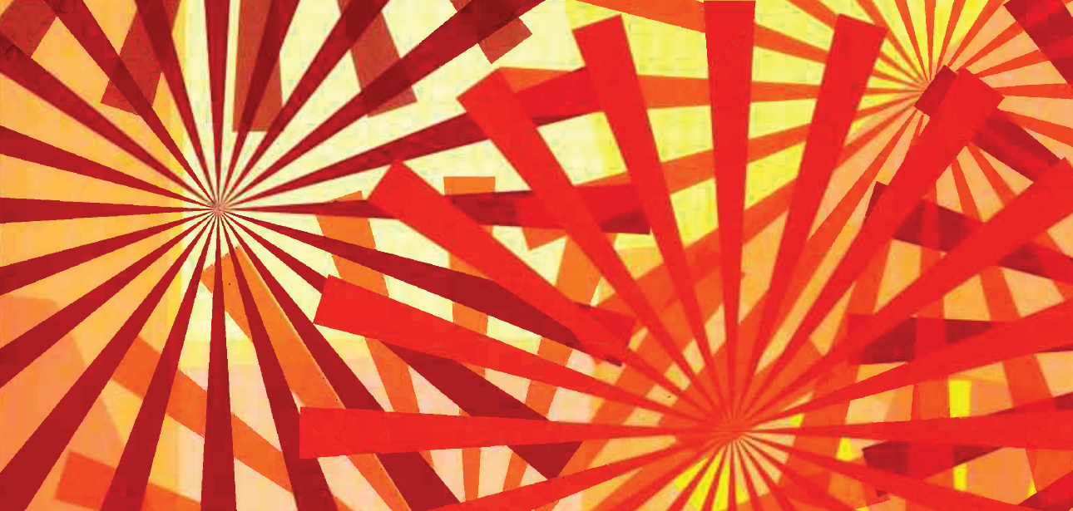

New English File
Upper-intermediate
Term 2 – Session 4

Slide 3
COLLOQUIAL ENGLISH Stage and screen p. 64
Glossary
voice-over: information or comments in a film or TV programme
given by a person who you do not see on the screen
fringe theatre: plays, often by new writers, that are unusual and question the way people think
props: objects used by actors during the performance of a play or film
rehearsal: time that is spent practising a play or piece of music
Dictaphone: a small machine used to record people speaking
oftentimes: (North American English) often

Slide 4
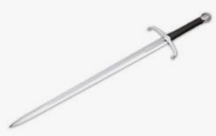
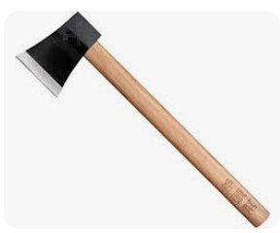
COLLOQUIAL ENGLISH Stage and screen p. 64
Glossary
Royal Shakespeare Company: A British drama company which
specializes in Shakespeare’s plays
Coriolanus: one of Shakespeare's lesser known plays set in Roman times
feature film: a full-length film with a story, i.e. not a documentary
sword: a weapon with a long metal blade
axe: a weapon with a wooden handle and
a heavy metal blade, also a tool for
chopping wood
parry: to defend yourself by stopping sb hitting you, e.g. with your arm or with a weapon
sword
axe

Slide 5
COMMON PHRASES p. 64
1. There isn’t much I don’t do, I guess, as far as acting goes. (= related to acting)
2. You just show up and you are expected to know all your lines. (informal, a phrasal verb = arrive somewhere where you are expected to be / do something, synonym turn up)
3. You do it a few times and that’s it. (= informal way of saying that’s all there is, it’s finished)
4. It’s amazing the difference it makes when the writing is good. (= there is a big difference between good and bad writing)
5. I gave the other guy three stitches on his fingers at one point when he parried in the wrong place. (= at one moment)
6. You get to do it over and over again. (idiom: informal way of saying many times one after another, synonym again and again)

Slide 6
COMMON PHRASES p. 64
1. I was in a music video once, but that’s about as far as I’ve gone. (= informal way of saying that’s all I’ve done)
2. The buzz of it, being able to be someone else in front of people. (= informal way of saying the excitement)
3. And you can just sort of get taken away into this other world. (= expression used when you are trying to think of the word / expression you want to use, or can’t think what to say)
4. A couple of plays I’ve been in. (= two)
5. It is nerve-wracking just as you’re about to go on.
(= just before you walk on the stage)
nerve-wracking (adj) = making you feel very nervous

Slide 7
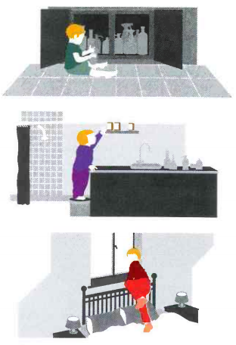
Writing An article p. 65
a. Look at the three pictures. What do you think the child’s parents should / shouldn’t have done? Read the article and check.
b. This article was originally written in six short paragraphs. Mark (/) where each new paragraph should begin.
Click to check your answers.

Slide 8
Make your home a safer place!
You probably think that your home is the one place where you are safe. That’s what I thought until last week. Now I know our flat is full of accidents waiting to happen. / Next month we’re looking after my niece and nephew while their parents go away for a short break. We asked them to come and make sure everything was OK. We got a few surprises. We started in the spare bedroom, where the children will sleep. Everybody knows you shouldn’t put children’s beds under a window in case a child tries to climb out. Everybody except us! Next was the bathroom. We keep our medicines on a shelf above the washbasin. A terrible idea, as my sister explained. Never leave medicines somewhere children can find them. They might think they are sweets. Finally, the kitchen. This is the most dangerous room in the house. Knives should be kept in drawers which children can’t reach, and all cleaning liquids in high cupboards. So we have three weeks to make our house safe. It’s not difficult...once you know how.

Slide 9
Writing An article p. 65
a. What do you think the child’s parents should / shouldn’t have done? Read the article and check. Click to check your answers.
They should have put the cleaning liquids in a cupboard which was out of reach of children.
They shouldn’t have left medicines where children could find them.
They shouldn’t have put the child’s bed under the window.

Slide 10
Writing An article p. 65
Useful language
Giving advice
Don’t forget to ... Remember to ...
Make sure you …
You should …
Never ...
Reasons
... in case
... so (that)
... because it might …

Slide 11
What do you remember? GRAMMAR P. 66
a. Complete the second sentence so that it means the same as the first. Click to check your answers.
1. They escaped from the jungle because they found the river.
They wouldn’t have escaped from the jungle if they _____ _____ the river.
2. I’m sure you left your glasses in the restaurant.
You _____ _____ left your glasses in the restaurant.
3. Why didn’t you tell me it was your birthday?
You _____ _____ _____ me it was your birthday!
4. I don’t have much time so I can’t go to dance classes.
I would be able to go to dance classes if I ___ _____ _____.
5. I’m sure the backpackers haven’t got lost. They know the area well.
The backpackers ____ ____ ____ lost. They know the area well.
hadn’t found
must have
should have told
had more time
can’t have got

Slide 12
What do you remember? GRAMMAR P. 66
b. Choose a, b, or c. Click to check your answers.
1. The sky’s very dark. It ____ there’s going to be a storm.
a. looks b. looks like if c. looks as if
2. What ____ do tonight, eat out or stay in?
a. would you rather b. had you rather c. do you rather
3. If I hadn’t really liked the jacket, I ______ it.
a. wouldn’t buy b. hadn’t bought c. wouldn’t have bought
4. What a lovely material! It ____ silk.
a. feels b. feels like c. feels as if
5. Mark’s very late. Do you think he ____ forgotten about the dinner?
a. can’t have b. could c. might have

Slide 13
What do you remember? VOCABULARY P. 66
Word groups. Underline the word that is different. Say why. Click to check your answers.
upset disappointed relieved offended
2. amazed astonished surprised anxious
3. palm calf wrist nail
4. kidney heart liver hip
5. nod wave clap point
the others are negative feelings
the others mean surprised
the others are part of the hand / fingers
the others are organs
the others are gestures you do with your hand

Slide 14
What do you remember? VOCABULARY P. 66
b. Underline the right verb. Click to check your answers.
1. Please remind / remember the children to do their homework.
2. A. I’m terribly sorry.
B. Don’t worry. It doesn’t mind / matter.
3. The robbers stole / robbed € 50,000 from the bank.
4. If you know the answer, raise / rise your hand, don’t shout.
5. Don’t argue / discuss with your father about it! He doesn’t listen.

Slide 15
What do you remember? VOCABULARY P. 66
c. Complete with one word.
Click to check your answers.
I was _____ the moon when I heard I’d passed the exam!
You look fed _____. Have you been waiting for a long time?
I really put my foot _____ it when I mentioned the war.
We set _____ on our journey just after dawn.
My car broke ______ on the motorway.
over
up
in
off
down

Slide 16
What do you remember? VOCABULARY P. 66
Write the verbs for the definitions.
Click to check your answers.
ch_____: to bite food into small pieces in your mouth.
y______: to open your mouth wide, when you are tired or bored
sc_____: to rub your skin with your nails
f______: to make a serious, angry, or worried expression
st_____: to look at something / somebody for a long time
chew
yawn
scratch
frown
stare

Slide 17
What can you do? P. 67
CAN YOU UNDERSTAND THIS TEXT?
a. Complete the article with a sentence A-F. There is one sentence you don’t need.
A. The photographs are then put in a drawer and forgotten.
B. At the flick of a switch, the manufacturers claim, a woman can lose as much as a dress size.
C. ‘But it did just enough to hide some of the evidence of a few too many good restaurant meals.’
D. The only victim will be the truth.
E. They don’t seem to notice that the lost weight seems to have mysteriously returned since the holiday.
F. ‘It worked better than a four-week diet of raw vegetables.’
b. Look at the highlighted words and phrases. Can you guess what they mean? Read the article, then click to check your answers.

Slide 18
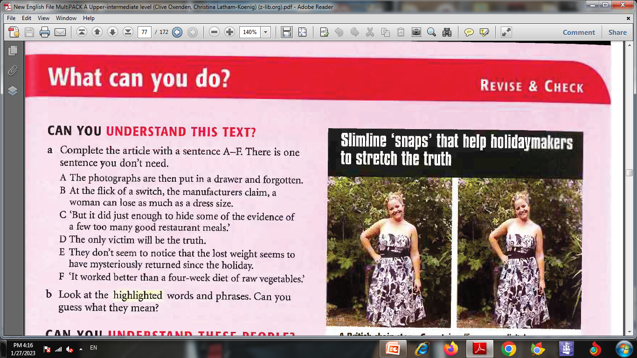
Slimline ‘snaps’ that help holidaymakers to stretch the truth
A British chain store, Comet, is selling a new digital camera which will take pictures of you – and make you look thinner. The HP Photosmart R727 contains a 'slimcam' function which ‘squeezes‘ the object at the centre of the frame without distorting the background. ¹ __ And a man can develop, if not a flat stomach, then at least a more respectably proportioned figure for the holiday photograph album.
B
Click to check your answers.

Slide 19

Comet believes that the photography of self-delusion will become hugely popular in the future. In a culture obsessed with unrealistic ideas of the perfect body, the answer seems to be to show your friends holiday photographs in which you look healthily slim. ²__
'Like many women in Britain, I am a size 16 and sometimes my holiday photos are not as flattering as I would like,' said Sally Cranham,24, a professional singer from Reigate, who tried out the camera. 'The slimming button certainly trimmed off a bit where it counts,' she said. ³__
People nowadays are very used to the doctored images of celebrity magazines, and some users of the camera might worry that the truth of their 'slimcam' photography would emerge when friends flicked through the holiday snaps. But Ms Cranham is convinced that her friends won't realize. 'If the camera had made me look like a size 8, then no one would believe it,' she said. ⁴__
A spokeswoman for Comet said that it brought technology that usually favoured only the rich and famous within the grasp of ordinary people. ⁵__ Click to check your answers.
E
F
C
D

Slide 20
What can you do? P. 67
CAN YOU UNDERSTAND THIS TEXT?
b. Look at the highlighted words and phrases. Can you guess what they mean?
squeezes = normally to press hard with your fingers, e.g. to get the juice out of a lemon. Here it means makes smaller.
trimmed off = cut a little bit off
doctored = changed in order to trick sb
flicked through = looked through quickly
within the grasp of = accessible to, within reach of

Slide 21


