Slide 1

New English File
Intermediate
Session 3

Slide 2
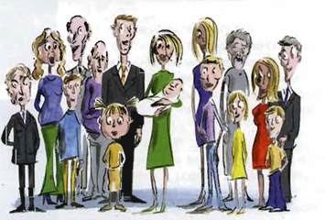
Unit 1
Part C _ We are family
1 VOCABULARY

Slide 3
Read the article then match the highlighted words with the definitions.
Twenty years ago, the typical extended family was ‘wide’. It usually consisted of two or three generations, with many children in each ‘nuclear family’. People had lots of aunts and uncles but often didn't know their grandparents. However, according to a new study by the British research group Mintel, the family is changing shape. The family groups of the future will be ‘long and thin’, with three or four small generations. Here are some of their predictions:
1. Most children will know their great-grandparents (and even great-great-grandparents) because people are living longer.
2. Very few children will have brothers or sisters, and it will be common to be an only child. As a result, future generations will not have many cousins either.
3. Many children will grow up isolated from other children and young adults. This will make them more selfish and introverted.
4. More couples will divorce and re-marry, some more than once. They may have children with their new partners, so many children will have a stepmother or stepfather and half-brothers or sisters.
5. There will be many ‘boomerang children’. These are children who leave home to get married, but then divorce and return to live with their parents.
6. There will be more single-parent families.
7. Because houses are now so expensive, different generations may decide to live together, so parents, grandparents, and adult children may co-own their houses, and many couples will have to live with their in-laws.

Slide 4
_{1. your grandparents' parents}
2. families where the mother or father is bringing up the children on his / her own
3. your uncle’s or aunt’s children
4. the family of your husband / wife
5. all your relatives including aunts, grandparents, etc.
6. your grandparents’ grandparents
7. boys who have the same father as you but a different mother
_{8. the new wife of your father}
9. people who are having a relationship
10. a child who doesn’t have any brothers or sisters
Great-grandparents
single-parent families
cousins
in-laws
extended family
Great-great-grandparents
half-brothers
stepmother
couples
an only child

Slide 5
Unit 1
Part C _ We are family
2 GRAMMAR

Slide 6
Future forms: be + going to + inf
Future plans and intentions
My sister’s going to adopt a child.
Are you going to buy a new car?
I’m not going to go to New York next week.
Predictions
I think they’re going to win. (They’re playing very well.)
It’s going to rain. (The sky is very dark.)
  Use going to NOT will/won’t when you have already decided to do something. With the verb go you can leave out the infinitive.
  I'm not going (to go) to New York.

Slide 7
Future forms: be + verb+ -ing
Future arrangements
We’re getting married in October.
They’re meeting at 10.00.
She’s leaving on Friday.
You can usually use present continuous or going to for future plans / arrangements.
Going to shows that you have made a decision
We’re going to get married in the summer.
Present continuous emphasizes that you have made the arrangements.
We’re getting married on July 12th. (e.g. we’ve booked the church)

Slide 8
Future forms: will / shall + inf
I’ll have the steak. (instant decision)
I won’t tell anybody where you are. (promise)
I’ll carry that bag for you. (offer)
Shall I help you with your homework? (offer)
Shall we eat out tonight? (suggestion)
You’ll love the film! (prediction)
Use will/ won't (NOT the present simple) for instant decisions, promises offers, and suggestions.
Use shall( NOT will) with I and we for offers and suggestions when they are questions.
Use will or going to for predictions.

Slide 9
Unit 1
Part C _ We are family
3 READING

Slide 10
Read the following questions and try to answer them while reading the text.
Who do you think…….?
had a more eccentric hairstyle
admired her sister
didn't want to be with her sister
followed her sister everywhere
tried to compete with her sister
wasn't a good student
told her parents when her sister did something wrong
used to hurt her sister physically
was jealous of her sister
always defended the other sister

Slide 11
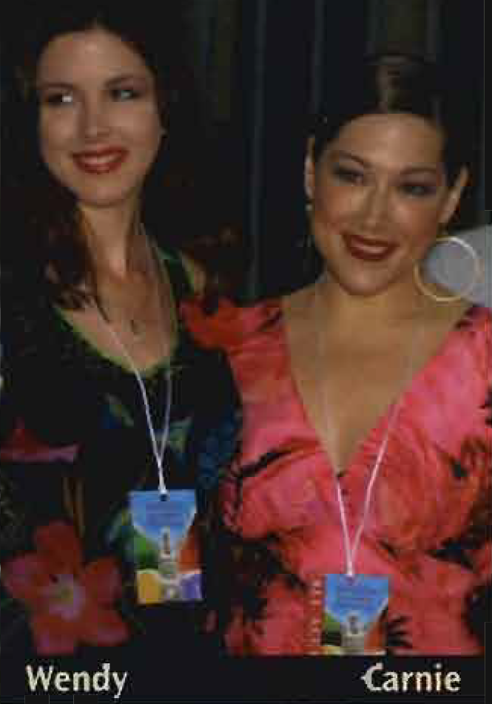
We are family …
Two sisters tell the truth about themselves and each other…
Wendy Wilson and her older sister Carnie are the daughters of the Beach Boys founder, Brian Wilson. They formed the band Wilson Philips (with the daughter of Michelle Philips of The Mamas and Papas) and their first album was a worldwide hit. Today they are both married and live in Los Angeles. Here they talk about their relationship.

Slide 12
Wendy the younger sister
I always thought Carnie was really 1 cool .Especially when she was a teenager and had bright red spiky hair. But, like most older sisters, she wasn’t at all interested in her younger sister. I desperately wanted to be with her and her friends, and sometimes I used to follow them, but she hated that.
when we were 2 kids we both had a lot of material things like toys and clothes, but even then we knew that Mom and Dad weren't happy. We used to talk about it all the time, and after a while they separated and we stayed with my Mom. We didn’t see Dad for quite a few years, which really hurt us. But it’s also the thing that brought me and Carnie closer together. When I was 16 or 17 the one and a half year 3 age gap between us didn’t matter any more, and we started to get on with each other and to write songs together.
Being in a band - or working at anything - with a member of your family can be difficult, but it also has advantages. If we have a big argument about a song, after a while we remember that we are sisters and we 4 make it up. Nothing is going to stop US from being sisters.

Slide 13
Carine and the older sister says:
I sometimes think that poor Wendy has spent all her life competing with me. She was a very quiet, shy child, while I was incredibly talkative and demanding -I was awful! I wasn't interested in studying, all I wanted to do was go to parties, and Wendy used to tell my parents. So I was horrible to her- I used to 5 pinch her and bite her.
I was very jealous of Wendy also because she was more attractive than me. But she always defended me when other people 6 criticized me, and sometimes it seemed as if she was the older sister and I was the younger one. Although we were complete opposites, 7 we were also very close and had a lot of fun together. We still do.
I think I suffered a lot because of my father leaving US when we were small, but Wendy helped me to understand that Dad loved US too, but in a different way. She also taught me that you can’t 8 blame other people for your problems, you have to look at yourself.

Slide 14
Who do you think...?
1. had a more eccentric hairstyle
2. admired her sister
3. didn't want to be with her sister
4. followed her sister everywhere
5. tried to compete with her sister
6. wasn't a good student
6. told her parents when her sister did something wrong
7. used to hurt her sister physically
8. was jealous of her sister
9. always defended the other sister
Carine
Wendy
Carine
Wendy
Wendy
Carine
Wendy
Carine
Carine
Wendy

Slide 15
Look at the bold words and phrases in the text. Choose the right meaning a or b.
1. Cool a. boring
b. fashionable
2. Kids a. children
b. adults
3. Age gap a. age difference
b. the time they weren’t together
4. Make it up a. become friends again
b. stop speaking
5. Pinch a. kiss
b. hurt with your fingers
6. Criticize a. say bad things about
b. say good things about
7. Close a. we got on very well
b. we got on very badly
8. Blame a. ask for help
b. say that somebody is responsible for something bad

Slide 16
HOW WORDS WORK...
Look at two sentences from the We are family text.
“We started to get on with each other.”
“You have to look at yourself.”
Use each other when A does an action to B and B does the same action to A
We love each other = I love you and you love me.
Use a reflexive pronoun (myself, yourself, himself, herself itself, ourselves, yourselves, themselves) when the subject of the verb is the same as the object.
I cut myself. She looked at herself in the mirror.
You can also use a reflexive pronoun for emphasis.
Nobody helped me = I did it all myself.

Slide 17
Complete the sentences with each other or a reflexive pronoun.
1. After the argument they didn’t speak to ________ for a week.
2. This light is automatic. It turns _________ on and off.
3. We built the house _________. It took three years.
4. We only see _________ once a month.
5. They argue a lot. They don’t understand _________.
6. I blame _________ for the accident. It was my fault.
each other
itself
ourselves
each other
each other
myself

Slide 18
Unit 1
Part C _ We are family
4 VOCABULARY

Slide 19
Can you remember? What do we call a person who……?
1. talks a lot _________________
2. doesn’t talk very much _________________
3. feels uncomfortable and nervous when he / she meets new people _________________
4. thinks someone loves another person more than him / her _________________
talkative
quiet
shy
jealous

Slide 20
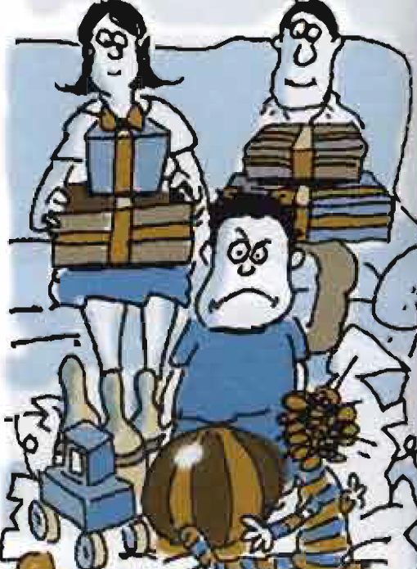
What are they like?
Complete the sentences with the personality adjectives.
affectionate / aggressive / ambitious / bossy / charming /
Competitive / independent/ jealous / manipulative / moody/
reliable / selfish / sensible / sensitive / sociable / spoilt

Slide 21
children behave badly because they are given everything they want.
people always want to win.
people think about themselves and not about other people.
people get angry quickly and like fighting and arguing.
people have an attractive personality that makes people like them.
people have common sense and are practical.
people are friendly and enjoy being with other people.
people are good at influencing other people to do what they want.
spoilt
competitive
selfish
aggressive
charming
sensible
sociable
manipulative

Slide 22
people are happy one minute and sad the next, and are often bad-tempered.
people like doing things on their own, without help.
people like giving orders to other people.
people show that they love or like people very much.
people you can trust or depend on.
people understand other people's feelings or are easily hurt or offended.
people want to be successful in life.
people think that someone loves another person more than them, or wants what other people have.
moody
independent
bossy
affectionate
reliable
sensitive
ambitions
jealous

Slide 23
Opposite adjectives
Match the adjectives and their opposites.
stupid/ self-confident / mean / talkative / hard-working / extrovert
1. clever
2. generous
3. insecure
4. lazy
5. quiet
6. shy
stupid
mean
self-confident
hard-working
talkative
extrovert

Slide 24
Negative Prefixes
Which negative prefix do you use with these adjectives? Put them in the correct column.
ambitious / friendly / honest / imaginative / kind / organized / patient / reliable / responsible / selfish / sensitive / sociable / tidy
Un- | Dis- | In- im- ir-
unambitious
unfriendly
unimaginative
unkind
unreliable
unselfish
unsociable
untidy
dishonest
disorganized
impatient
irresponsible
insensitive

Slide 25
{{ Thank You }}

