Slide 1

New English File
Intermediate
Session 8

Slide 2
Unit 6
Writing
Film Review

Slide 3
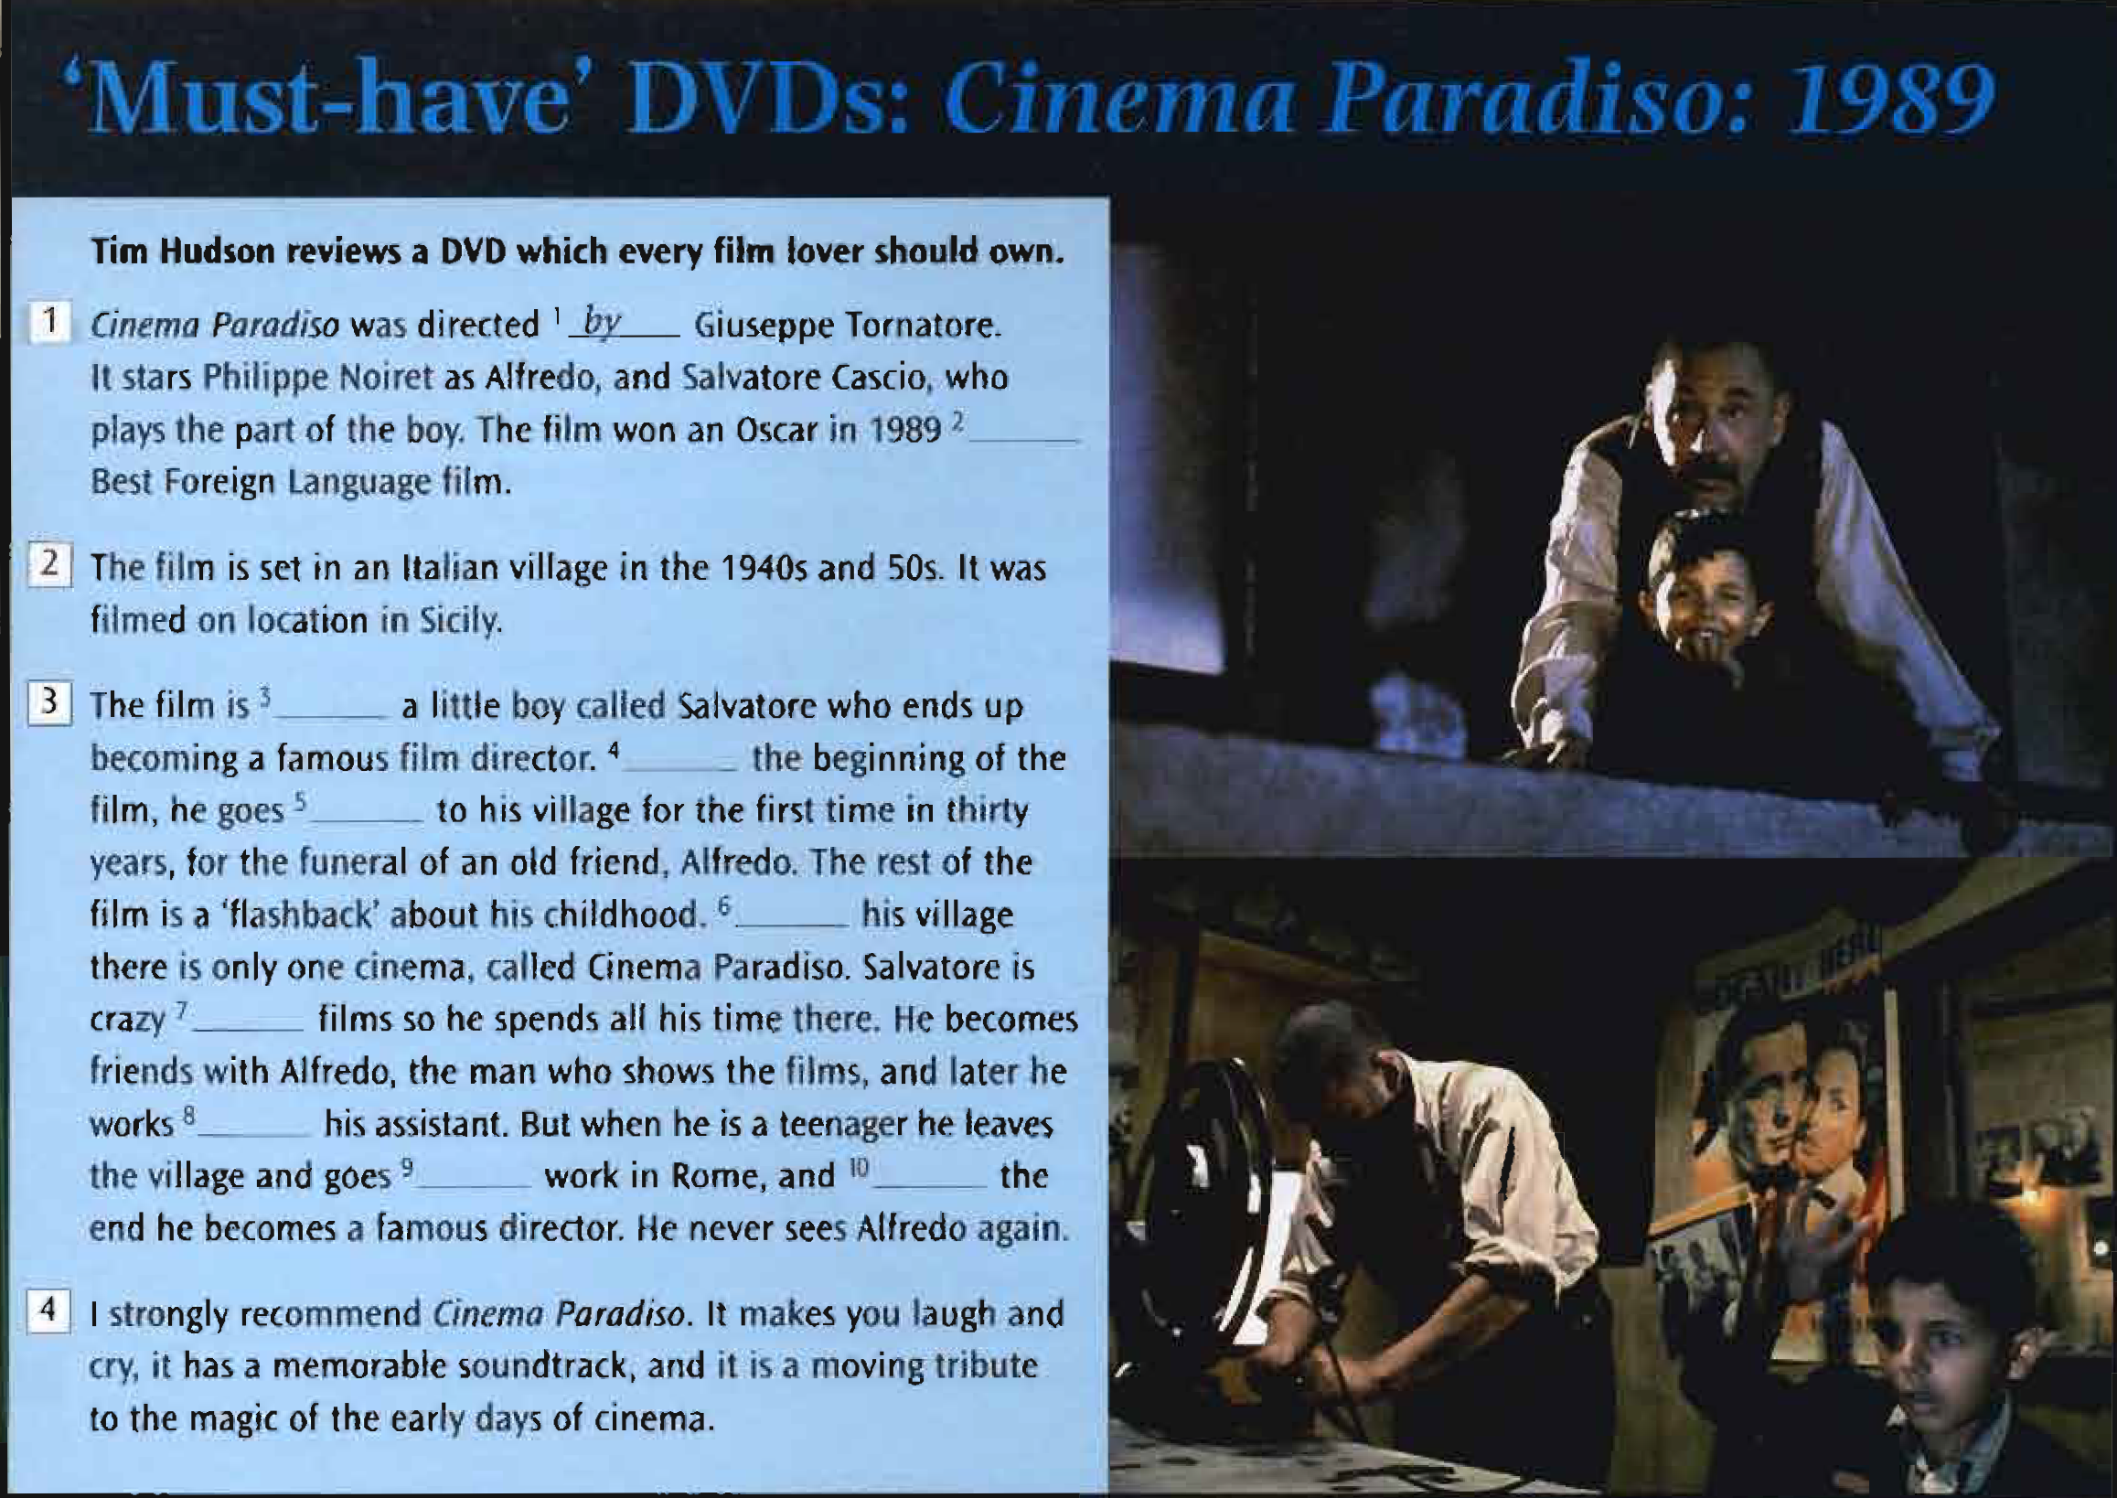
Read the film review. Number the paragraph summaries below in order, 1-4.
Paragraph ____ =The plot
Paragraph ____= The name of the film, the director,the stars, and any prizes it won
Paragraph ____= Why you recommend this film
Paragraph ____= Where and when it was set
3
1
4
2

Slide 4
Read the review again and complete it with the missing words.
about (x2)
at
as
back
by
in (x2)
for
to
for
about
At
back
In
about
as
to
in

Slide 5
Look at the third paragraph again. What tense do we usually use to tell the story of a film or book?
We usually use the present tense to tell the plot of a story or a book.
Useful language: describing a film
It was directed / written by...
It is set in...
It is based on the book...
It’s about...
It stars...
My favorite scene is...

Slide 6
Unit 6
Review
What do you remember?

Slide 7
GRAMMAR
Complete the second sentence with two words so that it means the same as the first.
1. ‘Do you want to have dinner?’ he asked
James asked me if _________ to have dinner.
2. ‘I’ll pay,’ she said.
Jacqueline said that __________ pay.
3. ‘Where am I?’ the man asked.
The man asked me where __________.
I wanted
she would
I was

Slide 8
4. ‘Can you open the window, please?’
My mother asked me __________ the window.
5. ‘Don't talk!’
The teacher told the students ________ talk.
6. They made the film in a studio.
The film ___________ in a studio.
to open
not to
was made

Slide 9
7. They’re building a new school.
A new school is ______________.
8. An American company has bought our company.
Our company has _______________ by an American company.
9. That man’s son goes to my school.
That’s the man _____________ goes to my school.
10. This is a machine. It cuts paper.
This is a machine ____________ paper.
being built
been bought
whose son
which cuts

Slide 10
VOCABULARY
a. Underline the word that is different. Say why.
1. baker’s shoe shop shop window newsagent’s
2. buy sales sell pay
3. cast extras special effects actors
4. thriller sequel comedy horror film
5. dubbed filmed directed plot

Slide 11
b. Write words for the definitions.
A shop where you can buy meat.
The piece of paper you are given when you buy something.
To stand in a line, e.g. in a shop. to
A basket on wheels that people use at supermarkets.
The words of a film translated on the screen.
The music from a film.
The people who watch a film in a cinema.
Something you buy more cheaply than usual.
Butcher’s
Receipt
Queue
Trolley
Subtitles
Soundtrack
Audience
Bargain

Slide 12
c. Complete with one word.
Can I try ____ these trousers, please?
Did you buy your car ____ credit?
People always complain ____ high prices.
If it’s broken, take it ____ to the shop.
The film is based ____ a book.
Schindler’s List was directed ____ Spielberg.
Les Miserables was set ____ 18th century Paris.
on
on
about
back
on
by
in

Slide 13
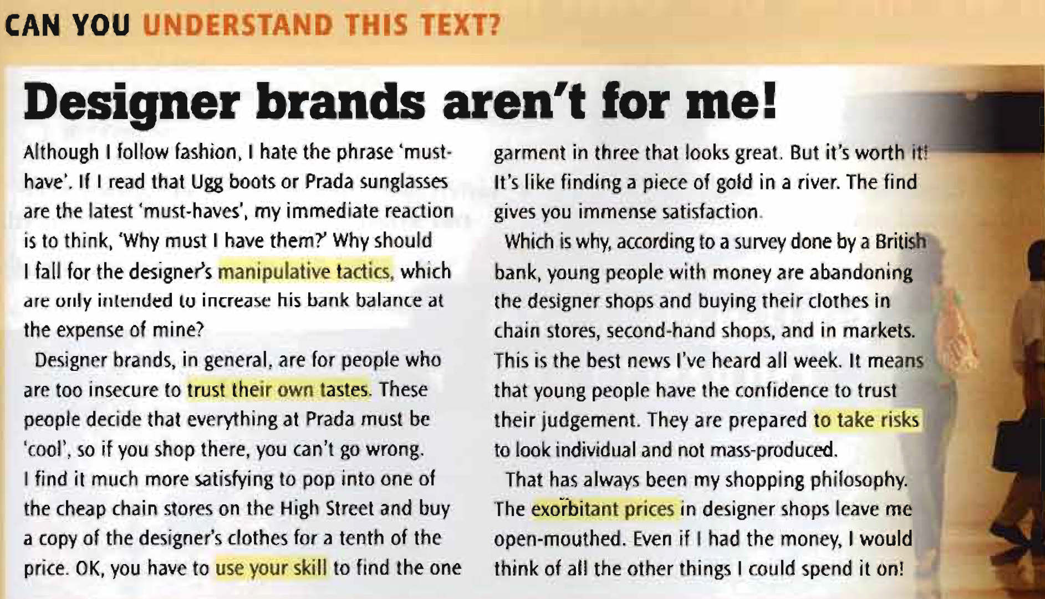
Read the text and choose a, b or c.
1. The writer thinks...
a fashion is ridiculous.
b Prada sunglasses are 'must-haves'.
c designers just want to make a lot of money.
2. She thinks people who buy designer brands...
a are ‘cool.’
b don’t have good taste.
c are frightened of making a mistake.

Slide 14
3. She thinks...
a it’s easy to find great, cheap clothes.
b you feel good if you find good, cheap clothes.
c the clothes in high street stores are better than designer clothes.
4. According to the bank survey, rich young people...
a now want to look different from each other.
b don’t have as much money to spend as they used to.
c are now buying more designer clothes.
5. The writer...
a thinks the price of designer clothes is fair.
b thinks there are better things to spend her money on.
c would like to have the money to buy designer clothes.

Slide 15
Look at the highlighted words in the text. What do they mean?
Manipulative tactics
Ways of controlling or influencing people
Trust their own tastes
Believe in their own opinion and judgement about what to wear
Use your skill
Use your ability to do something well
To take risks
Do something that you know might fail or be dangerous
Exorbitant prices
Much more expensive that they should be

Slide 16
{{ Thank You }}

