Slide 1

New English File
Intermediate
Session 1

Slide 2
New English File Intermediate
First year all faculties except for the medical faculties
  2nd semester (units: 5, 6 & 7)
    Each unit is divided into three parts A, B & C
This course covers Grammar, Reading, Vocabulary and Controlled Writing

Slide 3
Unit 5
Part A
1 GRAMMAR

Slide 4
a. Answer the following questions about you.
How much time (approximately) do you spend on a weekday ____?
sleeping
having meals
working
doing housework
relaxing
Possible answers
15 minutes / a quarter of an hour
60 minutes / an hour
30 minutes / half an hour

Slide 5
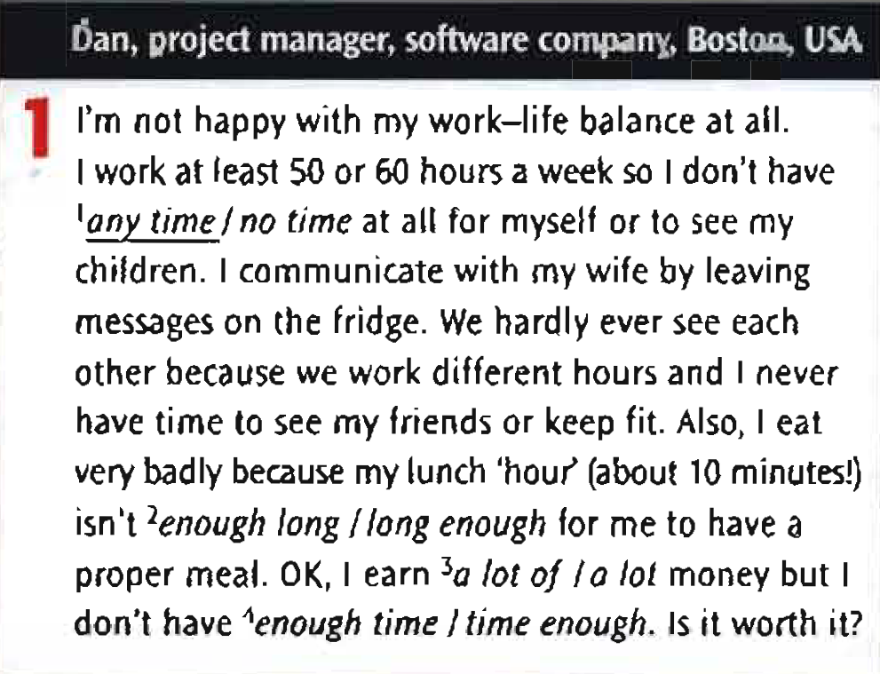
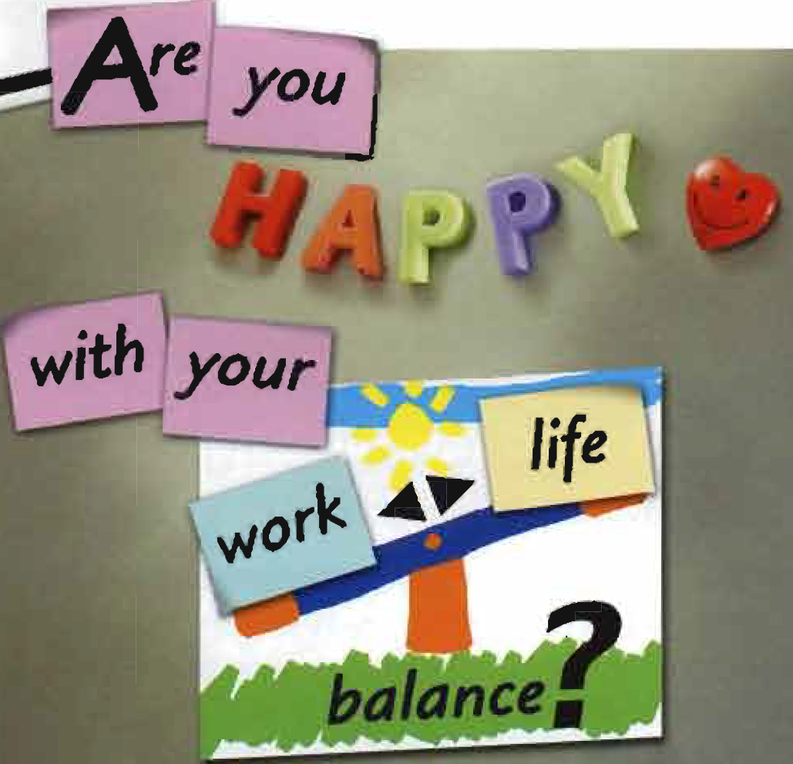
Read the article Are you happy with your work-life balance? And underline the correct phrases.

Slide 6
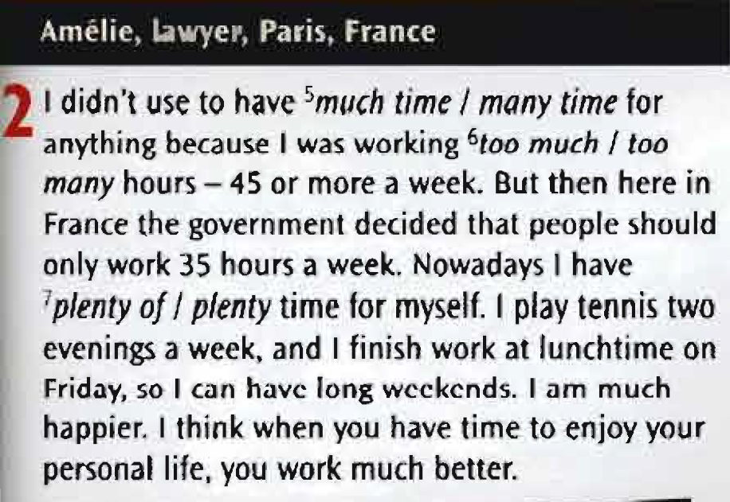
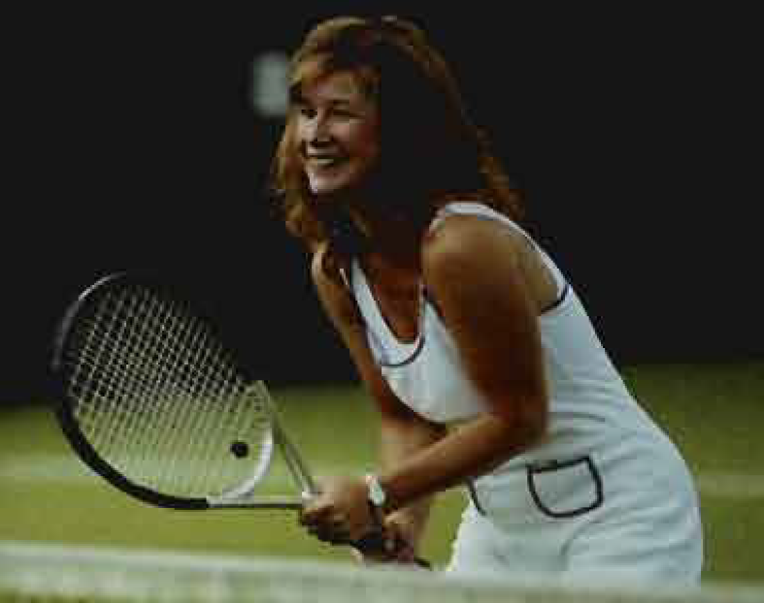

Slide 7
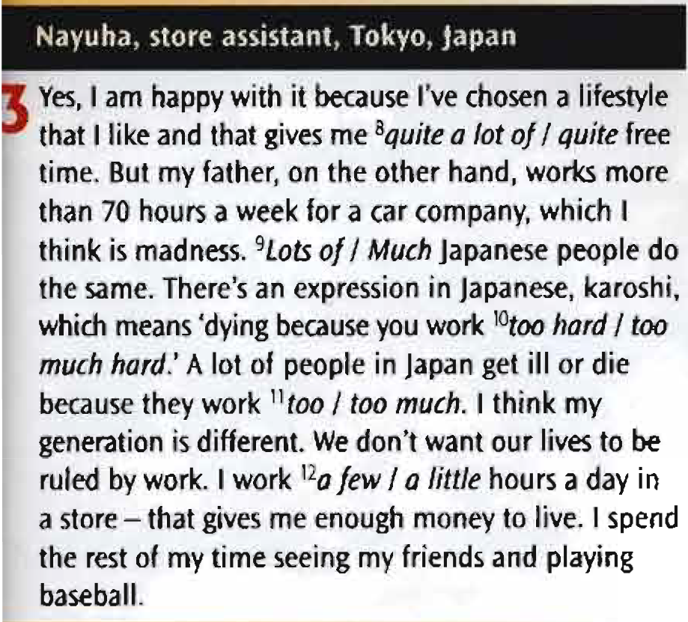
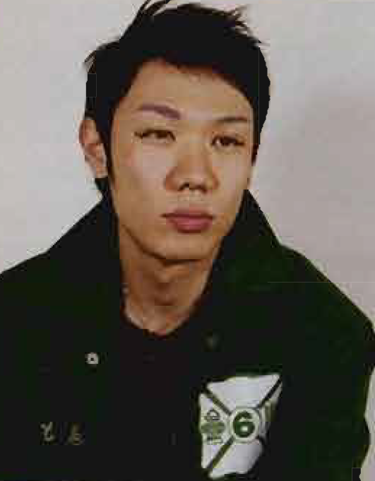

Slide 8
Quantifiers (Large quantities)
They have a lot of money.
She has lots of friends.
She eats a lot.
There aren't many cafés near here.
Do you watch much TV?
Don't run. We have plenty of time.
- Use a lot of / lots of in positive sentences.
- Use a lot when there is no noun e.g. He talks a lot.
- Much / many are normally used in negative sentences and questions, but a lot of can also be used.
- Use plenty of in positive sentences to mean as much as we need or more.

Slide 9
Quantifiers (Small quantities)
A: Do you want some ice cream? B: Just a little.
The town only has a few cinemas.
Hurry up. We have very little time.
I have very few close friends.
- Use little + uncountable nouns, few + plural countable nouns.
- a little and a few = some, but not a lot.
- (very) little and (very) few = not much / not many.

Slide 10
Quantifiers (Small quantities)
Use too + adjective, too much + uncountable nouns, too many + countable nouns.
- Use enough before a noun but after an adjective.
More than you need or want | Less than you need or want
I don't like this city. It's too big. There's too much traffic. There are too many tourists. | There aren't enough parks. The buses aren't frequent enough.

Slide 11
Underline the correct answer. Tick (√ ) if both are possible.
1. I think this restaurant is too / too much expensive.
2. There are too much / too many people in my salsa class.
3. Nobody likes him. He has very little / very few friends.
4. We've had a lot of / lots of rain recently.
5. There aren't enough car parks / car parks enough in the city center.
6. I have no / don't have any time.
7. He works a lot / much. At least ten hours a day.
8. A: do you speak French? B: Yes, a little / a few.
9. I don't have no time / any time for myself.
√
√

Slide 12
Right (√ ) or wrong (X). Correct the wrong sentences.
1. She drives too much fast.
2. Slow down! We have plenty time.
3. We have too many work at the moment.
4. I think I made a few mistakes in the letter.
5. He isn't enough old to understand.
6. We can't go tomorrow. We're too busy.
7. We have very little time to do this.
8. A: How many eggs are there? B: Any.
9. He's retired so he has much free time.
too fast
plenty of time
a lot of / lots of
√
old enough
√
√
None
a lot of / lots of

Slide 13
Unit 5
Part A
2 Reading & Vocabulary

Slide 14
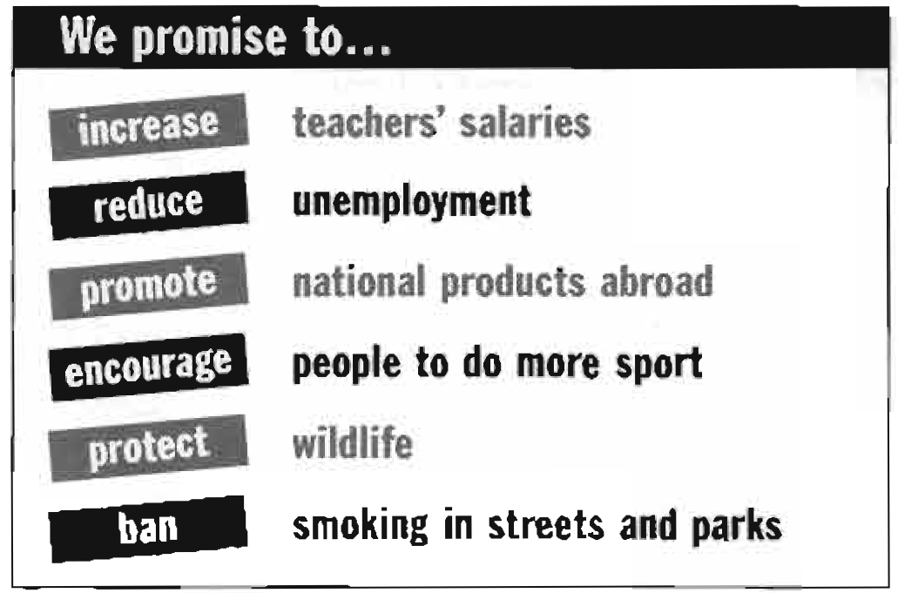
Read the leaflet and match the verbs with their meanings.
1. __________________ influence somebody in a positive way, e.g.
I _________________ my children to do sport.
2. __________________ to make something bigger, e.g. The boss
is going to _________________ my salary.
3. __________________ to say something is not allowed, e.g. We want to _________________ smoking everywhere.
4. __________________ to help something to happen or develop, e.g. The meeting helped to
_________________ better relations.
5. __________________ to make something smaller, e.g. _________________ the noise, the number of cars.
6. __________________ to defend somebody or something, or to keep them safe, e.g. We need to
_________________ these birds as they are becoming extinct.
encourage
encourage
increase
increase
ban
ban
promote
promote
decrease
decrease
protect
protect

Slide 15
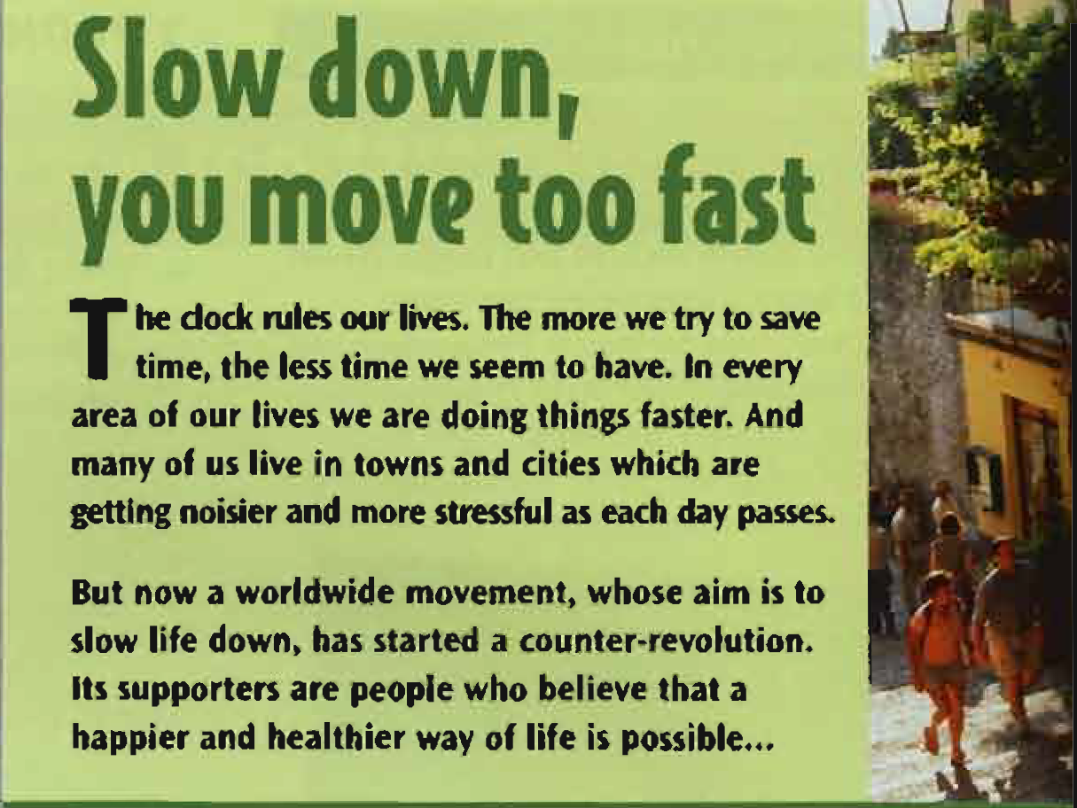
a. Read the introduction to the article. What is the ' counter-revolution'?

Slide 16

The Slow Food movement was founded the day that an Italian journalist, Carlo Petrini, saw that McDonald's had opened a restaurant in Piazza di Spagna, the beautiful square in Rome. He thought it was tragic that many people today live too quickly to sit down for a proper meal and only eat mass-produced fast food. He decided that he had to try to do something about it and so he started the Slow food movement. Although he didn’t succeed in banning McDonald’s أ from Piazza di spagna, Slow Food has become a global organization and now has more than 80,000 members in 100 countries.
"We believe,’ says Fiona Richmond of Slow Food UK, ،that people : should take time to enjoy food.'
Slow Food also encourages people to eat local and regional food, to use local shops and markets, to eat out in small family restaurants, and to أ cook with traditional recipes. Says Richmond, 'There is nothing more ! satisfying than relaxing around a lively table in the company of family ة and friends. The pleasure of eating quality food should be celebrated.

Slide 17
1. Who started the Slow Food movement? Why?
Carlo Petrini, an Italian journalist. Because he saw that McDonald's had opened a restaurant in a beautiful square in Rome.
2. What did he think was wrong with today's world?
He thought it was tragic that people live too quickly to sit down to eat a proper meal and that they only eat mass-produced food.
3. What are the aims of the Slow Food movement?
To encourage people to stop during the day and eat slowly, to use local shops and markets, eat out in small family restaurants, cook with traditional recipes.
4. How big is the Slow Food movement now?
It's now a global organization and has members in 100 countries.

Slide 18

The idea of ‘Cittaslow ‘ or 'slow Cities' was inspired by the Slow Food movement and it was started by the mayor of the small Italian town of Greve in Chianti. The aim of Slow Cities is to make our towns places where people enjoy living and working, and where they value and protect the things that make the town different. Towns which want to become a Slow City have to reduce traffic and noise, increase the number of green areas, plant trees, build pedestrian zones, and promote local businesses and traditions. Many other small towns in Italy have joined the movement and it has spread to other countries all over the world, from the UK to Japan and Australia. Aylsham in the UK recently became a Slow City, and most people are delighted. ‘Slow Cities are about having a community life in the town, so people don't come home from work, shut their doors and that’s it,' said a local resident. ،It is not “slow” as in “stupid”. It is “slow” as in the opposite of "frantic” and "stressful". It is about quality of lifeBut not everybody in Aylsham is happy. For teenagers, who have to go 25 km to Norwich, the nearest city, to buy trainers or CDs, living in a Slow City is not very attractive. 'It’s all right here,' says Lewis Cook, 16. 'But if you want excitement, you have to go to Norwich. We need more things here for young people.’

Slide 19
1. How did the Slow City movement start?
It was inspired by the Slow Food movement. It was started m\by mayor of Greve in Chianti in Italy.
2. What are the aims of the Slow City movement?
It aims to make our towns places where people enjoy living and working and to protect things that make the town different.
3. Where has it spread to?
It has spread all over the world, e.g. Japan, Australia, etc.
4. What do the people of Aylsham in the UK think about living in a Slow City?
Most people are very happy (delighted) because they think it increases their quality of life. Teenagers aren't so happy. They have to travel 25 km to the nearest city if they want excitement.

Slide 20
{{ Thank You }}

