Slide 1

Damascus University
Medical Preparatory English

Slide 2


New English File
Upper-intermediate
Term 1 – Session 12

Slide 3
High risk? COLLOQUIAL ENGLISH p. 48
Glossary
the South Bank the area of London on the south side of the River Thames
lamp post a tall post with a lamp on top used to illuminate the street
PE physical education, especially as a school subject
skateboard a short narrow board with small wheels at each end, which you stand on and ride as a sport
BMX a kind of mountain bike
calluses areas of thick hard skin on a hand or foot.

Slide 4
COMMON PHRASES
1 .. .but generally the people who practise would go to a particular spot = place (informal)
2 ... someone leading the way and the rest following. = going in front and showing the others where to go
3 … I just had to change my life around and become sensible all of a sudden. = suddenly
4 On the face of it what we do seems to be quite
dangerous. = by looking at it
5 To a degree, the risk element played a part. = to a certain extent
6 As long as you start out very small scale... = on the condition that

Slide 5
COMMON PHRASES
1 It was just making a fool of myself. = do sth stupid in front of other people which makes them think you are an idiot.
2 That was in my younger days. = when I was younger
3 Oh, it was awesome! (NAmE, informal) = fantastic, wonderful
4 Do they count? = is that included?

Slide 6
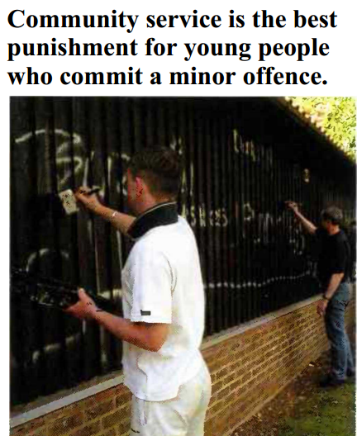
Expressing your opinion writing p. 49
Complete the composition with a word or phrase from the list below. Use capital letters where necessary.
finally firstly in addition
in conclusion in most cases
nowadays secondly so whereas

Slide 7
writing
¹Nowadays in the UK when a young person commits a minor offence he or she is normally sentenced to prison, a fine, or community service. ²_____________ I believe that community service is the best option.
³________, community service often persuades a young person not to reoffend. Working with sick children or old people makes young offenders realize that there are people who have more difficult lives than they do. So, community service can be an educational experience, ⁴__________ going to prison or paying a fine is not.
⁵_________, spending time in prison results in young people meeting other criminals and learning more about the criminal world, which may tempt them into committing more crimes. ⁶___________, in prisons many of the inmates take drugs and this is a terrible example for young offenders.
⁷_________, I do not think that a fine is a suitable punishment for young people. They do not usually have much money themselves ⁸________ it is often their parents who pay the fine for them.
⁹_____________, I believe that community service has important advantages both for minor offenders and for the community.
In most cases
Firstly
whereas
Secondly
In addition
Finally
so
In conclusion

Slide 8
Expressing your opinion writing p. 49
Firstly / Secondly are used to introduce main arguments.
In addition (or Also) can be used to add an extra point to an argument.
whereas is used to contrast two ideas.
so is used to introduce a consequence or result.
In conclusion (or To sum up) is used to introduce your final paragraph where you summarize your opinion.

Slide 9
Writing Useful language p. 49
Ways of giving your opinion
(Personally) I think /I believe...
In my opinion...
Ways of giving examples
There are several things we can do, for example / for instance / such as...
Another thing we can do is...
We can also...
Personally .. and In my opinion .. are both used to emphasize what you think.
For example / for instance can be used at the beginning of a sentence or in the middle.
such as can only be used in the middle of a sentence.

Slide 10
What do you remember? P. 50
GRAMMAR
Complete the second sentence so that it means the same as the first. (Click to check)
The accident happened when they were repairing the road.
The accident happened when the road __________ repaired.
They’ll probably never find the murderer.
The murderer will ________________ found.
People think the burglar is a teenager. The burglar is thought ___________ teenager.
They say that crime doesn’t pay.
It is ____________ crime doesn’t pay.
He isn’t likely to come.
He probably ____________.
was being
probably never be
to be a
said that
won’t come

Slide 11
What do you remember? P. 50
GRAMMAR
b. Complete the sentence with the right form of the verb in bold. (Click to check)
1 Imagine! This time tomorrow we __________ on the beach. lie
2 The match starts at 7.00. By the time I get home, it ______ already___________. start
3 You mustn’t use your mobile phone until the plane _________. land
4 Many people have problems sleeping if they ___________________ coffee after midday. drink
5 I want to spend a year travelling when I _____________
university. finish
‘ll be lying
will
have started
Or will have already started
has landed
have drunk/
drink/ have been drinking
finish/
have finished

Slide 12
What do you remember? P. 50
VOCABULARY
Word groups. Underline the word that is different. Say why. (Click to check)
robber burglar pickpocket kidnapper
fraud smuggler theft terrorism
evidence judge jury witness
chilly cool scorching freezing
hurricane mist blizzard flood
The others are all steal
The others are crimes
The others are people
The others refer to cold weather
The others are extreme weather

Slide 13
What do you remember? P. 50
VOCABULARY
b. Complete the sentences with a verb in the past simple.
(Click to check)
1 They c_________ a terrible crime.
2 The police c_______ the burglar at the scene of the crime.
3 The judge s________ him to five years in jail.
4 They k________ the politician’s son and asked for a million dollars ransom.
5 Jack the Ripper m________ seven women in London in the 19th century.
6 The wind b___ so hard that two trees fell down.
7 I sw_____ so much when I was at the gym that my T-shirt was soaking wet.
8 It p_____ with rain last night and we got soaked coming home.
9 We had six centimetres of snow when I woke up but it m ____ during
the morning.
10 We t____ advantage of the good weather and spent the day at the beach.
committed
caught
sentenced
kidnapped
murdered
blew
sweated
poured
melted
took

Slide 14
What do you remember? P. 50
VOCABULARY
c. Complete the sentences with one word.
(Click to check)
1 The woman was charged ____ drug dealing.
2 Are you planning to take ____ a new sport when you go to university?
3 Who do you take ____ most, your mother or your father?
4 Watch ____! You nearly hit that cyclist.
5 It’s very hot here. Let’s move and sit ____ the shade.
with
up
after
out
in

Slide 15
Reading Burglar caught by clever cartoonist p.51
WILLIAM ELLIS GREEN, aged 82, was making his breakfast when he heard somebody in his garden. 'I went out of the back door and suddenly I saw this bloke running towards me. He pushed me out of the way and took my bicycle from the garden shed.' Mr Green did not resist, as he knew he would come off second best in a fight with the intruder. The burglar tried to cycle away, but the tyres on the bike were flat so it was difficult to ride. 'He kept falling off the bicycle,' said Mr Green, 'at least three or four times.' After the man had fled, Mr Green called the local police.
When they arrived officers asked him to describe the man, but instead he offered to draw them a picture. 'When Mr Green started drawing,' said one of the police officers, 'I knew straight away who the burglar was.' In fact Mr Green had worked for more than 20 years in daily newspapers doing caricatures of Australian footballers. 'I had no difficulty in remembering the man's face because he was so close to me,' he said.
Police cruised the neighbourhood in a patrol car with the sketch in search of the alleged burglar and they found him within half an hour. The cartoon was a perfect likeness of the burglar,' said another police officer.
Police believe that this is the first time they have ever caught a suspect with a cartoon sketch. Phil Rushford, a senior police constable, said that in the past some victims had used their mobile phones to take photographs at crime scenes, but they had not been as effective.
A 34-year-old man is expected to be charged with theft, burglary, and assault.
The missing bike was later found in a road nearby.

Slide 16
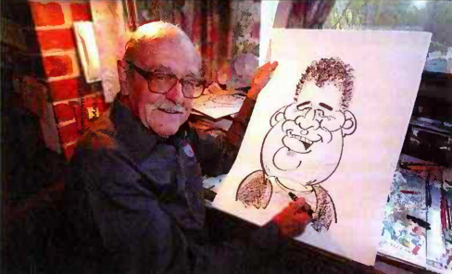
What can you do? REVISE p. 51
Read the article and choose a, b, or c. (Click to check)
1 Mr Green did not fight the burglar because
a he was wearing his best clothes
b he knew he would lose
c the burglar was too quick
2 ‘Flat’ (line 5) means
a broken
b not round
c without air
3 Mr Green used to be
a an artist
b a footballer
c a journalist

Slide 17
What can you do? REVISE p. 51
4 ‘Cruised’ (line 13) means
a drove around slowly
b looked everywhere
c went at top speed
5 According to the police,
a crime victims should take photos
b a drawing can be better than a photo
c mobile phone photos cannot be used in court
6 ‘Assault’ (line 20) means
a attacking someone
b stealing property
c breaking into someone’s house

Slide 18
The Exam
It consists of 90 questions divided into four main sections:
Section one: Reading. It includes:
one reading text from outside the book.
10 questions about the text.
Section two: Vocabulary. It includes 20 questions about vocabulary from the book only.
Section three: Grammar and Structure. It includes 40 grammar and structure questions from the book only.
Section four: Controlled Writing. It consists of 20 questions from the book only.

Slide 19

End of Term 1

