Slide 1

New English File
Intermediate
Session 12

Slide 2
Unit7
Writing
An article for a magazine

Slide 3
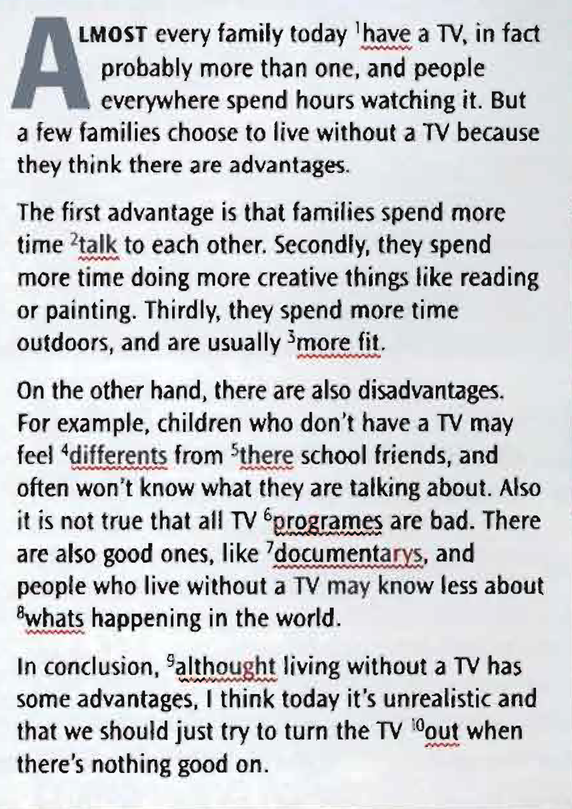
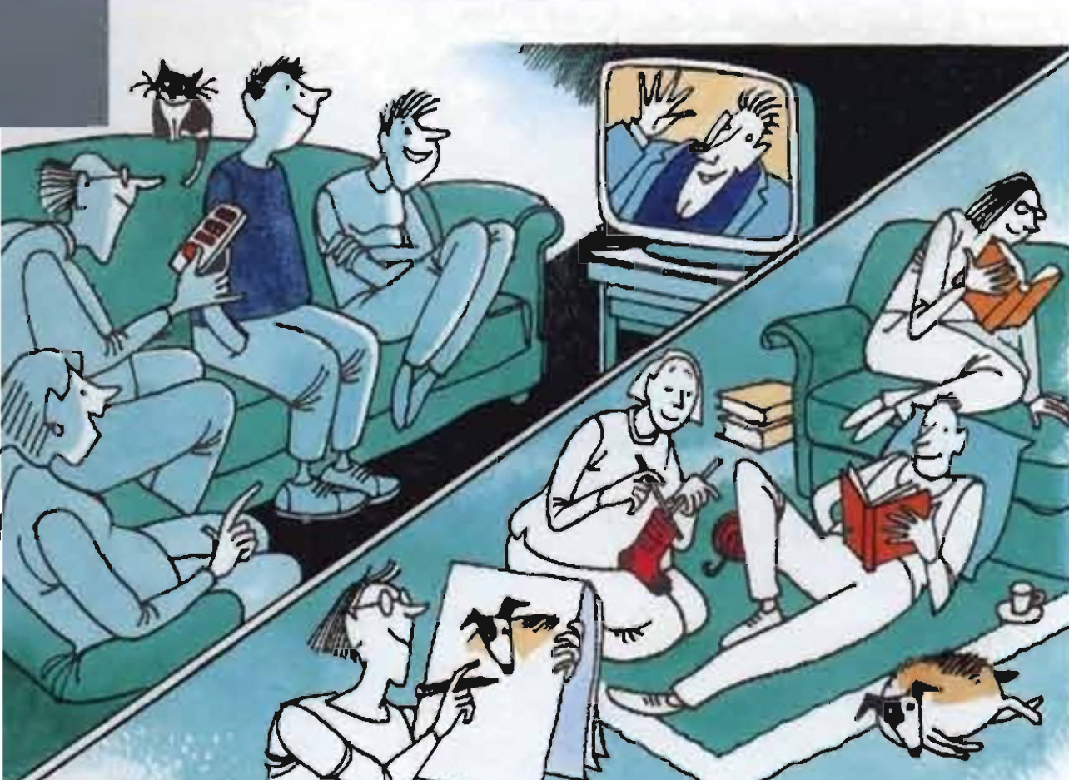
a. Read an article for a student magazine about the advantages and disadvantages of living without a TV. The computer has found ten mistakes (grammar, punctuation, or spelling). Can you correct them?
Check your answers
1 has 6 programmes
2 talking 7 documentaries
3 fitter 8 what’s (or what is)
4 different 9 although
5 their 10 off

Slide 4
b. Read the article again. Then answer the questions.
1. What are the three advantages of life without a TV?
Families spend time talking to each other. They do more creative things like reading. They are usually fitter.
2. What are the two disadvantages?
Children who don’t have a TV may feel different from their friends. They might know less about what is happening in the world.
3. Is the writer for or against having a TV?
The writer is for having a TV but thinks we should only watch good programmes.

Slide 5
Useful language
writing about advantages and disadvantages
Listing advantages
First,/Firstly,... Secondly,... Thirdly,...
Listing disadvantages
On the other hand, there are also (some) disadvantages.
For instance,... / For example,...
Also,...
Conclusion
In conclusion / To sum up, I think. ،.

Slide 6
Unit 7
Review
What do you remember?

Slide 7
Grammar
a. Choose a, b, or c.
1. If we hadn’t gone to that meeting, we ____ each other.
a. wouldn’t meet b. hadn’t met c. wouldn’t have met
2. Could you tell me what ____?
a. is your name b. your name is c. your name
3. Do you know ____ after lunch?
a. if the shop does open
b. if opens the shop c. if the shop opens
4. You aren’t coming tonight, ____?
a. are you b. aren’t you c. you aren’t
5. If you’ve finished watching TV, ____.
a. turn off it b. turn it off c. turn off

Slide 8
b. Complete the second sentence with two words so that it means the same as the first.
1. We were late because we got lost.
If we ________________ lost, we wouldn’t have been late.
2. What time did you arrive home last night?
Could you tell me what time ________________ home last night?
3. Does this train stop in Norwich?
Do you know ____ this train ______ in Norwich?
4. I think the film finishes at 8.00.
The film finishes at 8.00, __________?
5. I’m excited about our holiday.
I’m looking ____________ our holiday.
hadn’t got
you arrived
if
stops
doesn’t it
forward to

Slide 9
Vocabulary
a. Complete with an adjective or adverb from the bold noun.
1. He's very intelligent but __________ he’s not very good-looking. fortune
2. He hates waiting. He’s very ________ . patience
3. Let’s buy this sofa. It’s definitely the most ___________. comfort
4. I was very _____in the exam. The questions were all on things I’d studied the night before. luck
5. He writes very ________ and makes a lot of spelling mistakes. care
unfortunately
impatient
comfprtable
lucky
carelessly

Slide 10
b. Complete the compound nouns.
1. Excuse me? Where’s the nearest police __________?
2. A Do you like _______ films?
B No. I don't enjoy feeling frightened!
3. My three-year-old has just started at ________ school.
4. Yesterday I had to pay a £50 parking ________ .
5. When the banks are closed, you can get money from a ______machine.
station
horror
nursery
fine
cash

Slide 11
c. Complete the phrasal verbs.
1. He has to _______ after his father, as he’s in his 90s.
2. Could you turn the music _______? Its really quiet.
3. Could you give me _________my book, please?
4. My uncle has set _______ a small company.
5. I always feel nervous when planes ______ off.
6. ______ down, you’re walking much too fast.
7. Do you ______ on well with your boss?
8. If you carry ______ watching TV, you’ll get square eyes.
9. My grandmother brought ______ eight children without any help.
10. They ______ up last month, and now she’s got a new boyfriend.
look
up
back
up
take
Slow
get
on
up
broke

Slide 12
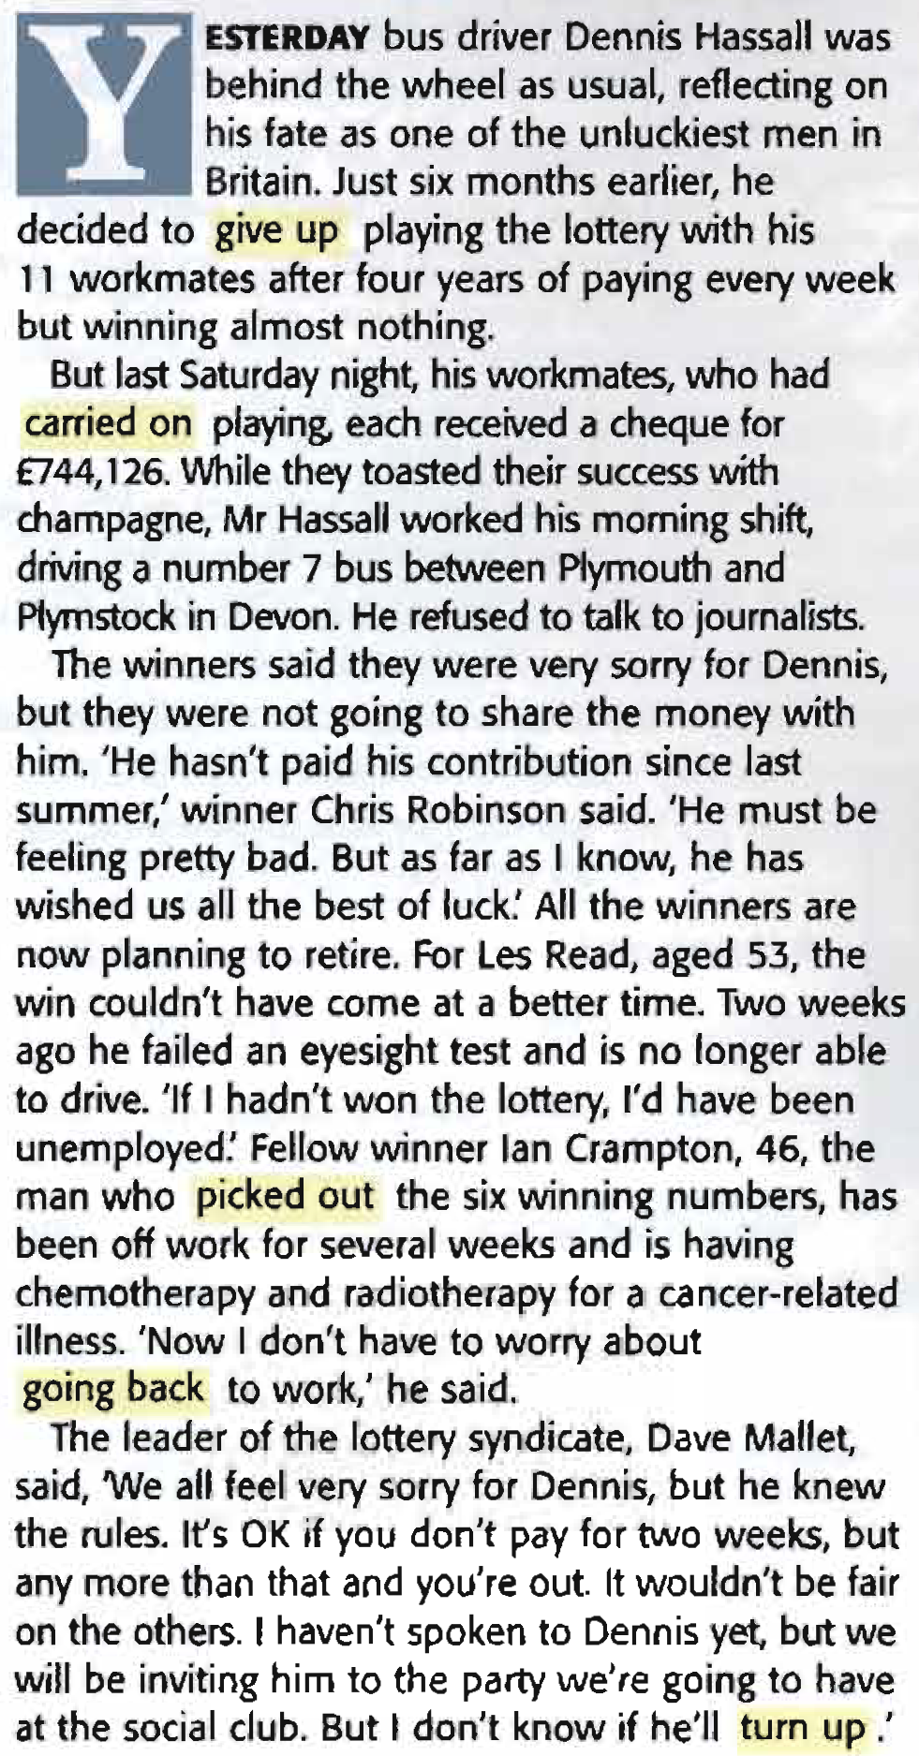
Reading: Can you understand this text?
a. Read the article and mark the sentences T (true), F (false), or DS (doesn’t say).
1. Dennis stopped playing the lottery four years ago.
2. Dennis didn't drink champagne with the lottery winners.
3. He gave an interview to journalists.
4. He stopped playing the lottery because he was short of money.
5. Dennis is the only person who will continue working.
6. Two of the winners had health problems.
7. Dave Mallet feels bad about what has happened to Dennis.
8. Dennis doesn’t want to go to the party.
F
T
F
DS
T
T
T
DS

Slide 13
b. Look at the highlighted phrasal verbs.
What do they mean?
Give up
Carried on
Picked out
Going back
Turn up
Stop
Continued, didn’t stop
Chosen
Returning to
Arrive, appear

Slide 14
{{ Thank You }}

