Slide 1

Damascus University
Medical Preparatory English

Slide 2


New English File
Upper-intermediate
Term 1 – Session 3

Slide 3
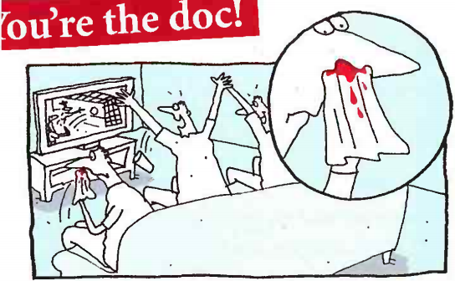
You’re the doc! P. 12
1C
Read about the two situations and work out the meaning of the highlighted words. Then decide which you think is the correct answer for each one.
You are at home watching
a football match on TV. In the
excitement, one of your friends
suddenly starts having a
nosebleed.
DO YOU...?
a. get some ice from the freezer and put it on his nose
b. get some toilet paper, tell him to put it in his nose, and suggest that he goes to the doctor to check his blood pressure
c. tell him to pinch the soft part of his nose for five minutes
You’re the doc!
1

Slide 4
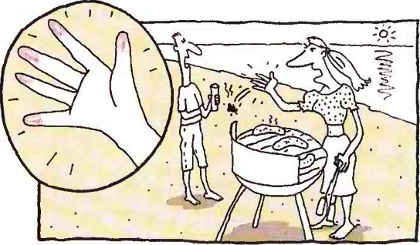
You’re the doc! P. 12
1C
2
You're having a barbecue with some friends on the beach. One
of your friends accidentally picks up a very hot piece of wood and burns her hand. It hurts a lot and she has blisters on her skin.
DO YOU...?
a. pour cold water on the hand and then cover it with a plastic bag
b. cover the burn with suncream
c. break the blisters and put on antiseptic cream
Let’s check your answers.

Slide 5
You’re the doc! P. 12
nosebleed = blood is coming out of your nose
blood pressure = the pressure of blood as it travels round your body; it can be high or low
pinch = take sth between your thumb and first finger and squeeze hard
burns = injures by fire
hurts = causes physical pain
blisters = swellings on the surface of the skin that are filled with liquid, e.g. which you often get on your feet if your shoes are too tight
antiseptic cream = cream that helps to prevent infection

Slide 6
You’re the doc! P. 12
1/c The correct treatment is to pinch the soft part of the nose. This will usually cure a nosebleed if you do it for five minutes. If not, repeat for 10 minutes, and if that still doesn't work, go to your nearest hospital.
2/a The correct treatment is first to pour cold water on the burn for at least 10 minutes and then to cover it with a loose bandage. If you haven't got a bandage, you can use a clean plastic bag or kitchen film. Do not break blisters and don't put any cream on the burn.

Slide 7
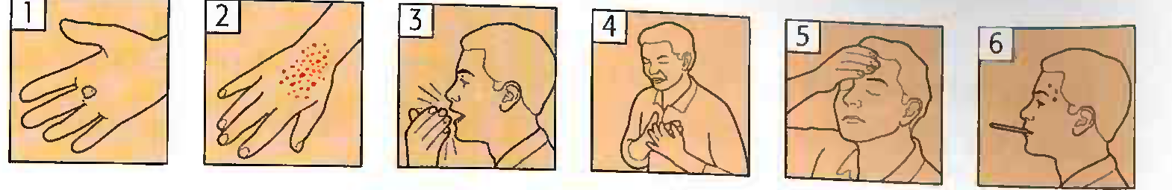
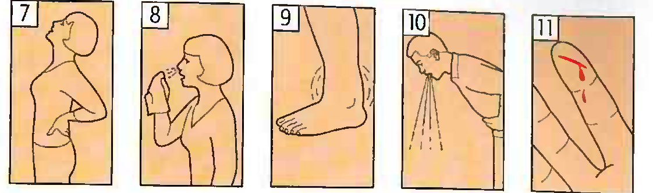
Vocabulary Bank Illness and treatment p. 147
1 Symptoms
a. Match the words and pictures. (Click to check)
He has/He’s got...
___ a temperature. ___ He’s being sick.
___ a cough. ___ She’s sneezing a lot.
___ a headache (earache, ___ Her finger is bleeding.
stomach ache, etc.). ___ His ankle is swollen.
___ a rash. ___ Her back hurts / aches.
_1_ a blister.
___ a pain (in his chest).
6
10
3
8
5
11
9
2
7
4

Slide 8
Vocabulary Bank Illness and treatment p. 147
b Match the sentences. (Click to check)
1. She’s unconscious. _____
2. She has a sore throat. _____
3. She has diarrhoea. _____
4. She feels sick. _____
5. She fainted. _____
6. She feels dizzy. _____
A. She's been to the toilet five times this morning.
B. She’s breathing but her eyes are closed and she can’t hear or feel anything.
C. She wants to be sick / vomit.
D. It was so hot on the train that she lost consciousness.
E. She feels that everything is spinning round.
F. It hurts when she talks or swallows food.
B
F
A
C
D
E

Slide 9
2 Illnesses and injuries p. 147 a Match the illnesses/conditions with their causes or symptoms.
1.He has flu. A It’s 150 over 100.
2.He’s caught a cold. B He was overweight, a smoker, and very
highly stressed.
3.He is allergic to cats. C His right side is paralyzed and he can’t
speak.
4.He has asthma. D He ate some prawns that weren’t fresh.
5.He has high (low) blood pressure. E He’s sneezing a lot and he has a cough.
6.He’s had a heart attack. F He dropped a chair on it and now
there’s a blue mark.
7.He’s had a stroke. G He has difficulty breathing.
8.He has food poisoning. H He starts sneezing as soon as he’s near
one.
9.He’s twisted / sprained his ankle. I He’s got a temperature and his body
aches.
10.He’s burnt himself. J He touched the iron when it was on.
11.He has a bruise on his toe. K He fell badly and now it’s swollen.
5
6
7
8
2
11
4
3
1
10
9

Slide 10
3 Treatment p. 147
Write the missing word (the treatment). (Click to check)
bandage injection medicine operation rest specialist stitches X-ray
Go to the doctor’s (GP). He / she may tell you to...
1. take some ____________ e.g. antibiotics /or painkillers.
2.stay at home and ___________.
3.go to hospital to see a ____________.
Go to hospital / to A & E (Accident and Emergency). You may have to...
4. have an ___________ or scan to see if anything is broken.
5. have ___________ if you have a very deep cut.
6. have an ___________ , when a drug is put into your body through a needle.
7. have a ___________ put on to keep the wound clean.
8. have an ___________ , when part of your body is cut open to remove or repair a damaged part.
medicine
rest
specialist
X-ray
stitches
injection
bandage
operation

Slide 11
Grammar Bank p. 132
1C Present perfect (simple and continuous)
present perfect simple: have / has + past participle
Use the present perfect simple:
1 I’ve been to Australia. Have you ever broken your leg?
2 We’ve just phoned the doctor. I’ve already finished my lunch.
3 It’s the best book I’ve ever read. It’s the first time we’ve done this.
to talk about past experiences when you don’t say when
something happened.
with already, just, and yet.
with superlatives and the first, second, last time, etc.

Slide 12
Grammar Bank p. 132
1C Present perfect (simple and continuous)
4 My sister’s had a baby! Look, I’ve cut my finger.
5 I’ve known her since I was a child. She’s had the job for six months.
6 How many of his books have you read?
She’s been out twice this week.
for finished actions (no time is specified) which are connected in some way with the present.
with How long? and for / since with non-action verbs
(= verbs not usually used in the continuous form, e.g.
be, have, know, like, etc.) to say that something started
in the past and is still true now.
when we say/ ask how much/ many we have done or how often we have done something up to now.

Slide 13
Grammar Bank p. 132
1C Present perfect (simple and continuous)
Present perfect continuous: have / has + been + verb + -ing
Use the present perfect continuous:
1 How long have you been feeling like this? I’ve been working here for two months.
2 I haven’t been sleeping well recently. It’s been raining on and off all day.
with How long? and for / since with action verbs to say that an action started in the past and is still happening now.
for repeated actions, especially with a time expression, e.g. all day, recently.

Slide 14
Grammar Bank p. 132
1C Present perfect (simple and continuous)
Present perfect continuous: have / has + been + verb + -ing
Use the present perfect continuous:
3 I’ve been shopping all morning. I’m exhausted.
A Take your shoes off. They’re filthy.
B Yes, I know. I’ve been working in the garden.
for continuous actions which have just finished (but which have present results).

Slide 15
Grammar Bank p. 132
1C Present perfect (simple and continuous)
Present perfect simple or continuous?
1 We’ve lived / We’ve been living in this town since 1980.
We’ve been living in a rented flat for the last two months.
2 We’ve painted the kitchen.
We’ve been painting the kitchen.
With How long... ? and for / since you can often use the present perfect simple or continuous. However, we often prefer the present perfect continuous for shorter, more temporary actions.
The present perfect simple emphasizes the completion of an action (= the painting is finished).
The present perfect continuous emphasizes the continuation of an action (= the painting is probably not finished).

Slide 16
Grammar Bank p. 133
1C Present perfect (simple and continuous)
a Choose the correct form of the verb. Tick (✓) if both are correct.
(Click to check your answers)
Have you ever tried / been trying caviar?
1 She’s lived / She’s been living here for years.
2 Your boss has phoned / has been phoning three times this morning!
3 The kids are exhausted because they’ve played / they’ve been playing outside all day.
4 He hasn’t seen / He hasn’t been seeing the new James Bond film
yet.
5 I’ve never met / I’ve never been meeting his wife. Have you?
6 We’ve studied / We’ve been studying English all our lives.
7 I’ve tidied / I’ve been tidying the garage all afternoon. I’ve nearly
finished.
8 He’ll be here soon. He’s just left / He’s just been leaving work.
9 How long have you had / have you been having your car?
10 Oh no! Someone has broken / has been breaking the window.
✓
✓

Slide 17

Grammar Bank p. 133
1C present perfect (simple and continuous)
b Complete the sentences with the present perfect simple or continuous.
I’ve bought a new car. Do you like it? (buy)
1 We __________Jack and Ann for years. (know)
2 You look hot. __________________? (you / run)
3 Rose ____________ her homework so she can’t go out. (not do)
4 Did you know _______________? They live in Torquay now. (they / move)
5 How long _____________________________ together? Five months? (Daisy and Adam / go out)
6 I ____________ time to cook dinner. Shall we get a pizza? (not have)
7 We _______________ for hours. I think we’re lost. (walk)
8 __________________ my chocolates? There are only a few left! (you/eat)
‘ve known
Have you been running
hasn’t done
they have moved
have Daisy and Adam been going out
haven’t had
have been walking
Have you been eating

Slide 18
GRAMMAR present perfect (simple and continuous) p. 14
Check what you know: present perfect/ past simple. Right
(✓) or wrong (X)? Correct the wrong highlighted phrases.
1. A Have you ever had an operation?
B Yes, I’ve broken my leg two years ago.
2. A How long was your uncle in hospital?
B Since last Tuesday. He’s coming home tomorrow.
3. You haven’t taken your medicine yet.
4. A Have you gone to see the doctor?
B Not yet. I’m going this afternoon.
5. Ouch! I cut my finger! Have you got a plaster?
6. I know my doctor for ten years. She’s very good.
(✓)
X. I broke my leg
X. has your uncle been
(✓)
X. Have you been
X. I’ve cut
X. I’ve known

Slide 19
New grammar p. 14
Read the jokes and choose the correct form (present perfect simple or continuous). (Click to check)
Patient Doctor, my son has swallowed / has been swallowing my pen, what should I do?
Doctor Use a pencil until I get there.

Slide 20
New grammar p. 14
Doctor You look exhausted!
Patient Yes. I’ve run / I’ve been running after a cat.
Doctor After a cat?
Patient Yes, I think I’m a dog, doctor.
Doctor I see. How long has this gone on / has this been going on for?
Patient Since I was a little puppy.
Doctor OK. Just lie down here on the couch and we’ll talk about it.
Patient I can’t!
Doctor Why not?
Patient I'm not allowed on the furniture.

Slide 21
New grammar p. 14
Patient Have they sent / Have they been sending you the results of my tests yet?
Doctor Yes. The news isn’t good, I’m afraid.
Patient How long have I got to live, doctor?
Doctor Ten...
Patient Ten WHAT? Months? Weeks?
Doctor Nine, eight, seven, six...

Slide 22
Use the prompts to ask and answer the questions. P. 14
1. / drink much water? How many glasses/ drink today?
2. /do any physical exercise? What? How long / do it?
3. / eat a lot of fruit and vegetables? How many portions / have today?
4. / walk to school/ work/university? How far / walked today?
Do you drink much water? How many glasses have you drunk today?
Do you do any physical exercise? What? How long have you been doing it?
Do you eat a lot of fruit and vegetables? How many portions have you had today?
Do you walk to school, etc.? How far have you walked today?

Slide 23
Use the prompts to ask and answer the questions. P. 14
5. / smoke? How long / smoke? How many cigarettes / have today?
6. / take any vitamins at the moment? How long / take them?
7. /How many hours / sleep a night? / sleep well recently?
8. / allergic anything? / ever have a serious allergic reaction?
Do you smoke? How long have you been smoking? How many cigarettes have you had today?
Are you taking any vitamins at the moment? How long have you been taking them?
How many hours do you sleep a night? Have you been sleeping well recently?
Are you allergic to anything? Have you ever had a serious allergic reaction?

Slide 24
Reading Get stressed, stay young p. 15
a. What symptoms do people have when they feel stressed?
b. Read the article once quite quickly and then tick (✓) the activities that are bad for your health, what does the article say about the others?
Packing for a trip at the last minute.
Being stuck in a traffic jam when you have an appointment.
Writing a report for your boss when you don’t have much time to finish it.
Running for a bus or train.
Looking after a family member who has a chronic illness.
Shopping in your lunch break.
Programming a DVD player using the instruction manual.
Sleeping problems, headaches, stomach problems, high blood pressure, …

Slide 25
Reading Get stressed, stay young p. 15
For decades doctors have warned us about the dangers of stress and have given us advice about how to cut down our stress levels. Everyone agrees that long-term stress, for example having to look after someone who has a chronic illness, or stressful situations where there is nothing we can do, for example being stuck in a traffic jam, is bad for our health and should be avoided whenever possible. However, some medical experts now believe that certain kinds of stress may actually be good for us.
2 Dr Marios Kyriazis, an anti-ageing expert, claims that what he calls 'good stress' is beneficial to our health and may, in fact, help us stay young and attractive and even live longer. Dr Kyriazis says that 'good stress' can strengthen our natural defences which protect us from illnesses common among older people, such as Alzheimer's, arthritis, and heart problems. He believes that 'good stress' can increase the production of the proteins that help to repair the body's cells, including brain cells.

Slide 26
Reading Get stressed, stay young p. 15
3 According to Dr Kyriazis, running for a bus or having to work to a deadline are examples of 'good stress', that is situations with short-term, low or moderate stress. The stress usually makes us react quickly and efficiently, and gives us a sense of achievement - we did it! However, in both these situations, the stress damages the cells in our body or brain and they start to break down. But then the cells' own repair mechanism 'switches on and it produces proteins which repair the damaged cells and remove harmful chemicals that can gradually cause disease. In fact, the body’s response is greater than is needed to repair the damage, so it actually makes the cells stronger than they were before.

Slide 27
Reading Get stressed, stay young p. 15
4 'As the body gets older, this self repair mechanism of the cells starts to slow down,' says Dr Kyriazis. The best way to keep the process working efficiently is to 'exercise' it, in the same way you would exercise your muscles to keep them strong. This means having a certain amount of stress in our lives.' Other stressful activities that Kyriazis recommends as being good stress include redecorating a room in your house over a weekend, packing your suitcase in a hurry to reach the airport on time, shopping for a dinner party during your lunch break or programming your DVD player or by following the instruction manual. So next time your boss tells you that she wants to see that report finished and on her desk in 45 minutes, don't panic; just think of it as 'good stress' which will have benefits for your long-term health!

Slide 28
Reading Get stressed, stay young p. 15
b. Read the article once quite quickly and then tick (✓) the activities that are bad for your health, what does the article say about the others?
Packing for a trip at the last minute.
Being stuck in a traffic jam when you have an appointment.
Writing a report for your boss when you don’t have much time to finish it.
Running for a bus or train.
Looking after a family member who has a chronic illness.
Shopping in your lunch break.
Programming a DVD player using the instruction manual.
(✓)
(✓)
The other activities are examples of ‘good stress’.

Slide 29
Reading Get stressed, stay young p. 15
c. Read the article again more slowly. Circle the correct main idea for each paragraph. (Click to check)
1. a. Being in traffic jams is bad for our health.
b. Some people think that not all kinds of stress are bad for us.
c. Doctors don’t agree how we can reduce our levels of stress.
2. a. Young people suffer more from stress than older people.
b. Alzheimer’s is one of the illnesses many old people suffer from.
c. Good stress stops us from getting ill.
3. a. Situations which produce good stress are always short term.
b. Some stress can make our cells stronger.
c. Too much protein can make us ill.
4. a. We need some stress to exercise our cells’ self-repair mechanism.
b. Doing physical exercise makes us feel less stressed.
c. Packing your suitcase in a hurry is an example of good stress.

Slide 30
Reading Get stressed, stay young p. 15
Complete the sentences using words from the article.
When we try to do less of something, we try to c_____
d_______ (Paragraph 1).
2. An illness that you have for a very long time is called a
c________ illness (1).
3. Something which is good for us is b_________ (2).
4. The verb to make something stronger is s__________ (2).
5. Our body is made up of millions of c_______ (2).
6. When we treat our body badly we d________ it (3).
7. Another word for illness is d_________.(3).
8. Something which is bad for us is h________(3).
9. Doing exercise helps to make our m_________ bigger and stronger (4).
ut
own
hronic
eneficial
trengthen
ells
amage
isease
armful
uscles

Slide 31
Phrasal verbs in context File 1 p. 157
Complete the phrasal verbs from File 1 with the correct particle. Click to check your answers.
back down (x2) up (x3)
My brother and his girlfriend broke ______ last month.
I can’t talk now, I’m driving. I’ll call you ______ in fifteen minutes.
This club isn’t a very good place to chat _____ girls. The music is too loud.
The doctor said that I had to cut _____ to one cup of coffee a day.
Don’t give _____ . If you keep trying, I’m sure you’ll find a good job soon.
Slow ______! There are speed cameras on this road.
up
back
up
down
up
down

Slide 32


