Slide 1

Damascus University
Medical Preparatory English

Slide 2


New English File
Upper-intermediate
Term 2 – Session 9

Slide 3
Speaking to the world p. 84
6A
READING
What do you know about the first moon landing?
Answer these questions.
1. Who was the first man to set foot on the moon?
a. Yuri Gagarin b. Buzz Aldrin c. Neil Armstrong
2. When did he land on the moon?
a. In 1959. b. In 1969. c. In 1979.
3. What was the first thing he said when he landed?
a. ‘Wow! It’s so big!’ b. ‘I’m floating in a most peculiar way.’
c. ‘That’s one small step for man, one giant leap for mankind.’
b. Read the article and check. What controversy has there been since then about what Neil Armstrong actually said? Why is the missing ‘a’ so important?

Slide 4
One small word, one big difference in meaning
As NEIL ARMSTRONG became the first man to walk on the Moon, a global audience of 500 million people were watching and listening. 'That's one small step for man, one giant leap for mankind,’ they heard him say as he dropped from the ladder of his spacecraft to make the first human footprint on the lunar surface. It was the perfect quote for such a momentous occasion. But from the moment he said it, people have argued about whether the NASA astronaut got his lines wrong.
Armstrong and Buzz Aldrin, who stepped outside a few seconds after him, landed the Apollo 11 spacecraft on the Moon on 20th July 1969. In the tense six hours and forty minutes between Ianding on the moon and stepping out of the capsule, Armstrong wrote what he knew would become some of the most memorable words in history.
Armstrong has always insisted that he wrote ‘one small step for a man, one giant leap for mankind,' which would have been a more meaningful and grammatically correct sentence. Without the missing ‘a’, the intended meaning of the sentence is lost. In effect, the line means, ‘That's one small step for mankind (i.e. humanity), one giant leap for mankind.‘

Slide 5
One small word, one big difference in meaning
But did he really say the sentence incorrectly? Until now Armstrong himself had never been sure if he actually said what he wrote. In his biography First Man he told the author James Hansen, ‘I must admit that it doesn’t sound like the word "a" is there. On the other hand, certainly the "a" was intended, because that's the only way it makes sense.’
But now, after almost four decades, the spaceman has been vindicated. Using hi-tech sound analysis techniques, Peter Shann Ford, an Australian computer expert has discovered that the ‘a’ was spoken by Armstrong, but he said it so quickly that it was inaudible on the recording which was broadcast to the world.
Mr Ford's findings have been presented to a relieved Mr Armstrong, James Hansen said, ‘Neil is a modest guy, but I think it means a lot to him to know that he didn't make a mistake.

Slide 6
Speaking to the world p. 84
6A
Answer these questions. Click to check your answers.
1. Who was the first man to set foot on the moon?
a. Yuri Gagarin b. Buzz Aldrin c. Neil Armstrong
2. When did he land on the moon?
a. In 1959. b. In 1969. c. In 1979.
3. What was the first thing he said when he landed?
a. ‘Wow! It’s so big!’
b. ‘I’m floating in a most peculiar way.’
c. ‘That’s one small step for man, one giant leap for mankind.’

Slide 7
Speaking to the world p. 84
6A
What controversy has there been since then about what Neil Armstrong actually said? Why is the missing ‘a’ so important? Click to check your answers.
The controversy was about what Neil Armstrong actually said when he landed on the moon. Did he say ‘One small step for man...’ or ‘One small step for a man...’?
The ‘a’ is important because the sentence makes good sense with it (‘One small step for an individual man, but a giant leap for humans in general’). Without the article the sentence doesn’t make sense as it means ‘One small step for people in general, one giant leap for people in general’.

Slide 8
Speaking to the world p. 84
6A
c. Read the article again. Then say why the following names and numbers are mentioned.
20th July 1969
First Man
6 hours and 40 minutes
James Hansen
500 million
Peter Shann Ford
Buzz Aldrin
Let’s go and check your answers.

Slide 9
Speaking to the world p. 84
6A
c. Read the article again. Then say why the following names and numbers are mentioned.
20th July 1969 was the date of the first moon landing.
First Man is the name of Armstrong’s biography.
6 hours and 40 minutes is the time the astronauts spent in the spacecraft between landing on the moon and stepping out of the capsule.
James Hansen is the author of his biography.
500 million people watched or listened to the moon landing live.
Peter Shann Ford is the computer expert who discovered through sound analysis that Armstrong really did say the ‘a’.
Buzz Aldrin was the second man to step on the moon.

Slide 10
Speaking to the world p. 84
6A
d. Cover the article and try to complete the sentences making words from the words in bold. What do they mean?
Click to check your answers.
1. Armstrong made the first human footprint on the lunar surface. foot
2. His first words were ‘That’s one small step for man, one giant leap for __________.’ man
3. It was the perfect quote for such a __________ occasion. moment
4. ‘One small step for a man’ would have made it a more ________ sentence. mean
5. They were possibly the most _________ words in history. memory
6. Armstrong said the ‘a’ so quickly that it was __________ on the recording. audio
mankind
momentous
meaningful
memorable
inaudible

Slide 11
Speaking to the world p. 84
6A
d. What do they mean?
1 footprint (noun) = a mark made by a foot or a shoe
2 mankind (noun) = people in general, humanity
3 momentous (adj) = very important or serious
4 meaningful (adj) = having a clear meaning
5 memorable (adj) = worth remembering
6 inaudible (adj) = can’t be heard

Slide 12
GRAMMAR articles p. 85
Right (✓) or wrong (X)? Correct the mistakes in the phrases in bold. Click to check your answers.
1 Neil Armstrong was born in the USA.
2 He was a shy boy, who loved the books and the music.
3 He studied aeronautical engineering at the university.
4 He was the first man who set foot on a moon.
5 His famous words were heard by people all over the world.
6 Before becoming a astronaut, he worked for the US navy.
7 Since 1994 he has refused to give the autographs.
8 In 2005 he was involved in a lawsuit with an ex-barber, who tried to sell some of the Armstrong’s hair.
✓
✓ X X
X
✓, X the moon
✓
X an astronaut, ✓
X
X

Slide 13
Grammar Bank 6A articles p. 142
basic rules: a / an / the, no article
1. My neighbour has just bought a dog. The dog is an Alsatian.
He got into the car and drove to the Town Hall.
Use a/an when you mention somebody/something for he first time or say who/what somebody/ something is.
Use the when it is clear who/what somebody/ something is (e.g. it has been mentioned before or it’s unique).

Slide 14
Grammar Bank 6A articles p. 142
basic rules: a / an / the, no article
2. Men are better at parking than women.
I don’t like sport or classical music.
I stayed at home last weekend.
Don’t use an article to speak in general with plural and uncountable nouns, or in phrases like
at home / at work,
go home / go to bed,
next / last (week).

Slide 15
Grammar Bank 6A articles p. 142
institutions (church, hospital, school, etc.)
My father’s in hospital.
They are building a new hospital in my town.
With prison, church, school, hospital, and university, etc. don’t use an article when you are thinking about the institution and the normal purpose it is used for.
If you are just thinking about the building, use a or the.

Slide 16
Grammar Bank 6A articles p. 142
geographical names
Tunisia is in North Africa.
2. Selfridges, one of London’s biggest department stores, is in Oxford Street.
3. Lake Victoria and Mount Kilimanjaro are both in Africa.
We don’t normally use the with:
1. most countries, continents, regions ending with the name of a country / continent, e.g. North America, South East Asia, islands, states, provinces, towns, and cities. (exceptions: the USA, the UK/United Kingdom, the Netherlands, the Czech Republic).
2. roads, streets, parks, shops, and restaurants
(exceptions: motorways and numbered roads, the M6,the A25).
3. individual mountains and lakes.

Slide 17
Grammar Bank 6A articles p. 142
geographical names
4. The River Danube flows into the Black Sea.
5. The National Gallery and the British Museum are London tourist attractions.
We normally use the with:
4. mountain ranges, rivers, seas, canals, deserts, and island groups.
5. the names of theatres, cinemas, hotels, galleries, and museums.

Slide 18
Grammar Bank 6A articles p.I43
Choose the correct article. Click to check your answers.
James bought a / the / (-) new suit at the weekend.
1. The weather was awful so we stayed at a / the / (-) home.
2. A / The / (-) dishwasher we bought last week has stopped working already.
3. I love reading a / the / (-) historical novels.
4. Sarah had had an exhausting day so she went to a / the / (-) bed early.
5. My boyfriend drives a / the / (-) very cool sports car.
6. The teachers are on strike so the children aren’t going to a / the / (-) school.
7. Turn left immediately after a / the / (-) church and go up the hill.
8. My neighbour’s in a / the / (-) prison because he didn’t pay his taxes.
9. People are complaining because the council have refused to build a / the/ (-) new hospital.
10. Visitors will not be allowed to enter a / the / (-) hospital after 7.00 p.m.

Slide 19
Grammar Bank 6A articles p.I43
b. Complete with the or (-). Click to check your answers.
They’re going to the USA to visit family.
1 I think ____ Sicily is the largest island in ____ Mediterranean.
2 Cairo is on ____ River Nile.
3 We didn’t have time to visit ____ Louvre when we were in Paris.
4 ____ south-west England is famous for its beautiful countryside and beaches.
5 ____ Mount Everest is in ____ Himalayas.
6 The largest inland lake is ____ Caspian Sea.
7 We stayed at ____ Palace Hotel while we were in Madrid.
8 Romeo and Juliet is on at ____ Globe Theatre.
9 ____ Channel Islands are situated between England and France.
10 I’ve always wanted to visit ____ India.
(-)
the
the
the
(-)
(-)
the
the
the
the
The
(-)

Slide 20
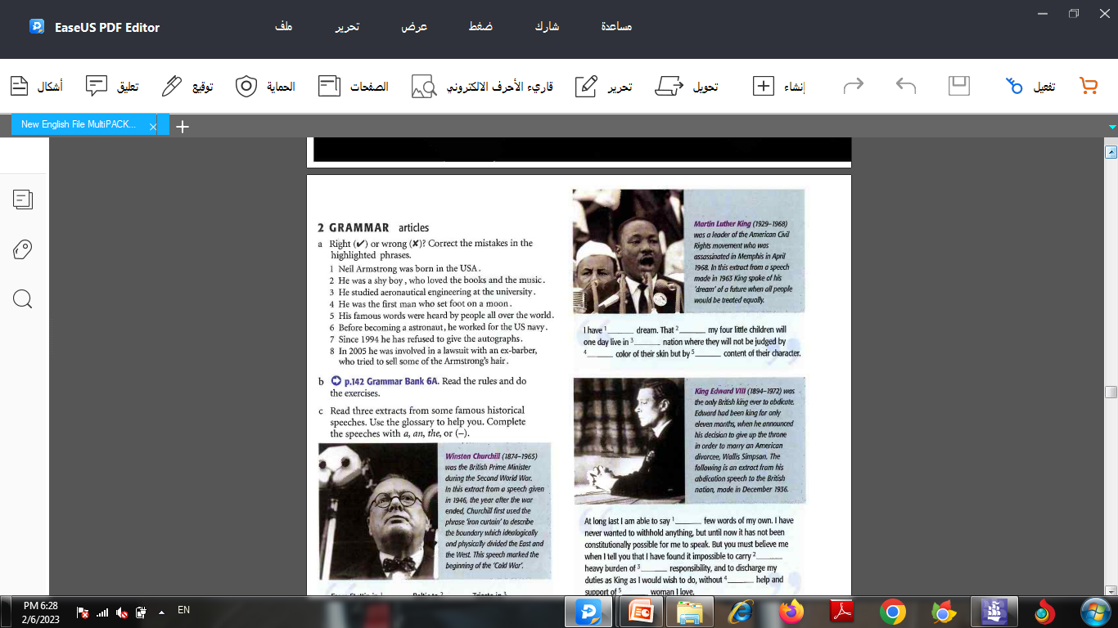
GRAMMAR articles p. 85
Read three extracts from some famous historical speeches. Use the glossary to help you. Complete the speeches with a, an, the, or (-). Click to check your answers.
Winston Churchill (1874-1965) was the British Prime Minister during the Second World War. In this extract from a speech given in 1946, the year after the war ended, Churchill first used the phrase ‘iron curtain' to describe the boundary which ideologically and physically divided the East and the West. This speech marked the beginning of the 'Cold War‘.

Slide 21
GRAMMAR articles p. 85
Read three extracts from some famous historical speeches. Use the glossary to help you. Complete the speeches with a, an, the, or (-). Click to check your answers.
(-)
From Stettin in ¹____ Baltic to ²____ Trieste in ³____ Adriatic, ⁴____ iron curtain has descended across ⁵_____continent. Behind that line lie all ⁶_____ capitals of ⁷____ ancient states of ⁸_____ Central and Eastern Europe, Warsaw, Berlin, Prague, Vienna, Budapest, Belgrade, Bucharest, and Sofia. All hese famous cities, and ⁹____ populations around them, lie in what I must call ¹⁰_____ Soviet sphere.
the
the
an
the
the
the
(-)
the
the
descend: come down ancient: very old
the continent: Europe sphere: an area of influence or activity

Slide 22
GRAMMAR articles p. 85
Complete the speech with a, an, the, or (-).
Click to check your answers.
Martin Luther King (1929-1968)
was a leader of the American Civil
Rights movement who was
assassinated in Memphis in April
1968. In this extract from a speech
made in 1963 King spoke of his
'dream' of a future when all people
would be treated equally.
I have ¹____ dream. That ²_____ my four little children will one day live in ³_____ nation where they will not be judged by ⁴_____ color of their skin but by ⁵_____ content of their character.
a
(-)
the
the
the

Slide 23
GRAMMAR articles p. 85
Use the glossary to help you. Complete the speech with a, an, the, or (-). Click to check your answers.
King Edward VIII (1894-1972) was the only British king ever to abdicate. Edward had been king for only eleven months, when he announced his decision to give up the throne in order to marry an American divorcee, Wallis Simpson. The following is an extract from his abdication speech to the British nation, made in December 1936.

Slide 24
GRAMMAR articles p. 85
Use the glossary to help you. Complete the speech with a, an, the, or (-). Click to check your answers.
a
At long last I am able to say ¹____ few words of my own. I have never wanted to withhold anything, but until now it has not been constitutionally possible for me to speak. But you must believe me when I tell you that I have found it impossible to carry ²_____ heavy burden of ³_____ responsibility, and to discharge my duties as King as I would wish to do, without ⁴_____ help and support of ⁵_____ woman I love.
the
(-)
the
the
abdicate: give up the position of being king or queen
at long last: finally, in the end
withhold: keep back, not say
burden: sth which is carried with difficulty, an obligation
discharge a duty: do what you have to do

Slide 25
Presentation Disasters! P. 86
Read part of an article about presentation disasters. Which tip from Ten Top Tips below should the speaker have remembered?
However bad you think your presentation has been, take some comfort from the fact that at least it probably wasn’t as bad as these true stories..
A FEW YEARS AGO I had to give a presentation to the Belgian management team of an international IT company. Not wishing to be the typical 'Brit‘ presenting in English, I had carefully prepared my presentation in French. I intended it as a surprise so I didn't say anything beforehand. After speaking in French for 45 minutes I was halfway through my
presentation and we had a break for coffee. At this point
the manager of the company came up to me asked me if I would change to speaking in English. 'Is my French that bad?‘ I said. 'No,' he replied, 'it’s just that we are all from the Dutch-speaking part of Belgium.‘

Slide 26
Presentation Disasters! P. 86
Read part of an article about presentation disasters. Which tip from Ten Top Tips below should the speaker have remembered?
Ten top tips for speaking in public
1 Don't make your presentation too long.
2 Don't have more than four or five main points.
3 Even if something distracting happens try not to lose your concentration.
4 Be careful about telling jokes – they may not be appropriate.
5 Always be punctual: start on time and try to finish on time.
6 Get to know as much as possible about your audience beforehand.
7 Try not to repeat yourself too much.
8 Be careful not to speak too fast.
9 Practise your presentation beforehand.
10 Make sure the equipment you need is working properly before you start. Click to check your answer.

Slide 27
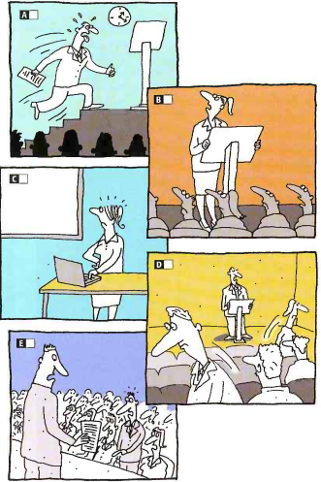
Presentation Disasters! P. 86
Look at pictures A-E . What do you think the problem was?
What tip would you give them?

Slide 28
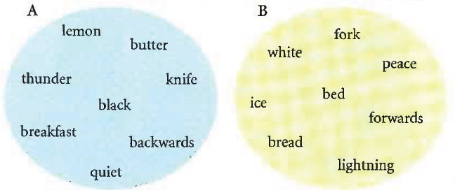
VOCABULARY collocation: word pairs p. 87
Some pairs of words in English which go together always come in a certain order, for example, we always say ‘Ladies and Gentlemen’ and ‘right or wrong’ NOT gentlemen and ladies , wrong and right .
Take one word from A and match it with another from B. Then decide which word comes first. They are all joined with and.

Slide 29
VOCABULARY collocation: word pairs p. 87
ice and lemon
bread and butter
thunder and lightning
knife and fork
black and white
bed and breakfast
backwards and forwards
peace and quiet

Slide 30
VOCABULARY collocation: word pairs p. 87
Look at some common word pairs joined with or. What is the second word?
Click to check your answer.
right or _______
sooner or _______
now or _______
all or _______
more or _______
once or _______
wrong
later
never
nothing
less
twice

Slide 31
VOCABULARY collocation: word pairs p. 87
Match the word pair idioms with their meanings.
Click to check your answer.
1. I’m sick and tired of hearing you complain. __
2. I didn’t buy much, just a few bits and pieces. __
3. I’ve been having headaches now and again. __
4. He’s unemployed and down and out. __
5. Every relationship needs a bit of give and take. __
6. We’ve had our ups and downs, but now we get on really well. __
7. The army were called in to restore law and order. __
8. Despite flying through a storm we arrived safe and sound. __
A. problems E. compromise
B. a situation in which the law is obeyed F. occasionally
C. fed up G. small things
D. without problem or injury H. without a home or money
C
G
F
H
E
A
B
D

Slide 32
VOCABULARY collocation: word pairs p. 87
Complete the sentences with a word pair from the previous exercises. Click to check your answer.
1. He visits us __________________, perhaps twice a year.
2. It’s your last chance I’m afraid. It’s __________________.
3. After lots of adventures she arrived home ______________.
4. Please stop making so much noise. I need a bit of __________________.
5. __________________he’ll realize that she’s not the woman for him.
6. After the riots the government sent soldiers in to try to establish __________________.
7. She’s __________________of her husband. She wants to leave him.
8. It was an amazing storm. There was lots of __________________.
now and again
now or never
safe and sound
peace and quiet
Sooner or later
law and order
sick and tired
thunder and lightening

Slide 33


