Slide 1

New English File
Intermediate
Session 6

Slide 2
Unit 6
Part B
1 READING

Slide 3
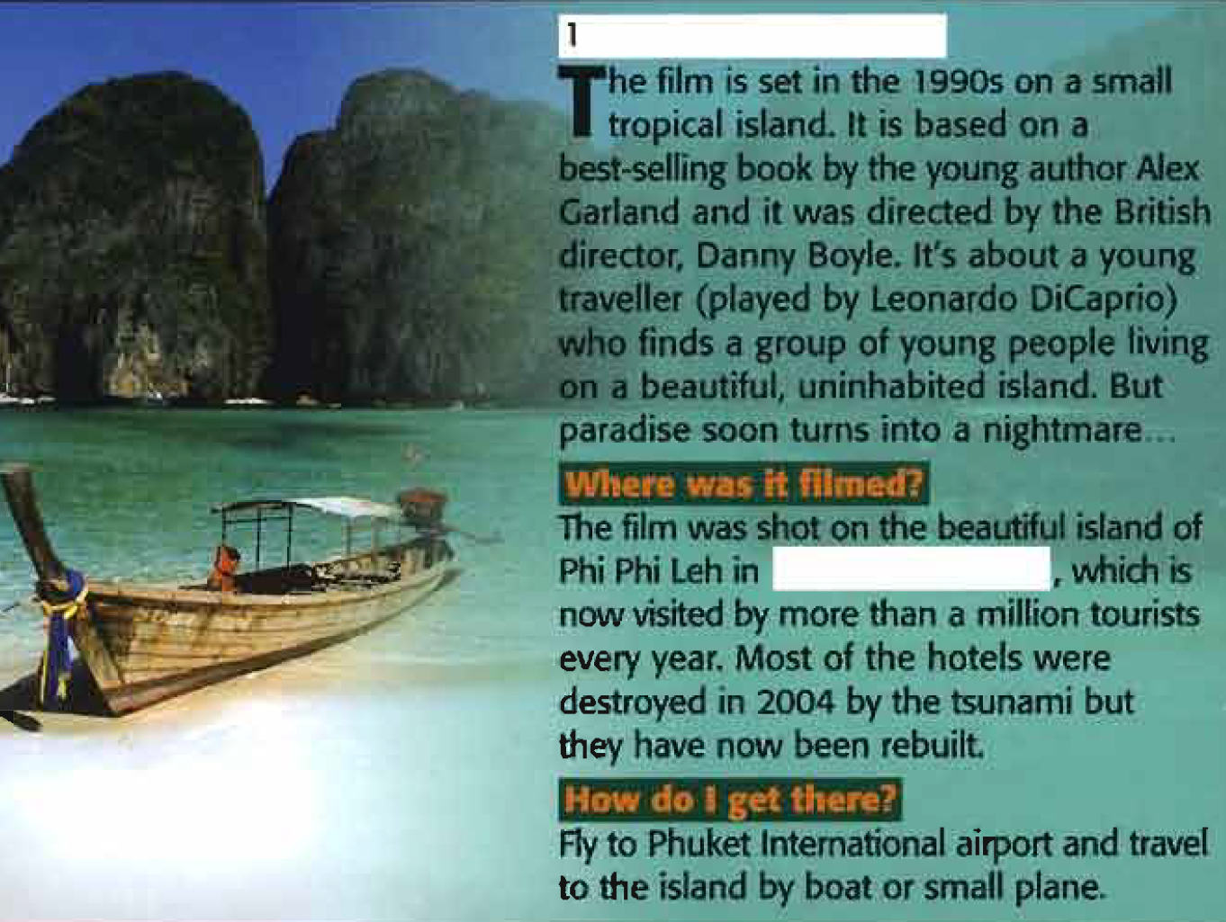
Read the article and try to complete each text with the name of the film and the country where it was made. Use the photos to help you.
_{The Beach}
Famous films that moved us literally!
Sometimes when you see a film, the sense of place is so strong that it makes you think ‘ I have to go there one day’. Here are three films, from three different decades, that have made thousands of people pack their cases and catch a plane. There's travel information too, in case you want to go there yourself
_{Thailand}

Slide 4
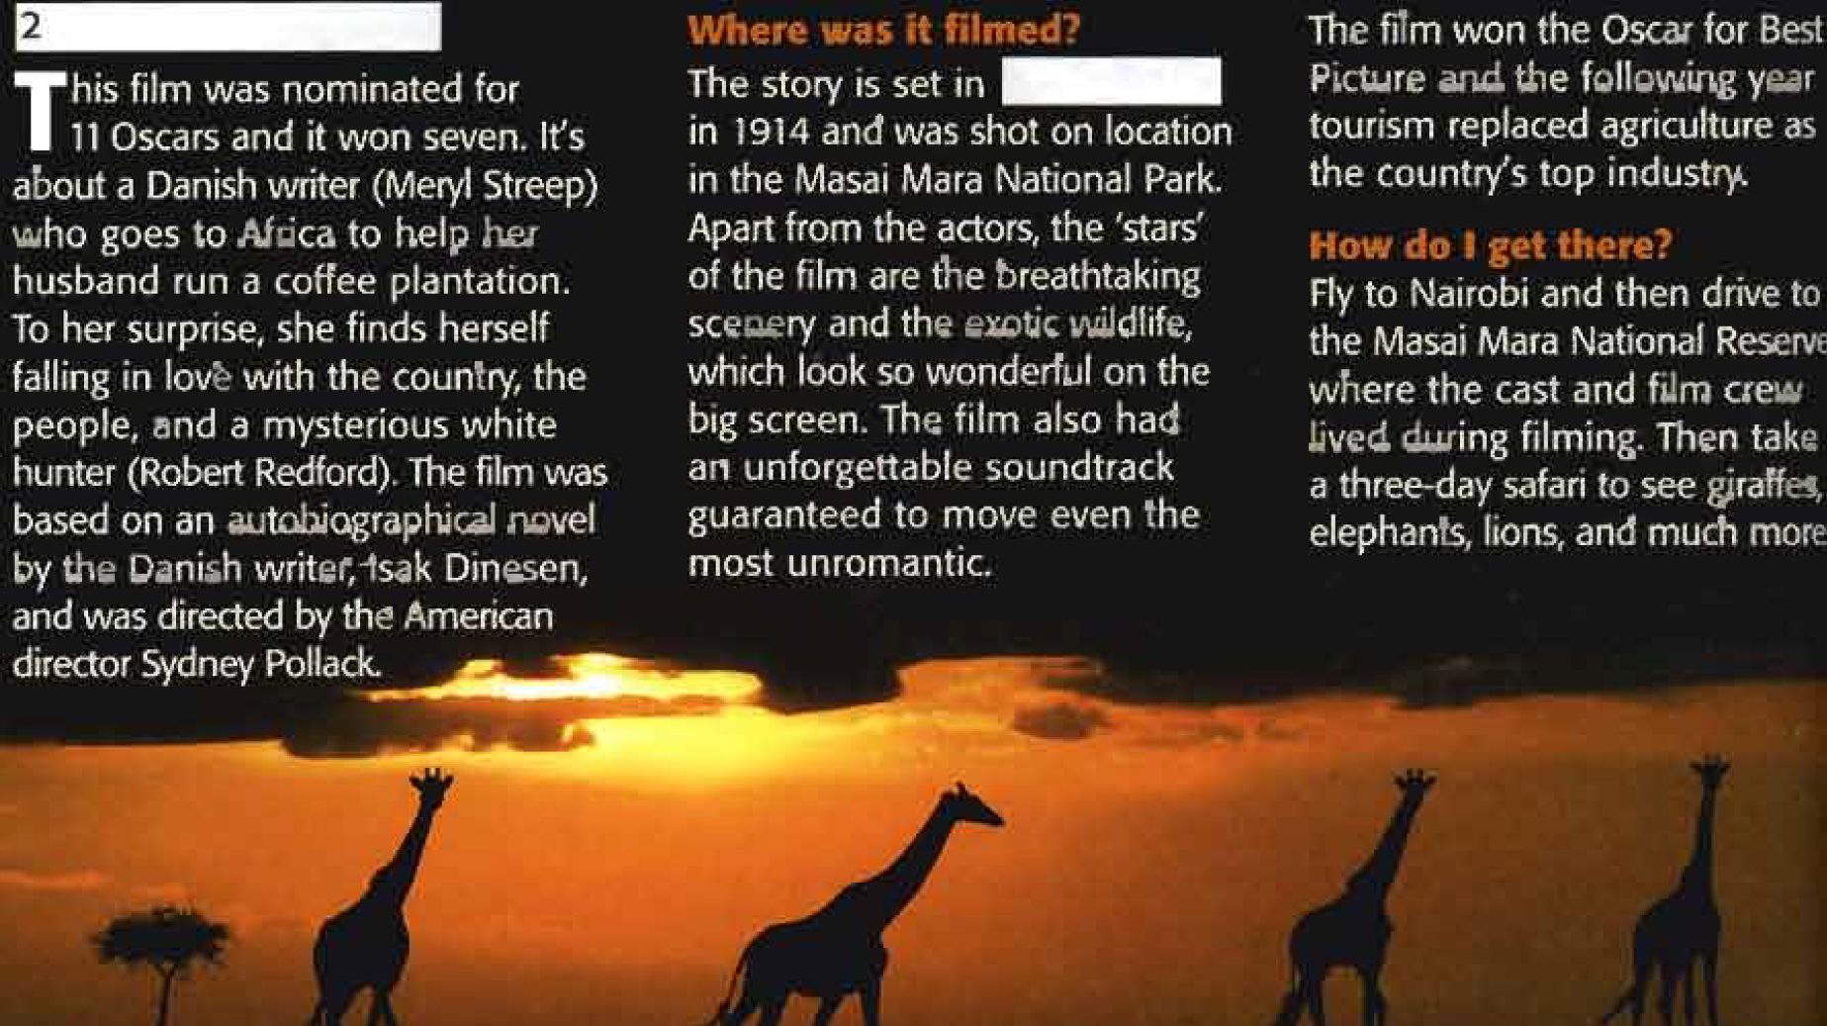
Out of Africa
Kenya

Slide 5
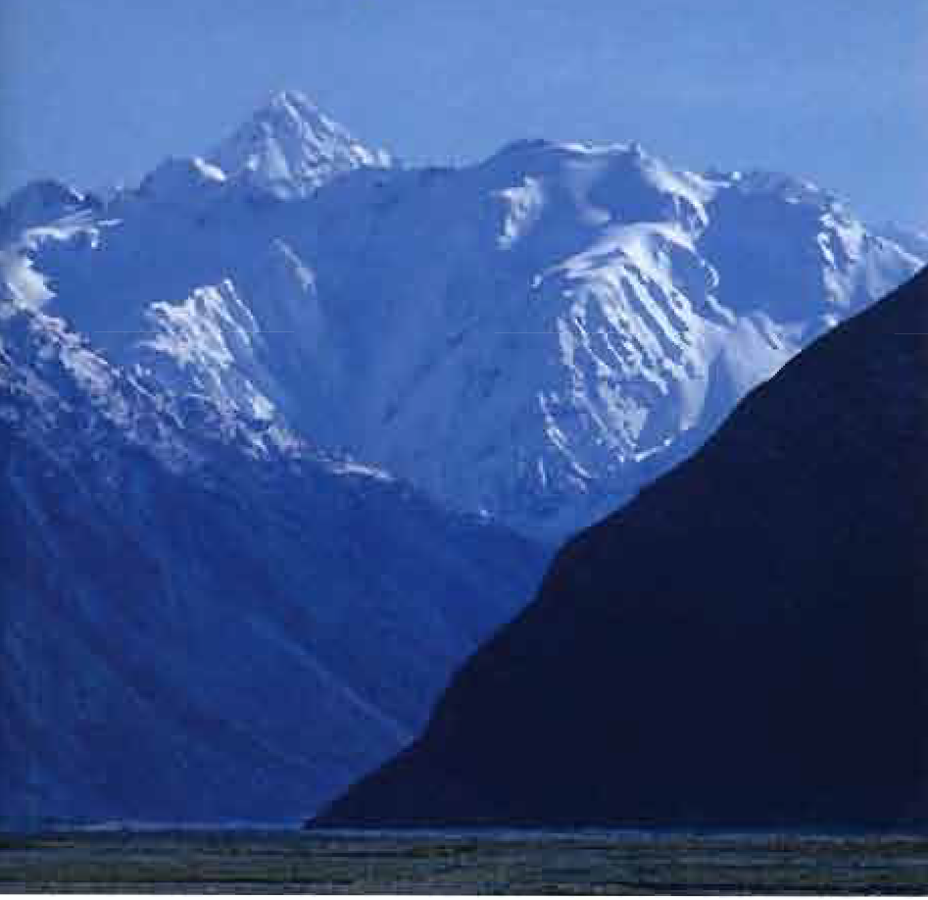
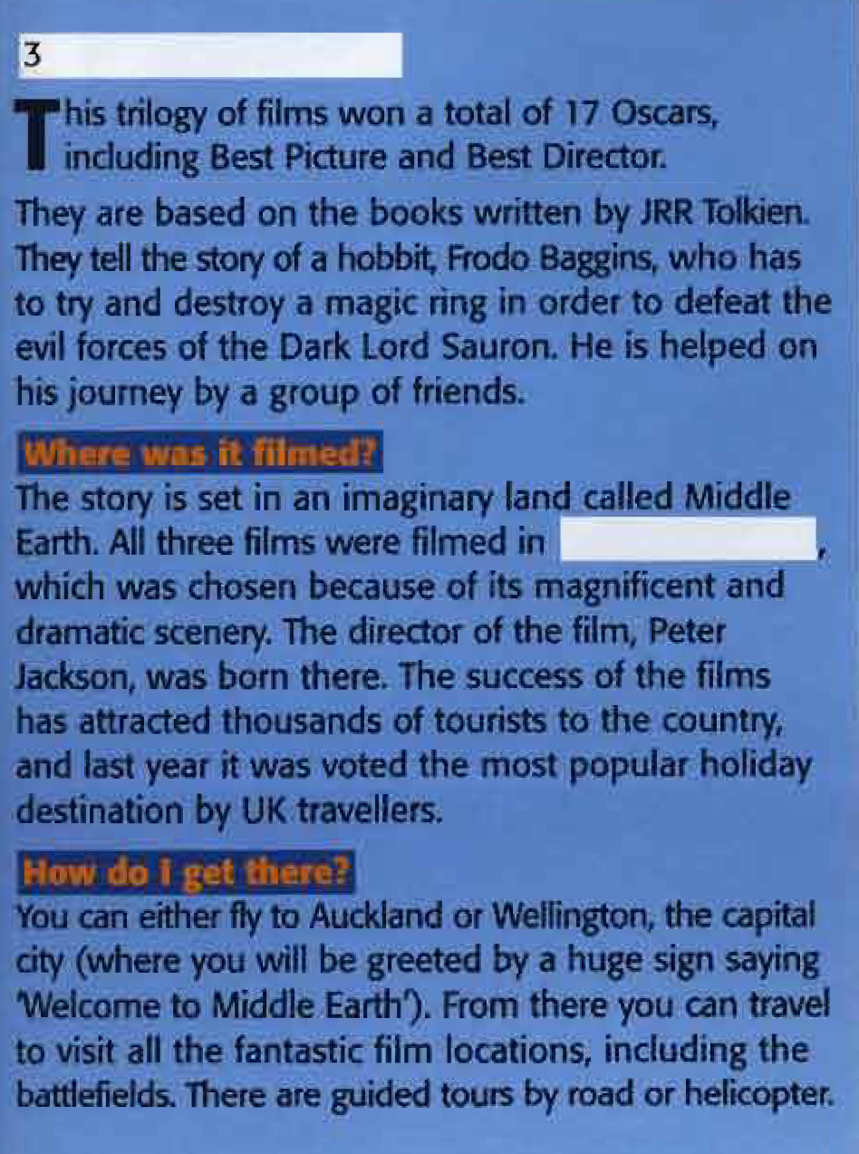
The Lord of the Rings
New Zealand

Slide 6
Read the article again and answer the questions. Which film(s)...?
1. had three parts
2. were based on a book
3. was set at the beginning of the 20th century
4. was set in a place where later there was a natural disaster
5. was filmed in a wildlife park
6. didn’t win an Oscar
7. was a romantic film
8. was directed by a man born in the country where the film was made
The Lord of the Rings
All three films
Out of Africa
The Beach
Out of Africa
The Beach
Out of Africa
The Lord of the Rings

Slide 7
Unit 6
Part B
2 GRAMMAR

Slide 8
Passive: be + past participle
Read about The Beach again. Underline an example of the present passive, the past passive, and the present perfect passive. How do you form the passive?
Possible answers
Present simple passive: It is based on a best-selling book.
Past simple passive: It was directed by the British director, Danny Boyle.
The film was shot on the island of Phi Phi Leh.
Most of the hotels were destroyed in 2004 by the tsunami.
Present perfect simple passive:... they have now been rebuilt.
The passive is formed with the verb be (in the appropriate tense) and the past participle.

Slide 9
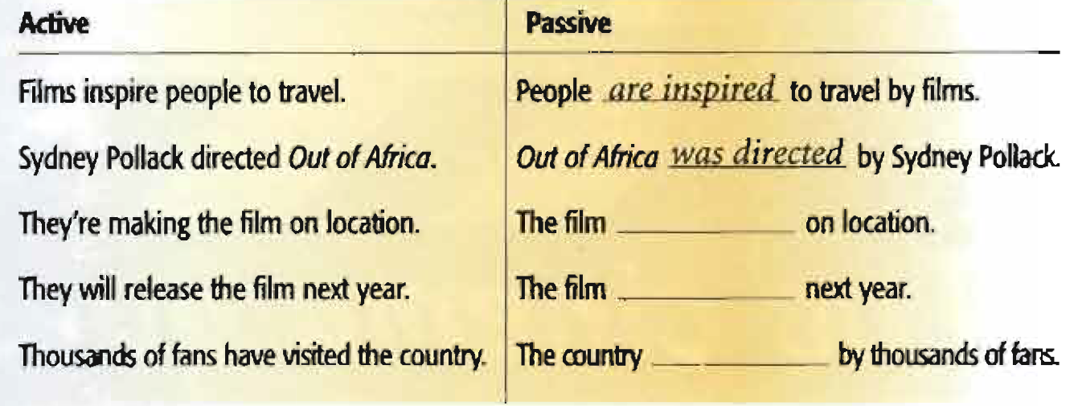
Look at the active sentences in the chart below and underline the verbs. What tense are they? Complete the chart with passive verbs.
is being made
will be released
has been visited

Slide 10
Passive: be + past participle
A lot of films are shot on location.
My bike has been stolen.
My car is being repaired today.
You’ll be picked up at the airport.
Death in Venice was directed by Visconti.
This bill has to be paid tomorrow.
She died when the film was being made.
We often use the passive when it’s not clear or important who does an action, e.g. My bike has been stolen (: Somebody has stolen my bike. I don’t know who.)
If you want to say who did the action, use by.

Slide 11
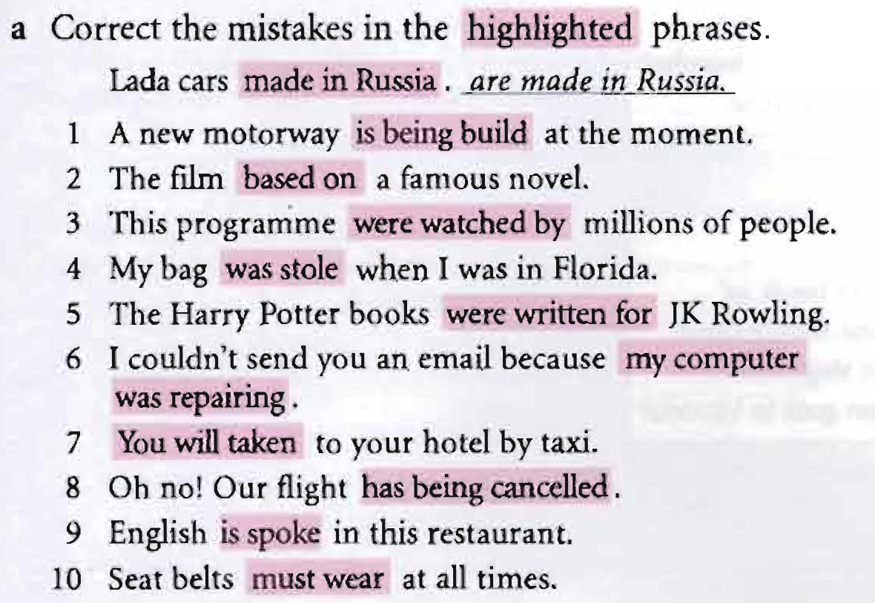
is being built
is based on
was watched by
was stolen
were written by
my computer was being repaired
You will be taken
has been cancelled
is spoken
must be worn

Slide 12
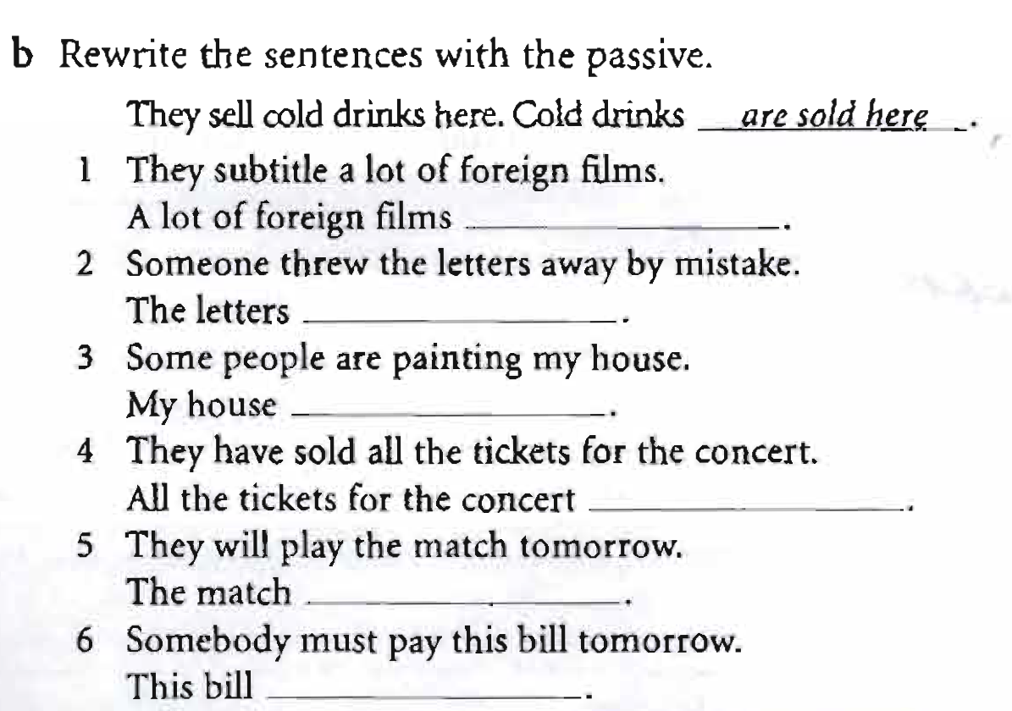
are subtitled
were thrown away by mistake
is being painted
have been sold
will be played tomorrow
must be paid tomorrow

Slide 13
Unit 6
Part B
3 VOCABULARY

Slide 14
Cinema
Try to remember words or phrases from READING which mean...
The _______________ music from a film.
The_______________ person who makes a film.
_______________ all the actors in a film.
_______________ all the people who make a film.
_______________ (filmed) in the real place, not in a studio.
_______________ the part of a cinema or TV where the image appears.
sound track
director
The cast
The film crew
On location
The screen

Slide 15
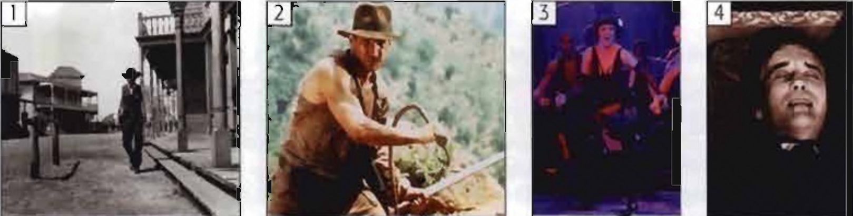
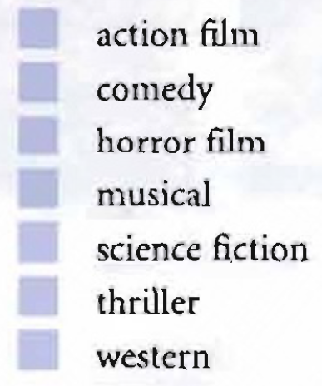
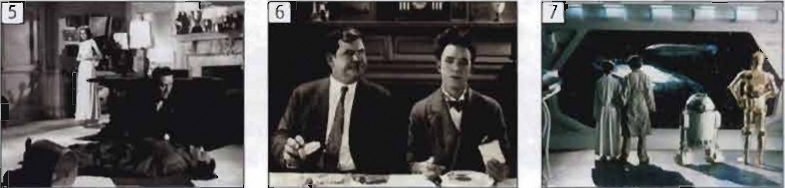
1. Kinds of Films
Match the films and the film types.
2
6
4
3
7
5
1

Slide 16
2. People and things Match the words and definitions.
audience/cast/director/extra/plot/scene/script/sequel/soundtrack/special effects/star/subtitles
1. ________ all the people who act in a film
2. ________ the most important actor or actress in a film
3. _____________ the person who makes a film
4. ________________ the music of a film
5. ________ the story of a film
6. ________ a part of a film happening in one place
7. ____________ the people who watch a film in a cinema
8. ________ a film which continues the story of an earlier film
9. ____________ images, often created by a computer
10. ________ the words of the film
11. ________ person in a film who has a small, unimportant part, e.g. in a crowd scene
12. ___________ translation of the dialogue of a film into another language
Cast
Star
Director
Sound track
Plot
Scene
Audience
Sequel
Special effects
Script
Extra
Subtitles

Slide 17
3. Verbs and phrases
Match the sentences 1-6 with the sentences a-f.
1. The film was set in 19th century Italy and England.____ 2. It was based on a novel by EM Forster. ____ 3. It was filmed / shot on location in Florence. ____ 4. It was directed by James Ivory. ____ 5. Helena Bonham-Carter played the part of Lacy. ____ 6. It was dubbed into other languages. ____ | a. He was the director. b. It was situated in that place at that time. c. This was her role in the film. d. The actors originally spoke in English. e. It was an adaptation of the book. f. It was filmed in the real place, not in a studio.
b
e
f
a
c
d

Slide 18
{{ Thank You }}

