Slide 1

Damascus University
Medical Preparatory English

Slide 2


New English File
Upper-intermediate
Term 2 – Session 6

Slide 3
Counting sheep p. 72
5B
GRAMMAR used to, be used to, get used to
Match the sentence beginnings 1-4 with endings A-D.
Click to check your answers.
I usually sleep 6 hours a night __
I used to sleep 7 hours a night, __
I’m not used to only sleeping 4 or 5 hours a night, __
I’m getting used to only sleeping 4 or 5 hours a night, __
but now I sleep less.
so it’s new and strange for me.
so it’s becoming less of a problem.
or more if I can.
D
A
B
C

Slide 4
GRAMMAR BANK p. 140
5B used to, be used to, get used to
used to, be used to, get used to
used to / didn't use to + infinitive
I used to drink five cups of coffee a day, but now I only drink tea.
When I lived in France as a child I used to have croissants for breakfast.
I didn’t recognize him. He didn’t use to have a beard.
Use used to / didn’t use to + infinitive to talk about past habits or repeated actions or situations / states which have changed.
used to doesn’t exist in the present tense. For present habits, use usually + the present simple,
e.g. I usually walk to work. NOT I use to walk to work.

Slide 5
GRAMMAR BANK p. 140
5B used to, be used to, get used to
You can also use would to refer to repeated actions in the past.
When I lived in France as a child I would always eat croissants for breakfast.
But you can’t use would with non-action verbs. NOT I didn’t recognize him. He wouldn’t have a beard.

Slide 6
GRAMMAR BANK p. 140
5B used to, be used to, get used to
be used to + gerund
Carlos has lived in London for years. He’s used to driving on the left.
I’m not used to sleeping with a duvet. I’ve always slept with blankets.
Use be used to + gerund to talk about a new situation which is now familiar or less strange.

Slide 7
GRAMMAR BANK p. 140
5B used to, be used to, get used to
get used to + gerund
A. I can’t get used to working at night. I feel tired all the time.
B. Don’t worry. You’ll soon get used to it.
Use get used to + gerund to talk about a new situation which is becoming familiar or less strange.
You can’t use the infinitive after be / get used to. NOT He’s used to drive on the left.

Slide 8
5B used to, be used to, get used to p. 141
Right (✓) or wrong (X)? Correct the wrong phrases. Click to check your answers.
She isn’t used to have a big dinner in the evening. X isn’t used to having
Nowadays I use to go to bed early.
When we visited our friends in London we couldn’t get used to drink tea with breakfast.
Sorry, I’m not used to staying up so late. I’m usually in bed by midnight.
X usually go / ’m used to going
X get used to drinking
✓

Slide 9
5B used to, be used to, get used to p. 141
Right (✓) or wrong (X)? Correct the wrong phrases.
Click to check your answers.
4. There used to be a cinema in our village, but it closed down three years ago.
5. Paul used to having a beard when he was younger.
6. A. I don’t think I could work at night.
B. It’s not so bad. I use to it now.
7. Did you used to wear a uniform at your school?
✓
X used to have
X I’m used to it
X Did you use to wear

Slide 10
5B used to, be used to, get used to p. 141
b. Complete with used to, be used to, or get used to and the verb in brackets. Click to check your answers.
He’s Spanish so he’s used to driving on the right. (drive)
1. When Nathan started his first job, he couldn’t _________________ at 6 a.m. (get up)
2. If you want to lose weight, then you’ll have to _________________ less. (eat)
3. I don’t like having dinner at 10.00 –
I _________________ a meal so late. (not / have)
4. When we were children we _______________ all day playing football in the park. (spend)
get used to getting up
get used to eating
’m not used to having
used to spend

Slide 11
5B used to, be used to, get used to p. 141
b. Complete with used to, be used to, or get used to and the verb in brackets.
Click to check your answers.
5. Jasmine has been a nurse all her life so she _______________ nights. (work)
6. I’ve never worn glasses before, but I’ll have to _______________ them. (wear)
7. I didn’t recognize you! You ______________ long hair, didn’t you? (have)
8. Amelia is an only child. She _________________ her things. (not / share)
is used to working
get used to wearing
used to have
isn’t used to sharing

Slide 12
READING p. 73
Read the first paragraph of the article. What
exactly is the test and what does it show? What does the last sentence mean?
Read, then click to check your answers.

Slide 13
Sleepy people – the dangers of sleep deprivation p. 73
Do this test tonight when you go to bed. Put a plate on the floor next to your bed. Lie down with one hand hanging over the bed holding a spoon above the plate. When you fall asleep, the spoon will fall on the plate and should wake you up. If you don't wake up until the next day, it probably means you are ‘sleep deprived’.
We live in a world of tired, sleep deprived people. This is the theory of behavioural biologist, Paul Martin. In his book Counting Sheep, he describes a society which is just too busy to sleep and which does not give sleeping the importance it deserves. We all know the importance of having a healthy diet and doing exercise, but we don't worry enough about sleeping the hours we need. Paul Martin says: ‘We might live longer and happier lives if we took our beds as seriously as our running shoes.’

Slide 14
READING p. 73
Read the first paragraph of the article. What exactly is the test and what does it show?
What does the last sentence mean?
Click to check your answers.
The test involves going to bed holding a spoon in your hand. When you fall asleep the spoon falls onto a plate and wakes you up. If you are already sleeping so deeply that the spoon doesn’t wake you up, then you are ‘sleep deprived.’
The last sentence means that we need to give as much importance to sleeping enough as we do to taking exercise (because both are vital for good health).

Slide 15
READING p. 73
b. Read the article and answer these questions.
Read, then click to check your answers.
How did the invention of the electric light change our sleep habits?
Why is it probably better to have an operation during the day than at night?
Are naps really useful?
How much does the average person sleep?
Does it vary according to profession? Why should politicians sleep more?
What is our ‘sleep debt’?

Slide 16
READING p. 73
b. Read the article and answer these questions.
Read, then click to check your answers.
7. What is the world’s most popular drug?
8. What’s the difference between driving when you are drunk and when you are very tired?
9. Do people sleep more or less than they used to? Why?
10. What should your bedroom not be if you want to sleep well?
11. How did lack of sleep cause the Chernobyl nuclear disaster?
12. How much sleep does the average person need?

Slide 17
So much to do, so little time p. 73
Modem society has invented reasons not to sleep. We are now a 24/ 7 society where shops and services must be available all hours. We spend longer at work than we used to, and more time getting to work. Mobile phones and email allow us to stay in touch round the clock and late-night TV and the Internet tempt us away from our beds. When we need more time for work or pleasure, the easy solution is to sleep less. The average adult sleeps only 6.2 hours a night during the week, whereas research shows that most people need eight or even eight and a half hours' sleep to feel at their best. Nowadays many people have got used to sleeping less than they need and they live in an almost permanent state of 'sleep debt', owing their bodies perhaps 25-30 hours of sleep.
Hours slept a night
Lawyers 7.8
Architects 7.5
Social workers 6.9
Teachers 6
Politicians 5.2
Hospital doctors (on call) 4.5
UK Sleep Council survey

Slide 18
Going against nature p. 73
Until the invention of electric light in 1879 our daily cycle of sleep used to depend on the hours of daylight. People would get up with the sun and go to bed at nightfall. But nowadays our hours of sleep are mainly determined by our working hours (or our social life) and most people are woken up artificially by an alarm clock. During the day caffeine, the world's most popular drug, helps to keep us awake. 75% of the world's population habitually consume caffeine which, up to a point, masks the symptoms of sleep deprivation.

Slide 19
Sleepy people p. 73
What does a chronic lack of sleep do to us? As well as making us irritable and unhappy as people it also reduces our motivation and ability to work. This has serious implications for society in general. Doctors, for example, are often chronically sleep deprived especially when they are on 'night call' and may get less than three hours' sleep. Lack of sleep can seriously impair their mood, judgement, and ability to take decisions. Our politicians are often 'jet lagged' after crossing time zones. World summit meetings called to deal with a crisis often result in decisions being taken after marathon sessions when everyone is severely sleep deprived. Human error caused by tiredness contributed to the worst nuclear accident in history at Chernobyl in 1986. Tired engineers, in the early hours of the morning, made a series of mistakes with catastrophic results. On our roads and motorways lack of sleep kills thousands of people every year. Tests show' that a tired driver can be just as dangerous as a drunk driver. However, driving when drunk is against the law but driving when exhausted isn't. As Paul Martin says, it is very ironic that we admire people who function on very little sleep instead of criticizing them for being irresponsible. Our world would be a much safer, happier place if everyone, whatever their job, slept eight hours a night.

Slide 20
SLEEP TIPS p. 73
Give sleep a high priority in your life.
Listen to your body. If you feel tired, you probably need more sleep.
Pay off your 'sleep debt' by going to bed half an hour earlier for a few weeks.
Have a regular routine – try to go to bed at roughly the same time every day.
Take a nap during the day (ideally after lunch). Research has shown that short naps are very effective in restoring our energy levels and mood.
Make sure your bedroom isn't too hot.
Don't use your bedroom as an office or for watching TV.

Slide 21
READING p. 73
b. Answer these questions. Click to check your answers.
1. How did the invention of the electric light change our sleep habits?
2. Why is it probably better to have an operation during the day than at night?
3. Are naps really useful?
4. How much does the average person sleep?
5. Does it vary according to profession? Why should politicians sleep more?
Before the invention of the light bulb people slept during the hours of darkness.
Because doctors who are on ‘night call’ are more sleep deprived than doctors working during the day.
Yes. They are very effective in restoring our energy levels and making us feel happier.
6.2 hours a night (during the week).
Yes. Because they often take important decisions when they are too tired.

Slide 22
6. What is our ‘sleep debt’?
7. What is the world’s most popular drug?
8. What’s the difference between driving when you are drunk and when you are very tired?
9. Do people sleep more or less than they used to? Why?
10. What should your bedroom not be if you want to sleep well?
11. How did lack of sleep cause the Chernobyl nuclear disaster?
12. How much sleep does the average person need?
The hours of sleep that we owe our body (i.e. the extra hours we need to sleep to feel at our best).
Caffeine.
Driving when you are tired isn’t against the law (but is just as dangerous).
They sleep less because they have more reasons not to sleep (work, the Internet, TV 24/7, society)
It shouldn’t be hot, used as an office, or for watching TV.
Tired engineers made very serious mistakes with catastrophic consequences.
8 - 8.5 hours.

Slide 23
VOCABULARY sleep p. 74
alarm blankets dreams
duvet fall keep you awake
insomnia jet-lagged log
nap nightmares oversleep
pillow set sheet
siesta sleeping tablets sleepy
snore yawn

Slide 24
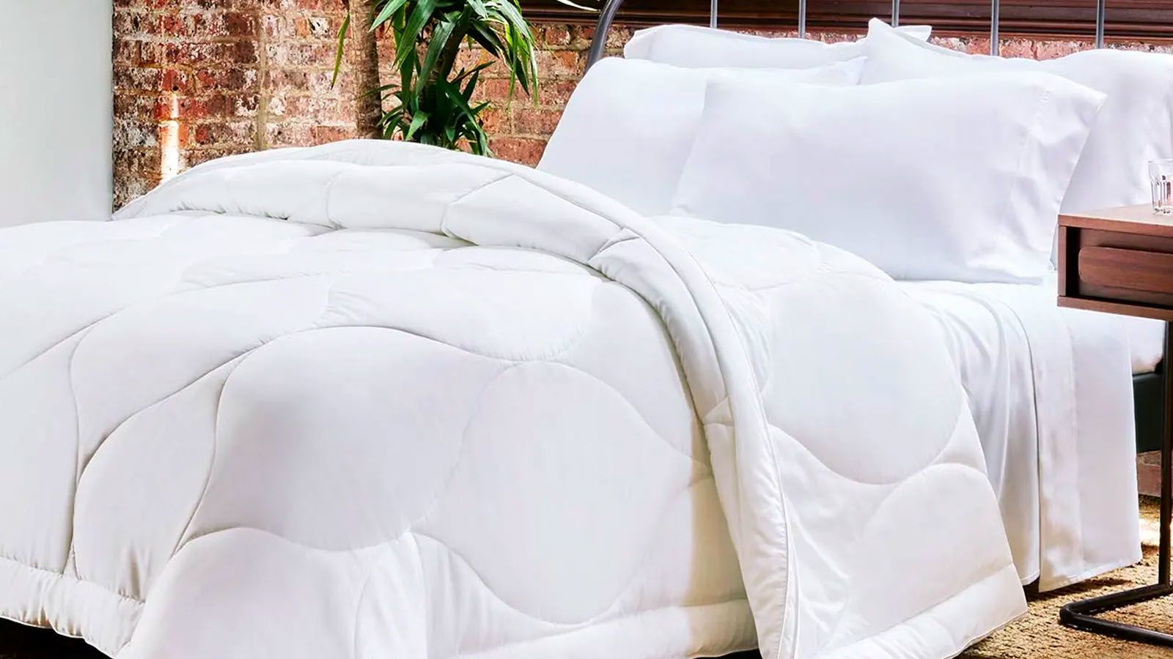
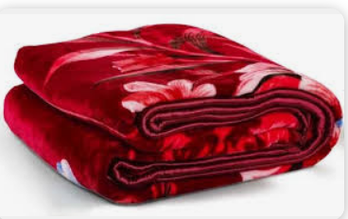
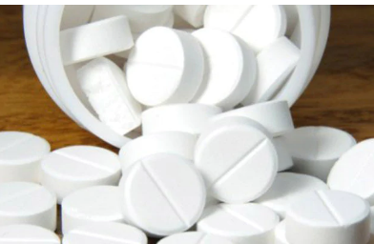
VOCABULARY sleep p. 74
pillow
sheet
duvet
blanket
sleeping tablets

Slide 25
Vocabulary race p. 74
Fill in the gap with the correct word.
Click to check your answers.
1. Most people start feeling sleepy around 11:00 at night.
2. They often open their mouth and __________.
3. They go to bed and __________ their __________ clock.
4. They get into bed and put their head on the _________.
5. They cover themselves up with a __________, or with __________ and __________.
6. Soon they ________ asleep.
7. Some people make a loud noise when they breathe. They __________.
yawn
set
alarm
pillow
duvet
sheets
blankets
fall
snore

Slide 26
Vocabulary race p. 74
dreams
nightmares
8. During the night people have __________ or __________ .
9. If you don’t hear your alarm in the morning, you might __________.
10. If you drink coffee in the evening, it might ______ _____ ________.
11. Some people can’t sleep because they suffer from __________ .
12. These people often have to take __________ _________.
13. Some people have a ________ or ________ after lunch.
14. A person who sleeps well ‘sleeps like a ________ .’
15. Someone who is tired after flying to another time zone is __________.
oversleep
keep
you
awake
insomnia
sleeping
tablets
siesta
nap
log
jet-lagged

Slide 27
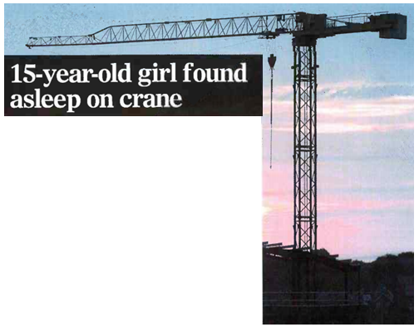
crane
Look at the photo and the headline. Why do you think the girl was asleep on the crane?
How did she get there?
What do you think happened next?
Read the newspaper article and check your answers.

Slide 28
15-year-old girl found asleep on crane p. 75
Yesterday a 15-year-old girl was discovered lying on top of a 30-metrehigh crane. A passer-by saw her when he was walking past a building site in Dulwich, south-west London, and immediately called the fire brigade. The police and fire brigade arrived at 1.30 in the morning. At first they thought the girl was suicidal but when a fireman climbed up the crane, he realized she was drunk. The fireman crawled along the arm of the crane and carefully put a safety harness on the girl. Then the girl used her mobile phone to call her parents, who came quickly to the building site. The rescue took two hours and the girl was brought safely down from the crane on a ladder.
After talking to her parents, the police discovered that the girl had been sleepwalking. She had left her house during the night, and had been able to get into the building site because the security guard was asleep. Her parents said that it wasn’t the first time that she had sleepwalked, and that she had left the house on several other occasions.

Slide 29
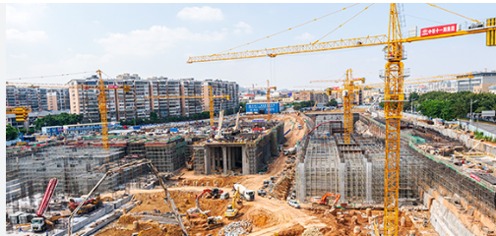
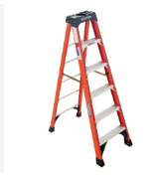
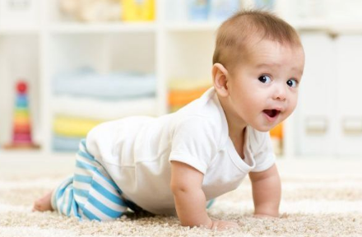
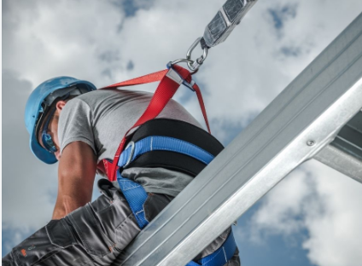
15-year-old girl found asleep on crane p. 75
ladder
building site
safety harness
crawl

Slide 30
15-year-old girl found asleep on crane
Why do you think the girl was asleep on the crane?
How did she get there?
What do you think happened next?
Click to check your answers.
The girl had been sleepwalking and had walked from her house to the building site.
A fireman rescued her from the top of a crane.

Slide 31


