Slide 1

New English File
Intermediate
Session 3

Slide 2
Unit 5
Part C
1 VOCABULARY (Work)

Slide 3
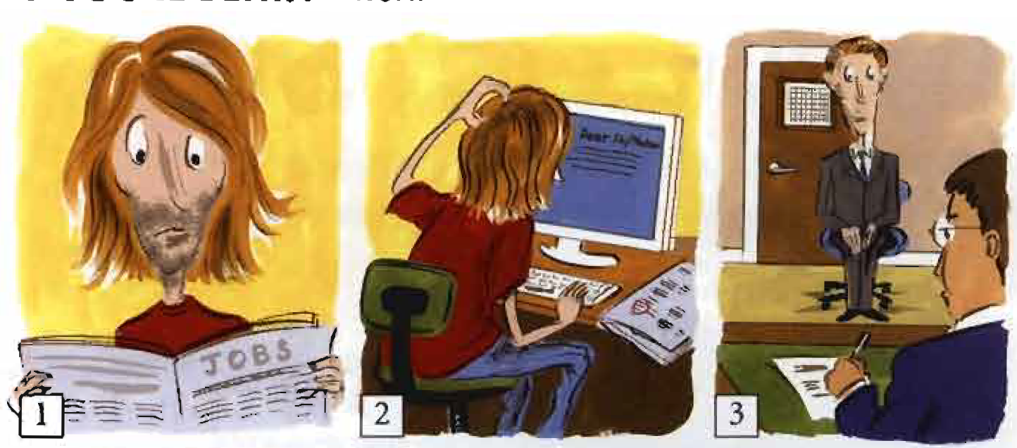
Look at the picture story and match a sentence with each picture.
He applied for a job with a food company, and sent in his cv. ____
Jake was unemployed and was looking for a job. ____
He had an interview, and he got the job. ____
2
1
3

Slide 4
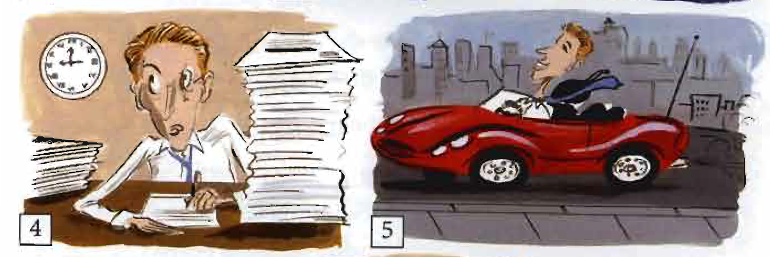
Look at the picture story and match a sentence with each picture.
But he was happy because he had a good salary and a company car. ____
He had to work very hard and do overtime. ____
5
4

Slide 5
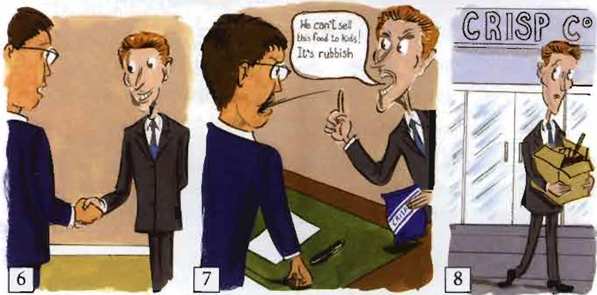
Look at the picture story and match a sentence with each picture.
He was sacked. Jake was unemployed again.. ____
After six months he got promoted. ____
But then he had an argument with his boss. ____
8
6
7

Slide 6
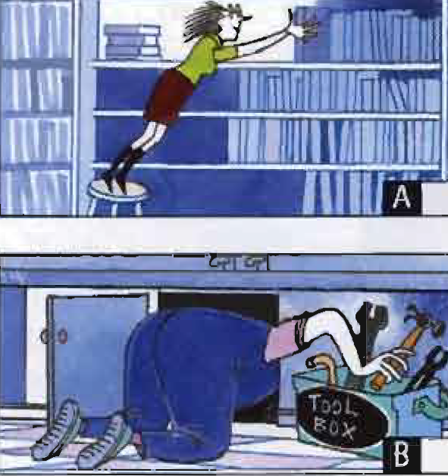
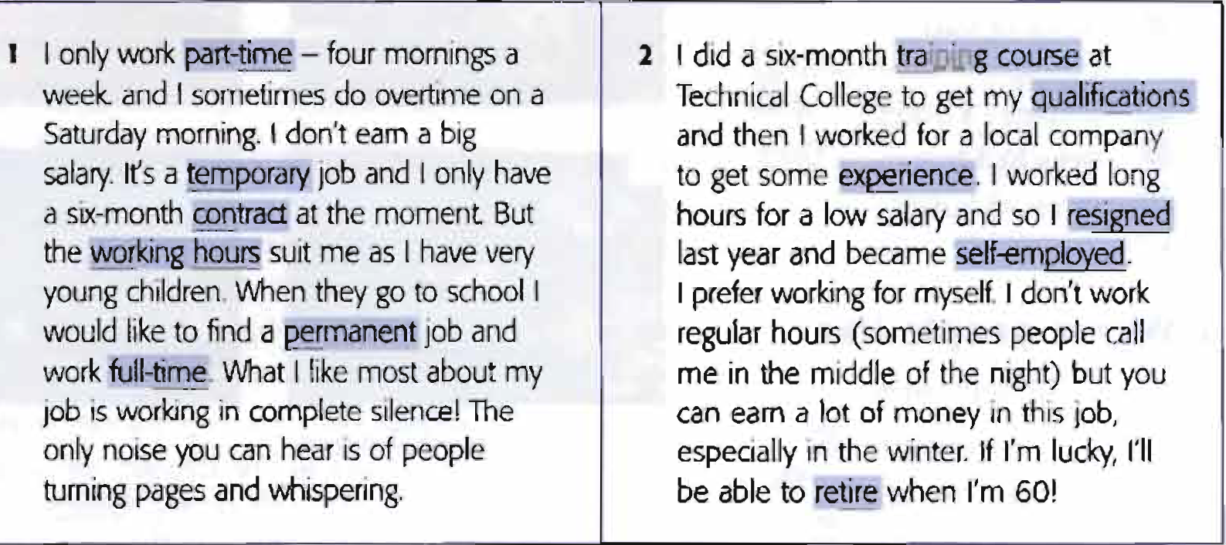
1. Describing your job
Read the texts and match them to the pictures. What are the jobs?
1
2

Slide 7
B. Match the highlighted words in the texts with their definitions.
1. a written legal agreement ______________
2. the knowledge you get from doing a job ______________
3. a series of lessons to learn to do a job ______________
4. the time you spend doing a job ______________
5. working for yourself, not for a company ______________
6. to stop working when you reach a certain age, e.g. 65 ______________
7. left a job because you wanted to ______________
8. lasting for a short time ______________ opposite of permanent
9. for only a part of the day or the week ______________
10. exams you've passed or courses you’ve done ______________
contract
experience
training course
working hours
self-employed
retire
resigned
temporary
Part-time opp of full-time
qualifications

Slide 8
2. Saying what you do
Complete the sentences with the appropriate prepositions.
1. I work____ a multinational company.
2. I work ____ a manager.
3. I'm ____ charge the marketing department.
4. I work ____ a factory.
5. I’m responsible ____ customer loans.
6. I’m ____ school / university.
7. I'm ____ my third year.
for
as
in
in
for
at
in

Slide 9
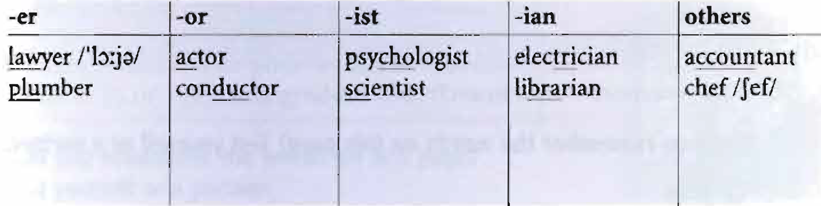
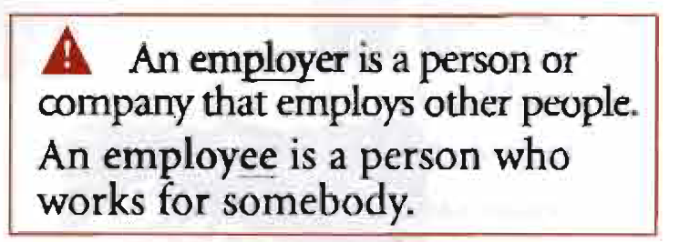
Write two more jobs in each column.
Remember!
builder
teacher
doctor
author
receptionist
journalist
musician
politician
housewife
nurse

Slide 10
Unit 5
Part C
2 GRAMMAR (Gerunds and Infinitives)

Slide 11
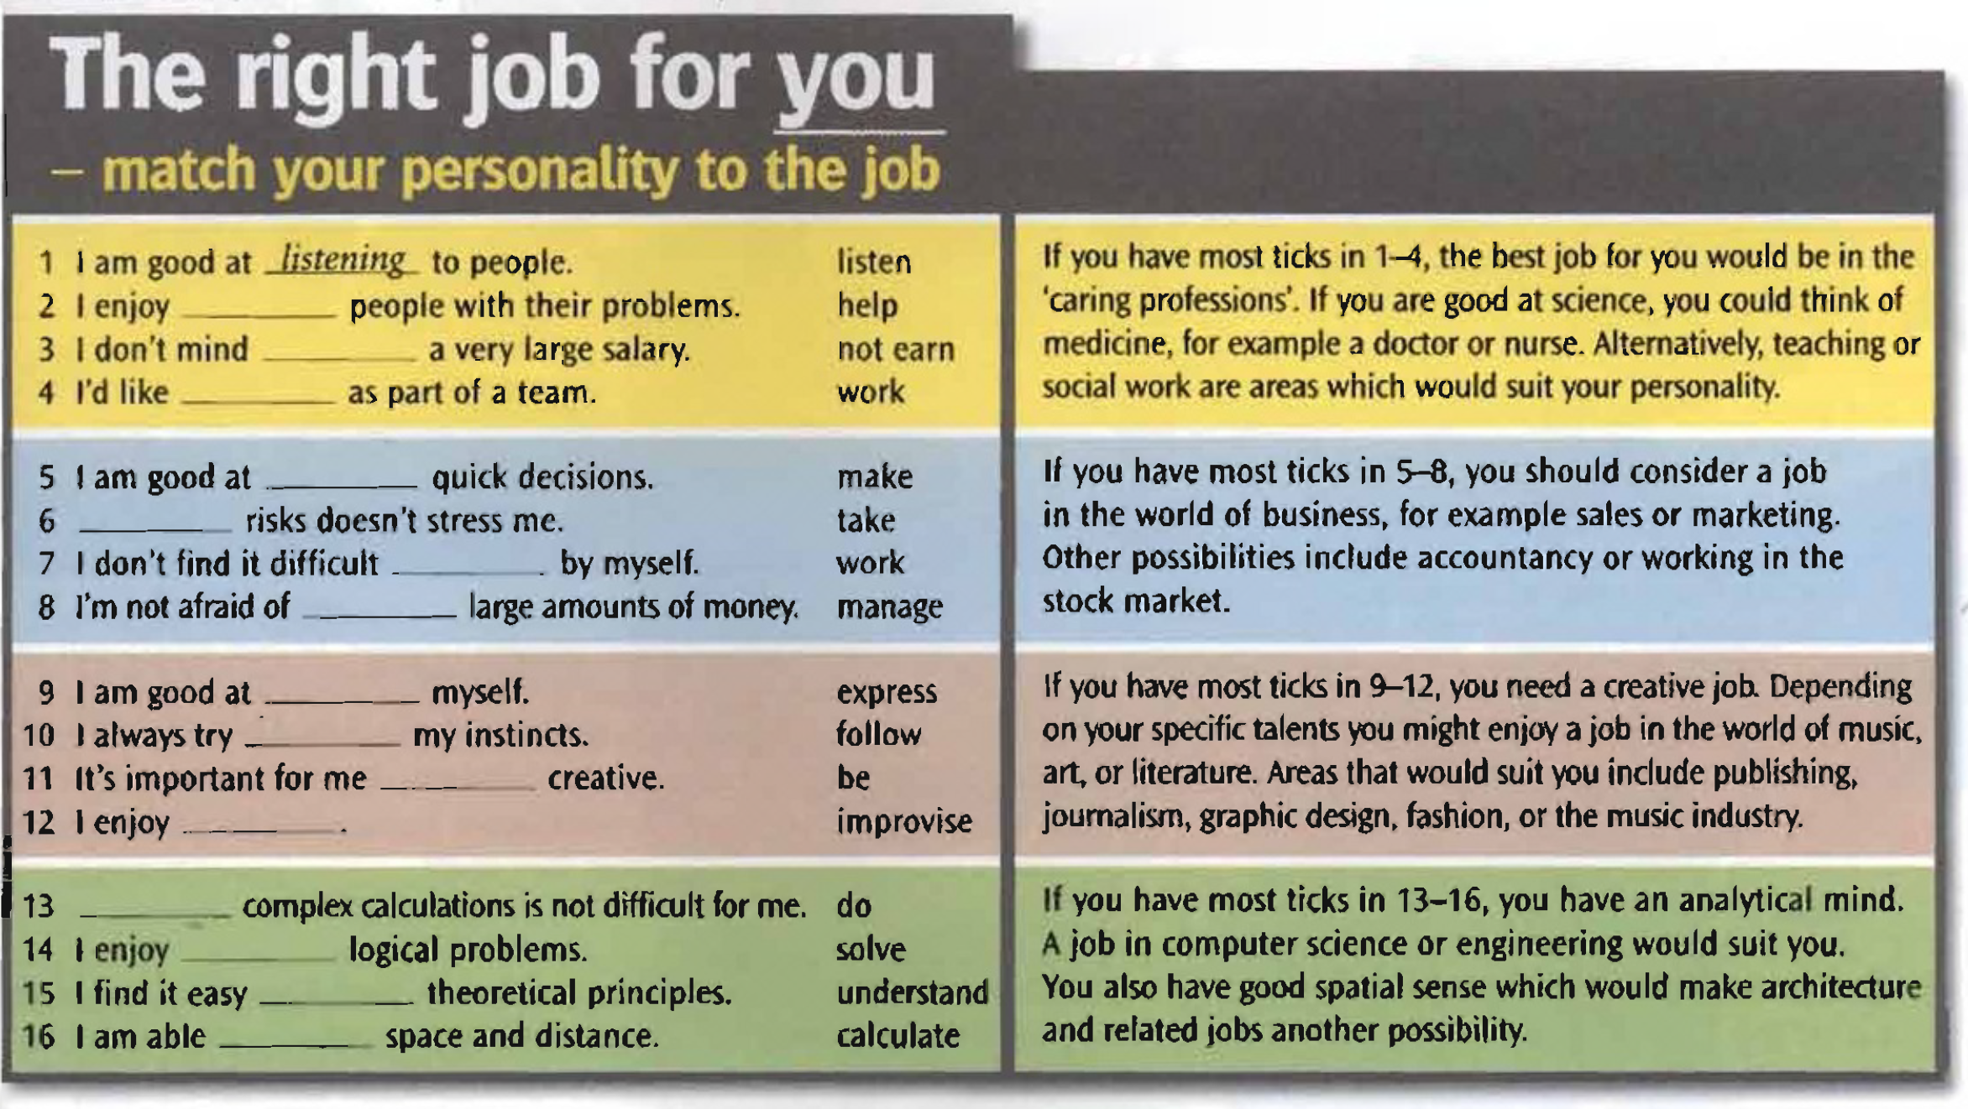
Complete sentences 1-16 with the correct form of the verb.
helping
not earning
to work
making
Taking
to work
managing
expressing
to follow
to be
improvising
Doing
solving
to understand
to calculate

Slide 12
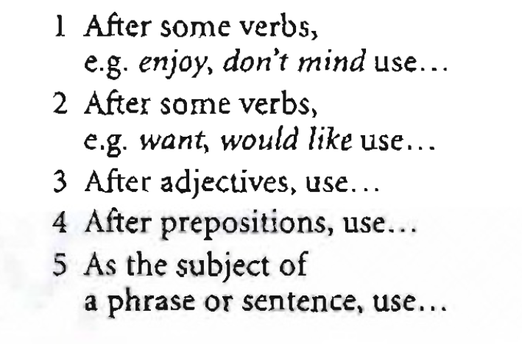
Look at the sentences in the questionnaire. Complete the rules with the gerund or infinitive +to.
the gerund
to + infinitive
to + infinitive
the gerund
the gerund

Slide 13
Use the gerund (verb+ing)
1. after prepositions and phrasal verbs.
  I’m very good at remembering names.
  She’s given up smoking.
2. as the subject of a sentence.
  Eating out is quite cheap here.
3. after some verbs, e.g. hate, spend, don't mind
  I don’t mind getting up early.
Common verbs which take the gerund include: enjoy, hate, finish, like, love, mind, practise, spend, stop, suggest and phrasal verbs, e.g. give up, go on, etc.

Slide 14
Use the infinitive+ to
1. after adjectives.
  My flat is easy to find.
2. to express a reason or purpose.
  He's saving money to buy a new car.
3. after some verbs, e.g. She's never learnt to drive.
  Try not to make a noise.
  want, need, learn.
Common verbs which take the infinitive (with to) include: (can’t) afford, agree, decide, expect, forget, help, hope, learn, need, offer, plan, pretend, promise, refuse, remember, seem, try, want, would like

Slide 15
Use the infinitive (without to)
1. after most modal and auxiliary verbs
  I cant drive. We must hurry.
2. after make and let.
  My parents don't let me go out much.
  She always makes me laugh.
Gerunds and infinitives form the negative with not, e.g. not to be, not being.
More verbs take the infinitive than the gerund.
These common verbs can take either the gerund or infinitive with no difference in meaning: begin, continue, prefer, start.

Slide 16
These verbs can take a gerund or an infinitive but the meaning is different.
Try to be on time. = make an effort to be on time.
Try doing yoga. = do it to see if you like it.
Remember to phone him. = Don’t forget to do it.
I remember meeting him years ago. = I have a memory of it.

Slide 17
a Complete with the gerund or infinitive.
Smoking is banned in all public place. (smoke)
1. It’s very expensive __________ a flat in the center. (rent)
2. Are you afraid of ____________? (fly)
3. I called the restaurant ____________ a table for tonight. (book)
4. Be careful _______________ a noise when you come home tonight. (not make)
5. She's worried about __________ the exam. (fail)
6. Everybody went on __________ until after midnight. (dance)
7. __________ an only child is a bit boring. (be)
8. It's easy __________ the way if you look at the map. (find)
9. He’s terrible at __________ languages. (learn)
10. A Why are you learning Spanish? B _____________talk to my in-laws. They’re Argentinian, and they don’t speak English. (be able to)
to rent
flying
to book
not to make
failing
dancing
Being
to find
learning
To be able to

Slide 18
b. Complete the sentences with work, to work, or working.
1. I regret not working harder when I was at school.
2. I spent all weekend __________ on the computer.
3. I've decided __________ abroad next year.
4. You must __________ harder if you want to get promoted.
5. My boss often makes me __________ late.
6. He isn’t very good at _________ in a team.
7. I don’t mind_________ on Saturdays if I can have a day off during the week.
8. He's gone to the UK __________ in his uncle’s shop.
9. __________ with members of your family can be quite difficult.
10. My husband promised not __________ on my birthday.
11. I used_______ in a restaurant when I was a student.
working
to work
work
work
working
working
to work
Working
to work
to work

Slide 19
Unit 5
Part C
3 READING

Slide 20
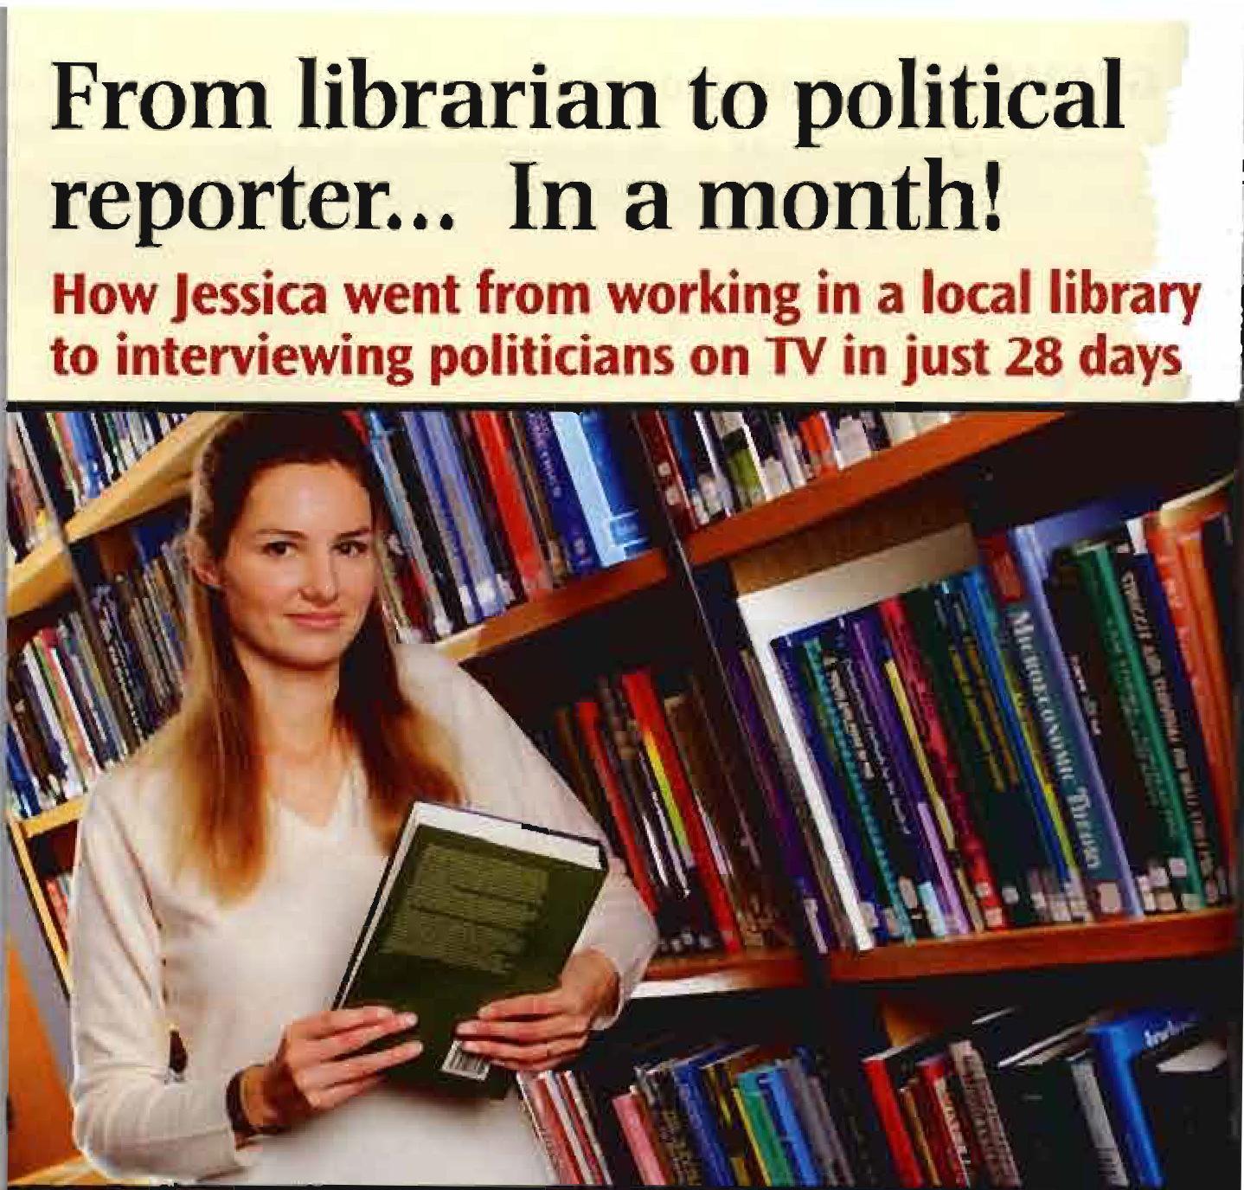
a. Read the title of the article. What kind of personality do you think you need to be a good political reporter?
You need to be extrovert, confident, etc

Slide 21
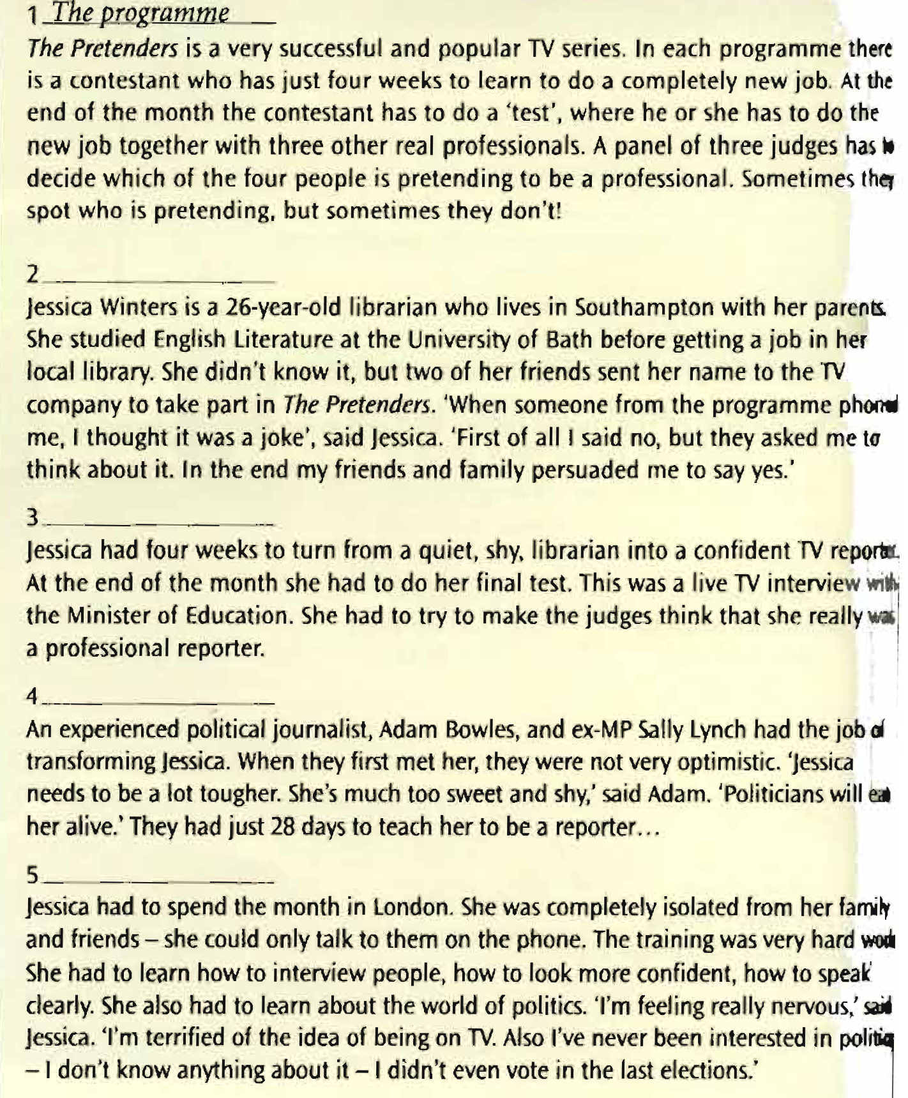
b. Read the text and put these headings
in the right place. (page78)
The challenge
The contestant
The teachers
The training
The programme
The contestant
The challenge
The teachers
The training

Slide 22
{{ Thank You }}

