Slide 1

Damascus University
Medical Preparatory English

Slide 2
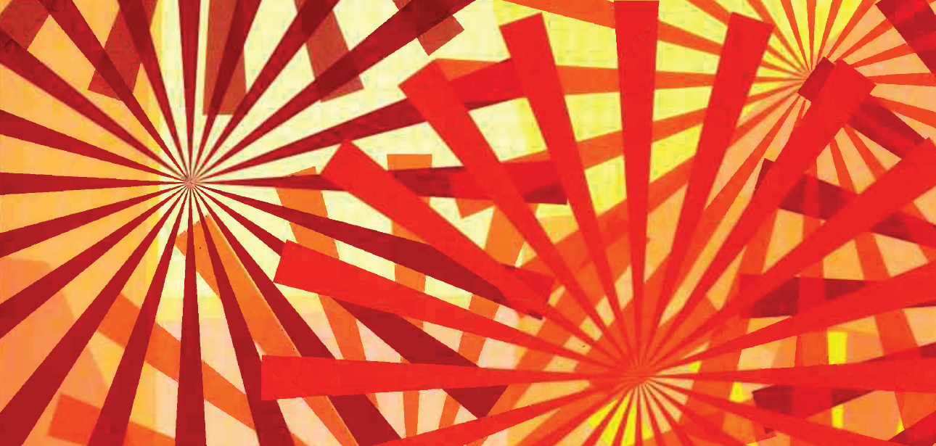

New English File
Upper-intermediate
Term 1 – Session 7

Slide 3
Grammar adverbs and adverbial phrases p. 28
2C
Read the four mini sagas and match them with the titles. You don’t need to use one of the titles. (Then click to check)
Generation gap
The last laugh
Good intentions
Written in the cards
Meeting the boss

Slide 4
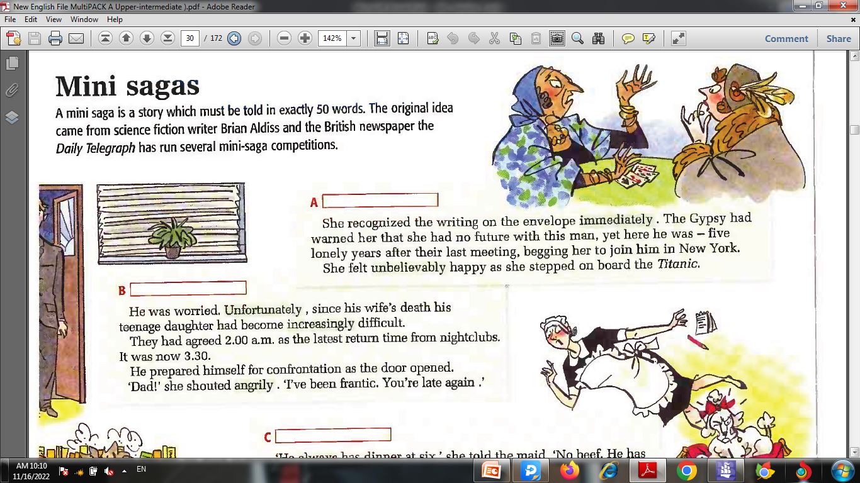
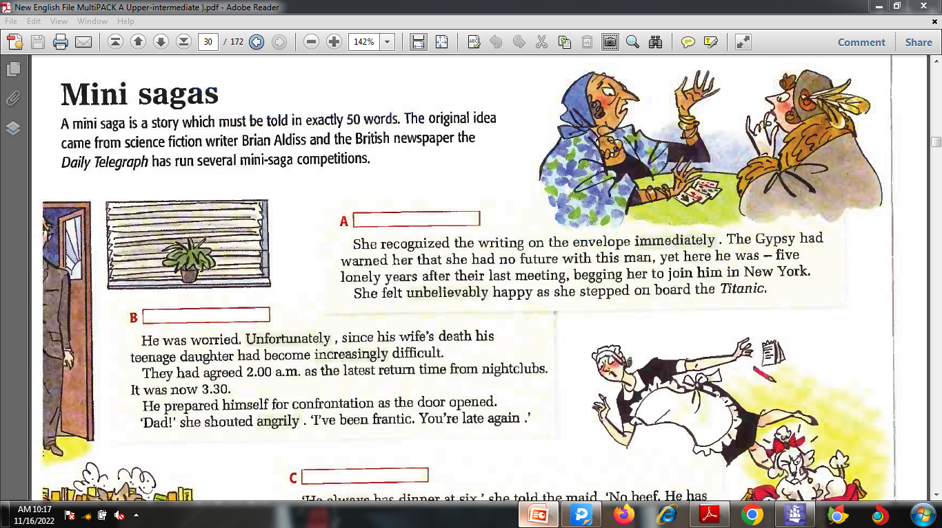
Incredibly short stories p. 28
2C
A. Written in the cards
B. Generation gap

Slide 5
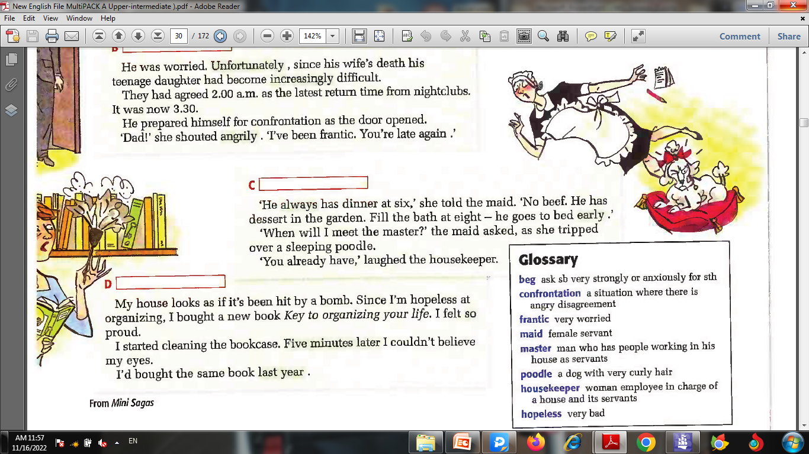
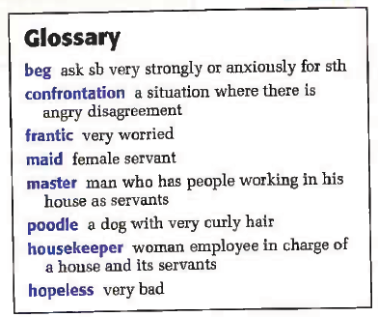
Incredibly short stories p. 28
2C
C. Meeting the boss
D. Good intentions

Slide 6

Grammar adverbs and adverbial phrases p. 28
2C
Look at the underlined adverbs or adverbial phrases in the stories. Think about what they mean and notice their position in the sentence. Write them in the correct place in the chart.
Types of adverbs
Time (When things happen, e.g. now) immediately __________ _______________ ____________
Manner (how you do something, e.g. slowly) ____________
Frequency (how often sth happens, e.g. sometimes) __________
Degree (describing / modifying an adjective, e.g. very) ____________ _____________ ____________
Comment (giving an opinion about a phrase, e.g. luckily) ____________
(Click to check)
early
five minutes later
last year
angrily
always
unbelievably
increasingly
so
unfortunately

Slide 7
Grammar adverbs and adverbial phrases p. 29
2C
Use your instinct. Where should the adverb go in these sentences? (Click to check)
1 He speaks three languages. fluently
2 I have breakfast during the week. hardly ever
3 My brother was in a car crash, but he wasn’t hurt. Fortunately
4 It’s often hot in Greece in July and August. extremely
5 When I know the date, I’ll call you. straight away
He speaks three languages fluently.
I hardly ever have breakfast during the week.
My brother was in a car crash, but fortunately he wasn’t hurt.
It’s often extremely hot in Greece in July and August.
When I know the date, I’ll call you straight away.

Slide 8
2C adverbs and adverbial phrases p. 134
Adverbs can describe an action (he walked slowly) or modify adjectives or other adverbs (it's incredibly expensive, he works very hard).
They can either be one word (often) or a phrase (once a week).
1. I don’t understand you when you speak quickly. The driver was seriously injured.
2. I never have breakfast. He’s always late.
3 They’ll be here soon. It rained all day yesterday.
Adverbs of manner (how somebody does something) usually go after the verb or phrase. However, with passive verbs they usually go in mid-position (before the main verb but after an auxiliary verb).
Adverbs of frequency go before the main verb but after the verb to be.
sometimes / usually / normally can go at the beginning of a sentence too.
Adverbs of time usually go at the end of a sentence or clause.

Slide 9
2C adverbs and adverbial phrases p. 134
4. I’ve nearly finished. We’re incredibly tired. He works a lot.
5. Unfortunately, we arrived half an hour late. Ideally, we should leave at 10.00.
Adverbs of degree (which describe how much something is done or to modify an adjective).
• extremely, incredibly, very, etc. are used with adjectives and adverbs and go before them.
• much and a lot are often used with verbs and go after the verb or verb phrase.
• a little / a bit can be used with adjectives or verbs, e.g. I’m a bit tired. She sleeps a bit in the afternoon.
Comment adverbs (which give the speaker’s opinion) usually go at the beginning of a sentence or clause. Other common comment adjectives are luckily, clearly, obviously, apparently, etc.
Most other adverbs go in mid-position, e.g. I just need ten more minutes. She didn’t even say goodbye.

Slide 10
2C Grammar Bank p. 135
Underline the adverb(s) or adverbial phrase(s) and correct the sentences which are wrong. (Click to check)
We’re going to be unfortunately late. X
Unfortunately, we’re going to be late.
We rarely go to bed before 11.30. ✓
1. She likes very much the theatre.
2. Dave was late for work yesterday.
3. Immediately the ambulance arrived.
4. They go usually jogging after work.
5. I was extremely tired last night.
X She likes the theatre very much.
✓
X The ambulance arrived immediately.
X They usually go jogging after work.
✓

Slide 11
2C Grammar Bank p. 135
6. They won easily the match because they played brilliantly.
7. I forgot your birthday almost.
8. We luckily had taken an umbrella.
9. She always eats healthily.
10. He’s been apparently sacked.
X They won the match easily because they played brilliantly.
X I almost forgot your birthday.
X Luckily we had taken an umbrella.
✓
X Apparently he’s been sacked.

Slide 12
2C Grammar Bank p. 135
b Put the adverbs in brackets in the normal position in these
sentences. (Click to check)
Sadly very
I don’t speak good English. (sadly, very)
1 The building was damaged in the fire. (badly, last week)
2 We need to do something. (obviously, quickly)
3 Ben is at his friend’s house. (often, in the evening)
4 She walked out and she didn’t say goodbye. (just, even)
The building was badly damaged in the fire last week.
Obviously we need to do something quickly.
Ben is often at his friend’s house in the evening.
She just walked out and she didn’t even say goodbye.

Slide 13
2C Grammar Bank p. 135
5. He drives fast. (always, extremely)
6. She danced at the ballet. (beautifully, last night)
7. She wasn’t injured when she fell. (luckily, seriously)
8. He broke his leg when he was skiing. (apparently, nearly)
9. My father sleeps in the afternoon. (usually, a bit)
He always drives extremely fast.
She danced beautifully at the ballet last night.
Luckily she wasn’t seriously injured when she fell.
Apparently he nearly broke his leg when he was skiing.
My father usually sleeps a bit in the afternoon.

Slide 14
VOCABULARY p. 29 confusing adverbs and adverbial phrases
Match each pair of adverbs with a pair of sentences.
(Click and check)
at the moment / actually __ in the end / at the end __
especially / specially __ late / lately __
ever / even __ near / nearly __
hard / hardly __ still / yet __
1 a Her French isn’t very good. She can ___________ say anything.
b He works very ___________ - at least ten hours a day.
2 a My boss always arrives ___________ for meetings.
b We haven’t seen Mary ___________. She’s been very busy.
3 a ___________ of the concert, everybody applauded.
b I didn’t want to go, but ___________ they persuaded me.
4 a I love all sports, but ___________ basketball.
b All her clothes are ___________ made for her in Paris.
3
4
2
1

Slide 15
VOCABULARY p. 29 confusing adverbs and adverbial phrases
Match each pair of adverbs with a pair of sentences.
(Click and check)
at the moment / actually __ in the end / at the end __
especially / specially __ late / lately __
ever / even __ near / nearly __
hard / hardly __ still / yet __
5 a She looks younger than me, but ________ she’s two years older.
b He’s unemployed ___________, but he’s looking for a job.
6 a It’s __________ stopped raining. We’ll be able to leave soon.
b Does your boyfriend live ____________ here?
7 a Have you found a flat _____________?
b No, we’re ____________ looking.
8 a Have you _____________ been to Texas? b I’ve been all over the USA - I’ve ____________ been to Alaska!
5
8
6
7

Slide 16
VOCABULARY p. 29 confusing adverbs and adverbial phrases
Now decide which adverb goes where and complete the sentences.
(Click and check)
at the moment / actually __ in the end / at the end __
especially / specially __ late / lately __
ever / even __ near / nearly __
hard / hardly __ still / yet __
1 a Her French isn’t very good. She can ___________ say anything.
b He works very ___________ - at least ten hours a day.
2 a My boss always arrives ___________ for meetings.
b We haven’t seen Mary ___________. She’s been very busy.
3 a ___________ of the concert, everybody applauded.
b I didn’t want to go, but ___________ they persuaded me.
4 a I love all sports, but ___________ basketball.
b All her clothes are ___________ made for her in Paris.
3
4
2
1
hardly
hard
late
lately
At the end
in the end
especially
specially

Slide 17
VOCABULARY p. 29 confusing adverbs and adverbial phrases
Match each pair of adverbs with a pair of sentences.
(Click and check)
at the moment / actually __ in the end / at the end __
especially / specially __ late / lately __
ever / even __ near / nearly __
hard / hardly __ still / yet __
5 a She looks younger than me, but ________ she’s two years older.
b He’s unemployed _____________, but he’s looking for a job.
6 a It’s __________ stopped raining. We’ll be able to leave soon.
b Does your boyfriend live ____________ here?
7 a Have you found a flat _____________?
b No, we’re ____________ looking.
8 a Have you _____________ been to Texas? b I’ve been all over the USA - I’ve ____________ been to Alaska!
5
8
6
7
actually
at the moment
nearly
near
yet
still
ever
even

Slide 18
VOCABULARY p. 29 confusing adverbs and adverbial phrases
Notes
hard = not easy; hardly = almost nothing
late = not early; lately = recently
at the end must be used with a noun, e.g. road, film; in the end is used on its own
specially goes with adjectives, e.g. specially designed,
especially = in particular
actually never means at the moment, it means the same
as in fact or to tell the truth
nearly and almost mean the same
Sentences like: I haven't found a job yet and I still
haven’t found a job mean more or less the same but the
use of still is more emphatic than not yet.

Slide 19
Reading
Reading for pleasure
When you read a longer text, e.g. a short story, you normally don’t read once quickly for gist and then re-read. You read, perhaps at a slightly slower speed, and keep going, focusing on following the story. It is also especially important to try to guess words from context. Only look up a word while you are reading if it’s holding you up or you really want to know what it means. Frequently looking up words may get in the way of your enjoyment. However, it can help to pause from time to time and look back, just to check you are clear about what is happening.

Slide 20
Little Brother TM
Read an American short story. Answer the questions 1-13.
Glossary
in a row one after the other
wrapped (up) covered with paper
pat hit lightly with your hand
limp not firm or strong
lap the top part of your legs that forms a flat surface when you are sitting down
bounce move (sb or sth) up and down, e.g. a ball
tottering walking like a baby, nearly falling over
tear (tore, torn) to break sth by pulling it apart, e.g. paper, material
keep up pv to move at the same speed as sb or sth
stacked up placed one on top of another
swat hit, (esp an insect) using your hand
howl make a long loud cry, like a dog or wolf
calm down pv become quiet and calm
wad into balls make e.g. paper into tight balls
let drop allow sth to fall

Slide 21
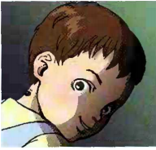
Little Brother TM
by Bruce Holland Rodgers
Peter had wanted a Little Brother™ for three Christmases in a row. His favourite TV commercials were the ones that showed just how much fun he would have teaching Little Brother™ to do all the things that he could
already do himself. But every year, Mommy had said that Peter wasn't ready for a Little Brother™. Until this year.
This year when Peter ran into the living room, there sat Little Brother™ among all the wrapped presents, babbling baby talk, smiling his happy smile, and patting one of the packages with his fat little hand. Peter was so excited that he ran up and gave Little Brother™ a big hug around the neck. That was how he found out about the button. Peter's hand pushed against something cold on Little Brother™'s neck, and suddenly Little Brother™
wasn't babbling any more, or even sitting up. Suddenly, Little Brother™ was limp on the floor, as lifeless as any ordinary doll.

Slide 22
Little Brother TM
Answer the questions. (Click to check)
1 What kind of toy is Little Brother™? What does the ™ mean?
2 What do you think ‘babbling’ means?
3 What happened when Peter hugged Little Brother™?
Little Brother™ is a robot doll. TM stands for trademark, which means a name or a symbol which a company uses for its products.
Talking like a baby, before he / she can say actual words.
He pressed a button which switched Little Brother™ off.

Slide 23
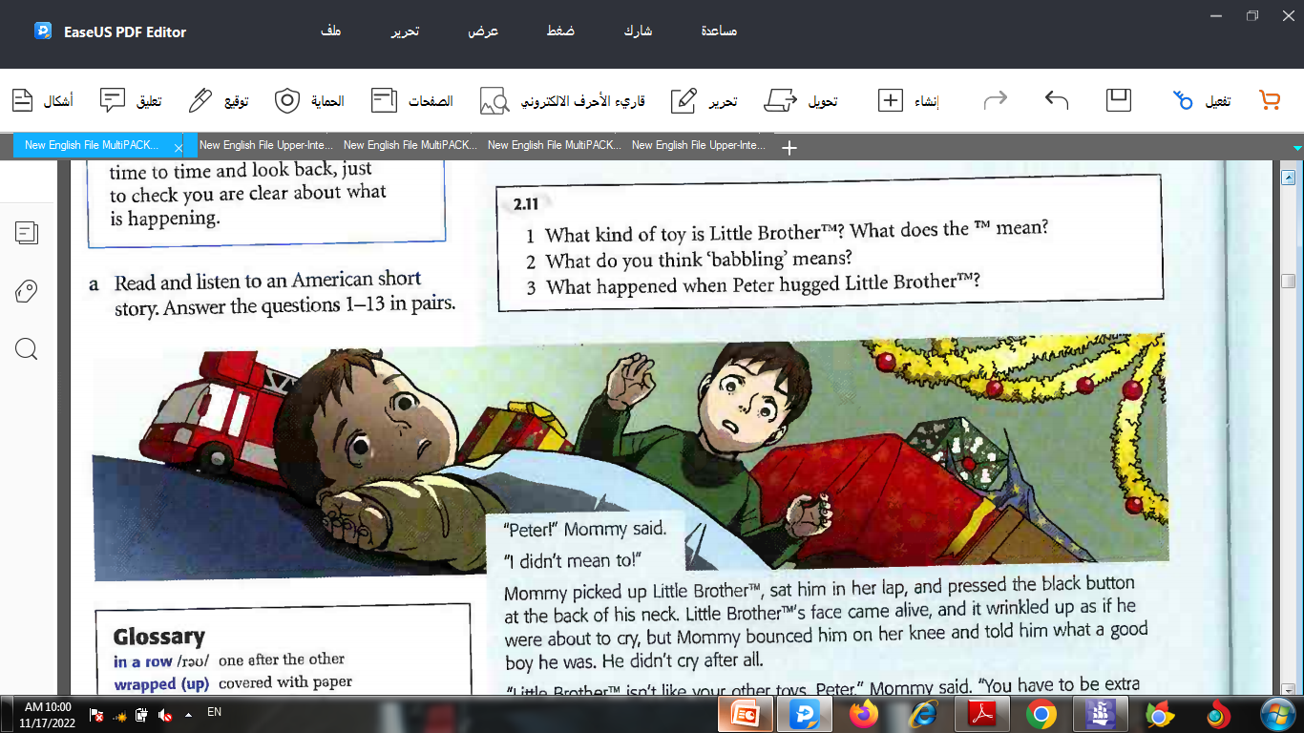
Mommy picked up Little Brother™, sat him in her lap, and pressed the black button at the back of his neck. Little Brother's face came alive, and it wrinkled up as if he were about to cry, but Mommy bounced him on her knee and told him what a good boy he was. He didn't cry after all.
"Little Brother™ isn't like your other toys, Peter," Mommy said. 'You have to be extra careful with him, as if he were a real baby."
She put Little Brother™ down on the floor, and he took tottering baby steps toward Peter. "Why don't you let him help open your other presents?"
So that's what Peter did. He showed Little Brother™ how to tear the paper and open the boxes. The other toys were a fire engine, some talking books, a wagon, and lots and lots of wooden blocks. The fire engine was the second-best present. It had lights, a siren, and hoses just like the real thing. There weren't as many presents as last year, Mommy explained, because Little Brother™ was expensive. That was okay. Little Brother™ was the best present ever! Well, that's what Peter thought at first

Slide 24
Little Brother TM
Answer the questions. (Click to check)
4. How did Peter’s mother stop Little Brother™ from crying?
5. What do you think ‘wrinkled up’ means?
6. What does the last line make you think?
She bounced him on her knee and told him what a good boy he was.
With the skin of the face in lines / folds, e.g. when you are going to cry.
It makes you think that later Peter will change his mind and decide Little Brother™ was not such a good present.

Slide 25
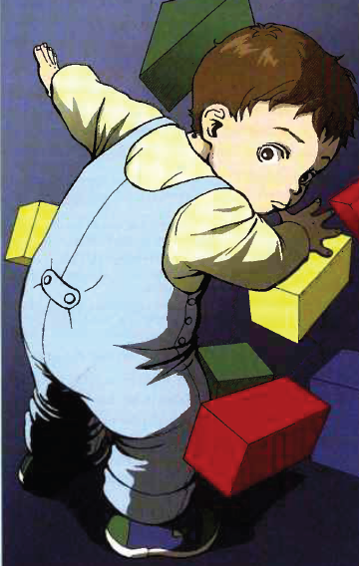
Little Brother TM
At first, everything that Little Brother™ did was funny and wonderful. Peter put all the torn wrapping paper in the wagon, and Little Brother™ took it out again and threw it on the floor. Peter started to read a talking book, and Little Brother™ came and turned the pages too fast for the book to keep up.
But then, while Mommy went to the kitchen to cook breakfast, Peter tried to show Little Brother™ how to build a very tall tower out of blocks. Little Brother™ wasn’t interested in seeing a really tall tower. Every time Peter had a few blocks stacked up, Little Brother™ swatted the tower with his hand and laughed. Peter laughed, too, for the first time, and the second. But then he said, ‘Now watch this time. I’m going to make it really big.’
But Little Brother™ didn’t watch. The tower was only a few blocks tall when he knocked it down.
‘No!’ Peter said. He grabbed hold of Little Brother™’s arm. ‘Don’t!’
Little Brother™’s face wrinkled. He was getting ready to cry.
Peter looked toward the kitchen and let go. ‘Don’t cry,’ he said.
‘Look, I’m building another one! Watch me build it!’
Little Brother™ watched. Then he knocked the tower down.
Peter had an idea.

Slide 26
Little Brother TM
Answer the questions. (Click to check)
7. What funny things did Little Brother™ do at first?
8. What do you think ‘grabbed hold of’ means?
9. What do you think Peter’s idea was?
He took the torn wrapping paper out of the wagon and
threw it on the floor; he turned the pages of Peter’s book
too fast.
Suddenly took and held hard.
Your own ideas.

Slide 27
Little Brother TM
When Mommy came into the living room again, Peter had built a tower that was taller than he was, the best tower he had ever made. ‘Look!’ he said.
But Mommy didn’t even look at the tower. ‘Peter!’ She picked up Little Brother™, put him on her lap, and pressed the button to turn him back on. As soon as he was on, Little Brother™ started to scream. His face turned red.
‘I didn’t mean to!’
‘Peter, I told you! He’s not like your other toys. When you turn him off, he can’t move but he can still see and hear. He can still feel. And it scares him.’
‘He was knocking down my blocks.’
‘Babies do things like that,’ Mommy said. ‘That’s what it’s like to have a baby brother.’
Little Brother™ howled.
‘He’s mine,’ Peter said too quietly for Mommy to hear.
But when Little Brother™ had calmed down, Mommy put him back on the floor and Peter let him toddle over and knock down the tower.
Mommy told Peter to clean up the wrapping paper, and she went back into the kitchen. Peter had already picked up the wrapping paper once, and she hadn’t said thank you. She hadn’t even noticed.
Peter wadded the paper into angry balls and threw them one at a time into the wagon until it was almost full.
That’s when Little Brother™ broke the fire engine. Peter turned just in time to see him lift the engine up over his head and let it drop.

Slide 28
Little Brother TM
Answer the questions. (Click to check)
10. Why didn’t Peter’s mother even look at the tower?
11. What makes Little Brother™ a different kind of toy?
12. Why did Peter feel annoyed with his mother?
13. What do you think is going to happen next?
Because she saw that Little Brother™ was on the floor and had been switched off.
Even when he is switched off, he can still see, hear and feel.
Because she hadn’t noticed his tower and hadn’t noticed that he had already picked up the wrapping paper once.

Slide 29
Phrasal verbs in context File 2 p. 157
Complete the phrasal verbs from File 2 with a verb in the correct form. Click to check your answers.
burst knock leave put turn
Everyone ______ out laughing when Jimmy arrived wearing a large white hat.
Can you ______ the TV up? I can’t hear it with the children shouting in the kitchen.
Don’t _______ anything behind when you get off the plane.
What a pity! They’re going to _____ down our local cinema and build a car park.
If you take any of my things, please _____ them back when you’ve finished with them.
burst
turn
leave
knock
put

Slide 30


