Slide 1

New English File
Intermediate
Session 10

Slide 2
Unit 3
Part B
1 READING

Slide 3
Read the text and answer the questions.
Judging by appearances
Do I really look like this?
Our passport (or identity card) photo is the photo we show to the largest number of different people during our lives. But how happy are we with our photo? Do we make an effort to get a good one? According to research done by the US printer company Lexmark, the answer varies according to nationalities. It seems that the Italians are the most embarrassed about their passport photo (21% said they didn’t like showing it to other people). On the other hand, 98% of Norwegians said they were happy with their photos. And the French spend most time trying to get the perfect photo (sometimes spending an hour in the photo booth!). We asked three British media celebrities how they felt about their passport photos. ..

Slide 4
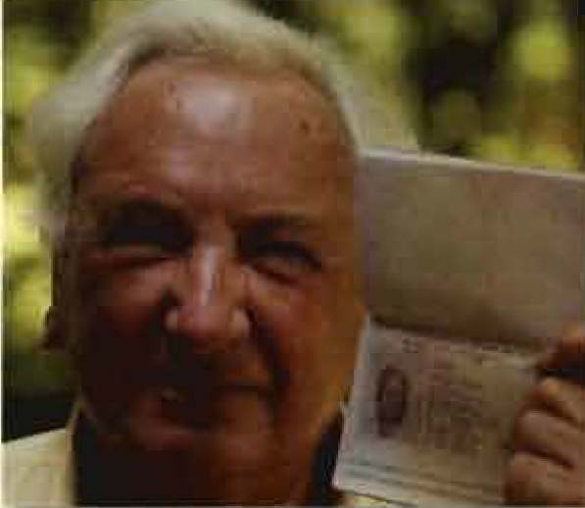
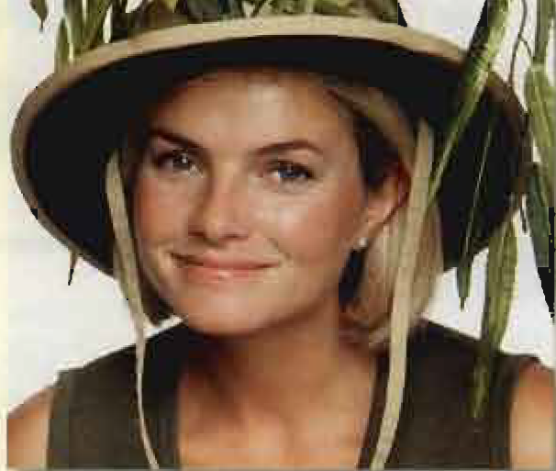
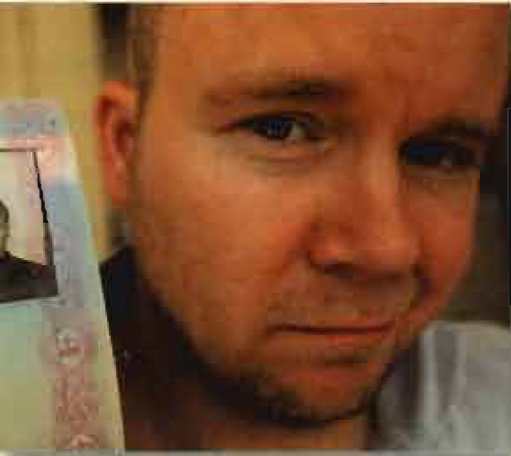
Michael Winner / Film Director ‘I used to be very proud of my passport photo,' said Michael Winner. 'For more than forty years I looked like an elegant film director.’ But recently Michael renewed his passport and took a new photo in a photo booth. 'Now I look like a drug dealer”, he says.
Ruth England / TV holiday show presenter Ruth England spends her life travelling and showing her passport photo to passport officials around the world. She confessed, ‘Once I had a passport photo where I looked really hideous and so I deliberately 'lost’ my passport and got a new one. For my latest passport, I took several photos and I chose the best one. I quite like it. I've had much worse ones.’
Toby Young / author and journalist Toby Young said, ‘I’m often stopped when I go through passport control because I don’t look like my passport photo at all. In my photo I had a lot more hair but now I'm bald . No one believes it is me. So, now I have two possibilities: take a wig with me every time I travel or get a new passport photo!'

Slide 5
Read the first paragraph of the article and answer the questions.
1. Why is our passport photo important?
Because it is the photo of ourselves that we most show to others.
2. Which nationality are the least happy with their photo?
3. Which are the happiest?
4. Which nationality are the vainest?
The Italians
The Norwegians
The French

Slide 6
Look at the highlighted words in the text and choose the correct meaning.
Research : a a study b a book
Embarrassed : a feeling uncomfortable b feeling happy
Celebrities : a journalists b famous people
Proud : a feeling pleased with yourself b feeling unhappy with yourself
Hideous: a very beautiful b very ugly
Bald: a without hair b with a lot of hair
Wig: a a kind of document b false hair

Slide 7
HOW WORDS WORK...
Look at two sentences from the text:
1. Once I had a passport photo where I looked really hideous.
2. I looked like an elegant film director.
You can use the verbs look and look like to talk about a person’s appearance.
Use look + adjective (or an age).
Use look like + a noun or pronoun.
Complete the sentences with look or look like in the correct form.
This photo doesn’t ______________ you at all. When was it taken?
You _________ very young in this photo. How old were you?
Your brother ________________ a rugby player. He’s enormous.
You ___________tired. Why don’t you go to bed?
look like
look
looks like
look

Slide 8
Unit 3
Part B
2 VOCABULARY

Slide 9
Describing people
1. Age
Complete the phrases. // -mid // about // early // late // forties
He’s ____________ 20. =19, 20, or 21
He’s in his ____________. = between 41 and 49
She’s in her ____________ thirties. = between 34 and 36
She's in her ____________ sixties. = between 67 and 69
He is his ____________seventies. = between 71 and 73
about
forties
mid-
late
early

Slide 10
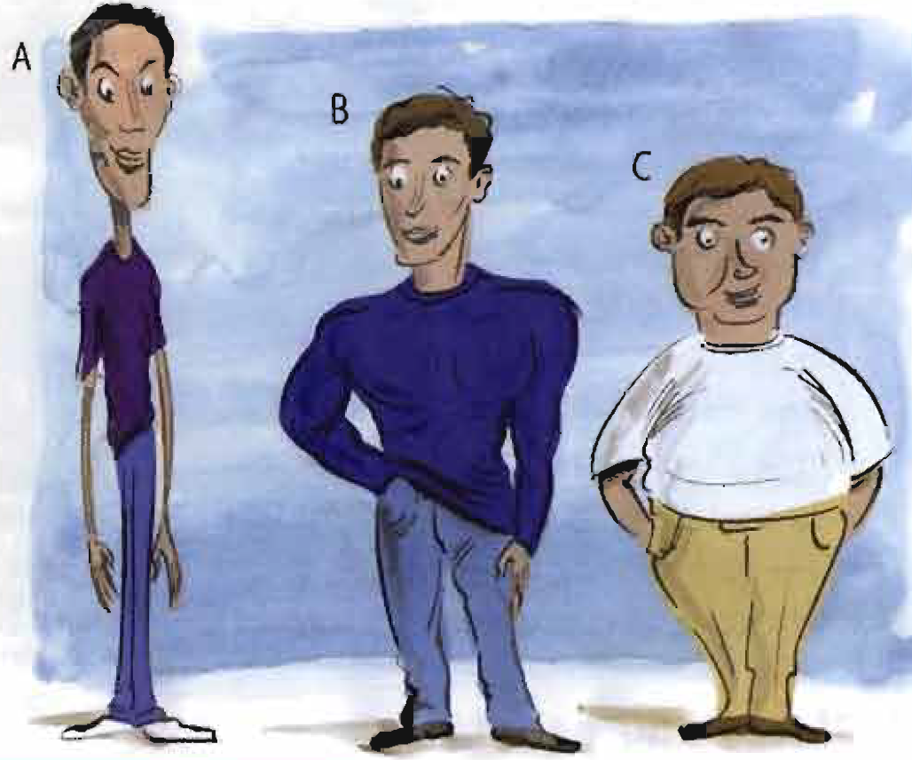
2. Height and build
Match the sentences and pictures A-C.
____He's tall and slim.
____He’s short and a bit overweight.
____He's medium height and well built.
Thin and slim are both the opposite of fat, but slim = thin in an attractive way.
A
C
B

Slide 11
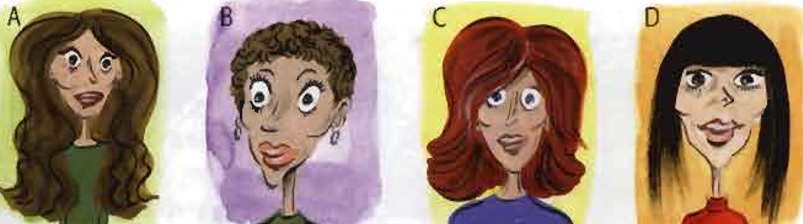
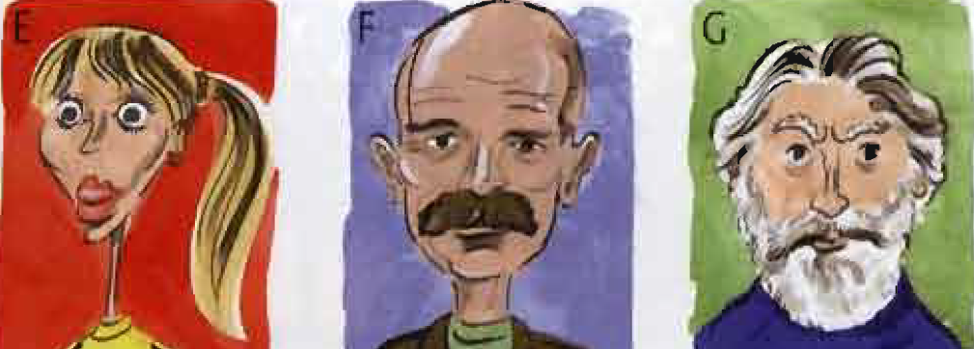
3. Hair
Match the sentences and pictures.
She has fair blonde hair and a ponytail. ____
She has long wavy hair. ____
He has grey hair and a beard. ____
She has short brown curly hair. ____
She has red shoulder-length hair. ____
He’s bald and has a moustache. ____
She has straight dark hair and a fringe. ____
E
A
G
B
C
F
D

Slide 12
4. General adjectives
Are these adjectives (+) or (-)? Are they used for men, women, or both? Write M, W, or B.
attractive ____ ____
beautiful ____ ____
good-looking ____ ____
handsome ____ ____
plain ____ ____
pretty ____ ____
ugly ____ ____
+
B
Remember
What does he/she look like? = Can you describe his / her appearance?
What is he /she like? = Can you describe his / her personality?
+
W
+
B
+
M
-
B
+
W
-
B

Slide 13
Unit 3
Part B
3 GRAMMAR

Slide 14
Must, May, Might, Can't (Deduction)
when you are sure something is true: must
They must be out. There aren't any lights on.
She must have a lot of money. She drives a Porsche.
when you think something is possibly true: may/might
His phone’s switched off. He might be on the plane now.
She might not like that skirt. Its not her style.
She’s not at home. She may be working.
He hasn’t written. He may not have my address.

Slide 15
when you are sure something is impossible / not true: can’t
He can’t be ill. I saw him at the gym.
They can’t be Italian. They’re speaking to each other in Spanish.
We often use must, may / might, and can’t in order to say how sure or certain we are about something (based on the information we have).
In this context, the opposite of must is can’t NOT mustn't.

Slide 16
Match the sentences.
He must be over 70. ___ He can't be at university. ___ He may not remember me. ___ He might like this book. ___ He must be very shy. ___ He can't be serious. ___ He may be in bed already. ___ He might not be at home yet. ___ He must have a computer. ___ He can’t be a good footballer. ___ | He hasn’t seen me for ages. He sometimes sends me emails. He must be joking. He’s interested in history. He sometimes works late. He gets up very early. He’s only 16. He's not fit enough. He retired 10 years ago. He never opens his mouth.
I
G
A
D
J
C
F
E
B
H

Slide 17
Complete with might/may (not), must, or can’t.
1. This sauce is really spicy. It _________ have chilli in it.
2. A: What music is this? B: I’m not sure but it _________ be Mozart.
3. She looks very young. She _________ be more than 16.
4. I'm not sure why she hasn’t phoned. She _________ have my new number.
5. They _________ have a lot of money. They live in an enormous house.
6. He _________ be away. His car is outside his house.
7. I _________ be a size 44! I'm usually a 40 or 42.
8. It _________ be true! I saw it on the news.
must
might/may
can’t
might/may not
must
can’t
can’t
must

Slide 18
{{ Thank You }}

