Slide 1

New English File
Intermediate
Session 2

Slide 2
Unit 5
Part B
1 GRAMMAR

Slide 3
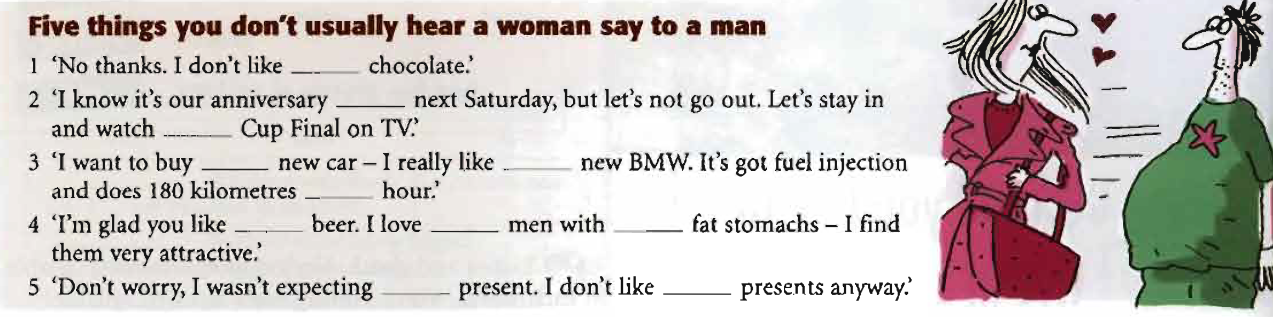
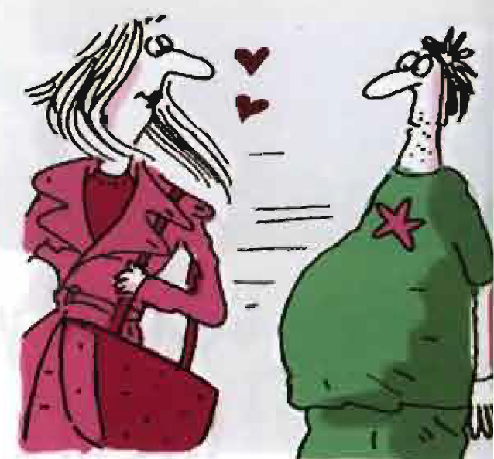
articles: a / an, the, no article
Read the text and complete it with a / an, the, X = (no article)
X
X
the
a
the
an
X
X
X
a
X

Slide 4
articles: a / an, the, no article
Use a / an with singular countable nouns
- the first time you mention a thing / person.
I saw an old man with a dog.
- when you say what something is.
It is a nice house.
- when you say what somebody does.
She’s a lawyer.
- in exclamations with What...!
What an awful day!
- in expressions like
“three times a week”

Slide 5
Use the
- when we talk about something we’ve already mentioned.
I saw an old man with a dog, and the dog was barking.
- when there is only one of something.
The moon goes round the sun.
- when it’s clear what you’re referring to.
He opened the door.
- with places in a town, e.g. cinema and theatre.
I’m going to the cinema.
- with superlatives.
It’s the best restaurant in town.

Slide 6
Don’t use the
when you are speaking in general (with plural and uncountable nouns).
Women talk more than men.
Love is more important than money.
with some nouns (e.g. home, work, school, church) after at / to / from.
She’s not at home today.
I get back from work at 5.30.
before meals, days, and months.
I never have breakfast on Sunday.
before next / last + days, week, etc.
See you next Friday.

Slide 7
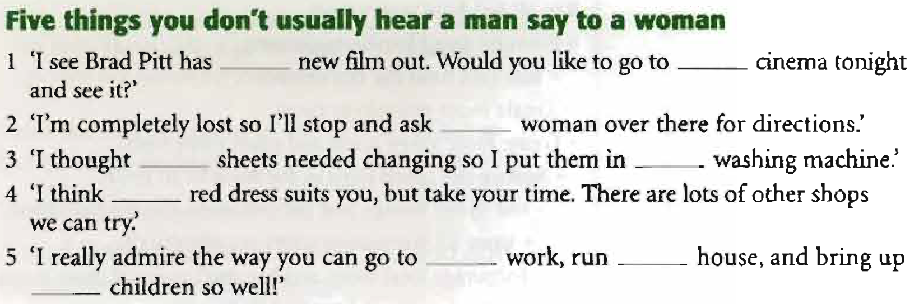
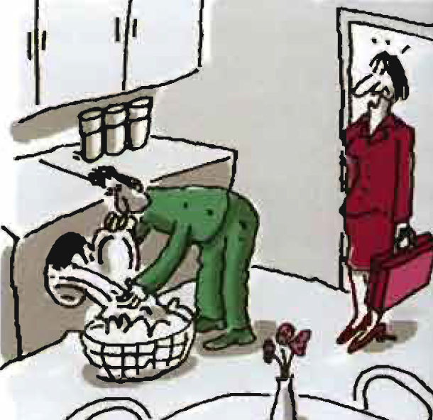
Read the text and complete it with a / an, the, X = (no article)
a
the
the
the
the
the
X
the
the

Slide 8
Unit 5
Part B
2 READING

Slide 9
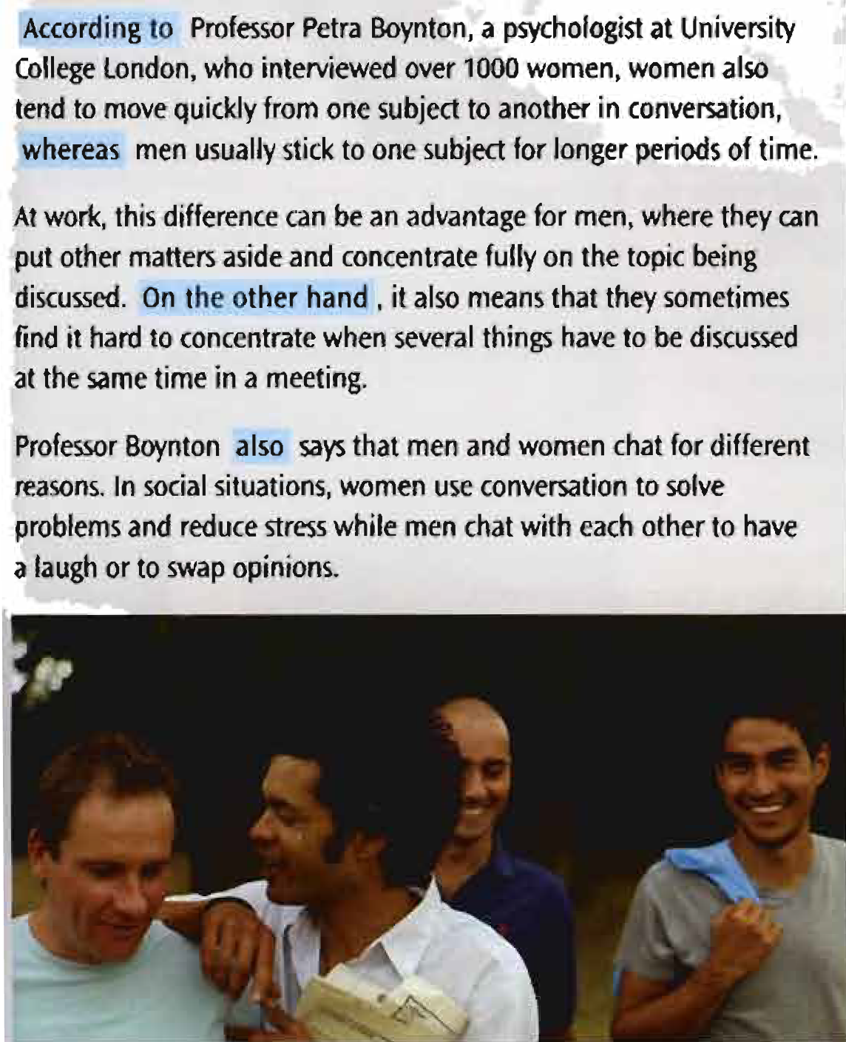
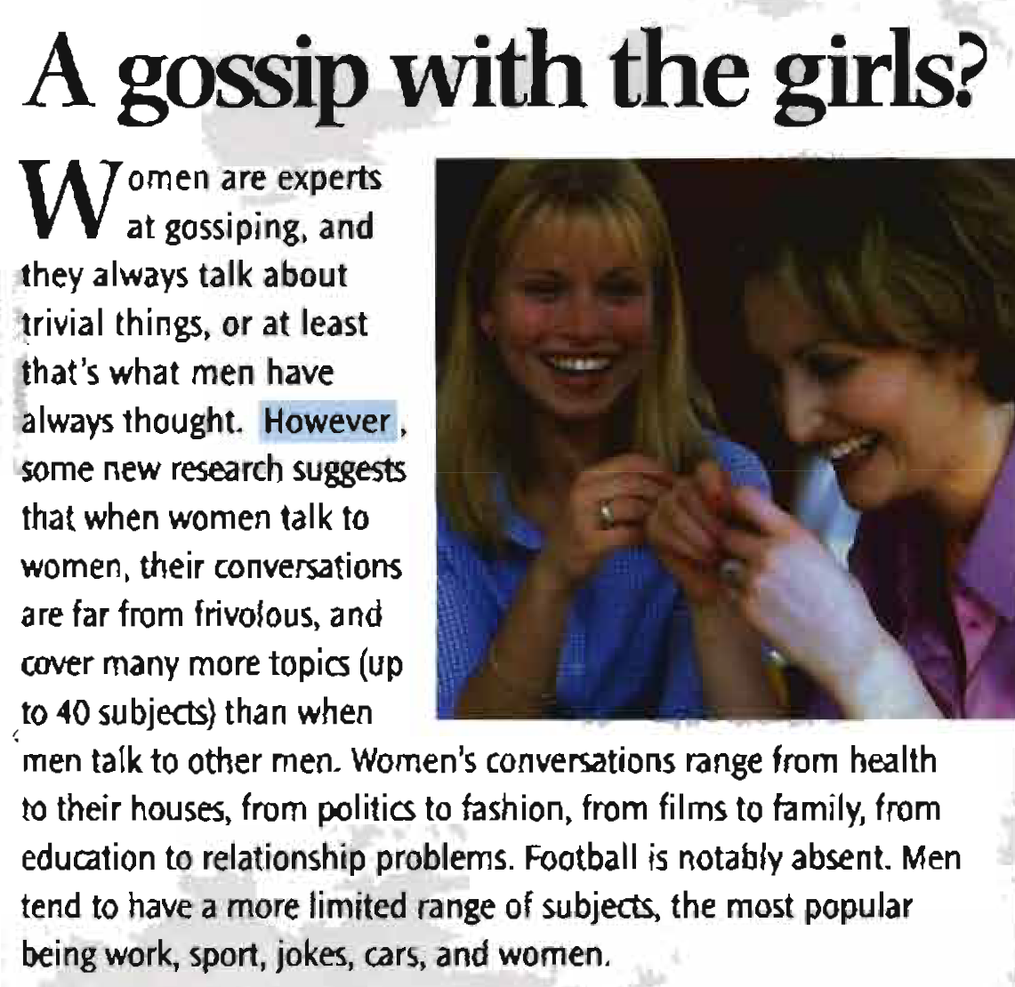
Read the article then answer the questions

Slide 10
What does the writer say? Choose a, b, or c.
1. When women talk to each other they generally talk about ____.
a unimportant things b very serious things c many different things
2. Men ____ as women.
a don't talk as much b don't talk about as many things c don't work as much
3. In conversation women ____ than men.
a talk more quickly b change the subject more often c talk more about work
4. At work, if there is a meeting which focuses on one subject,____.
a men will probably concentrate better than women
b women will probably concentrate better than men
c men and women will both concentrate
5. One of the reasons why women talk to each other is ____.
a to relax b to exchange ideas c to tell jokes

Slide 11
How words work
1. Look at the highlighted words and phrases in A gossip with the girls? Which one(s) do we use…? (However, According to, whereas, On the other hand, also)
1. to compare and contrast two facts or opinions ______________
2. to introduce an opposite point o f view ______________
3. to introduce some extra information ______________
4. to explain w ho says or believes something ______________
whereas
However, On the other hand
also
According to

Slide 12
2. Complete the sentences with one of the words or phrases. Sometimes there are two possibilities.
1. My sister plays tennis and she ____ goes swimming once a week.
2. Travelling by yourself can be fun. ____________________ it is often more dangerous.
3. __________ doctors, we shouldn't drink too much coffee.
4. Dogs are very affectionate, ________ cats are more independent.
5. New technology makes our lives easier. _____________________ , it can be difficult to learn to use.
also
However, On the other hand
According to
whereas
However, On the other hand

Slide 13
Unit 5
Part B
3 VOCABULARY

Slide 14
Verbs and adjectives + prepositions
Men think that women always talk about trivial things.
In fact, they cover more topics than when men talk to men.
Complete the sentences with the appropriate prepositions
1. Do you often talk ____ a friend ____ your problems?
2. Do you often think ____ the future?
3. Do you often have to wait ____ a bus or train?
4. Do you agree ____ your friends about politics?
5. What dish or dishes do you usually ask ____ in a restaurant?
to
about
about
for
with
for

Slide 15
Complete the sentences with the appropriate prepositions
6. Have you ever borrowed money ____ your family?
7. Do you often write emails ____ English-speaking people?
8. How often do you listen ____ classical music?
9. Do you think a man should pay ____ dinner on a first date?
10. Do you know anyone who works ____ a multinational company?
11. Do you know anyone who works ____ a DJ?
12. Are you going to apply ____ a job soon?
from
to
to
for
for
as
for

Slide 16
Complete the sentences with the appropriate prepositions
13. Are you good ____ sport?
14. Are you bad ____ remembering birthdays?
15. Are men’s hobbies very different ____ women’s hobbies?
16. Are you afraid ____ any insects?
17. Are you interested ____ fashion?
18. Are you worried ____ anything at the moment?
at
at
from
of
in
about

Slide 17
{{ Thank You }}

