Slide 1

New English File
Intermediate
Session 9

Slide 2
Unit 3
Part A
1 VOCABULARY

Slide 3
Modern Manners
Read the following sentences, and guess the meaning of the bold words.
He's dialling a number.
She’s texting a friend.
He’s just hung up.
She’s choosing a new ring tone.
He’s calling back.
The lines engaged / busy.
Calling
Send a text message
Ended the call
the sound that a phone makes when someone calls it
To phone someone who phoned you earlier
you called a person talking at that moment with someone else

Slide 4
Complete the sentences.
1. If you want to send a message to someone, you can _______________ them.
2. When you call somebody and they are already talking, the line is __________
3. When you finish a phone call you _________________ up.
4. If you want to call someone, you first have to _________________ their number, by pressing some keys.
5. The sound your mobile makes when someone calls you is a ______________
6. If you phone someone and they don’t answer, you can _________________ later.
7. You must remember to _________________ your mobile when you go into a theatre or concert hall.
8. If you use your phone when you are driving, you must use a _____________ phone.
9. If you want to dial a number quickly, you can use _________________ dialling.
text
busy
hang
dial
ring tone
call back
switch off
hand free
speed

Slide 5
Unit 3
Part A
2 GRAMMAR

Slide 6
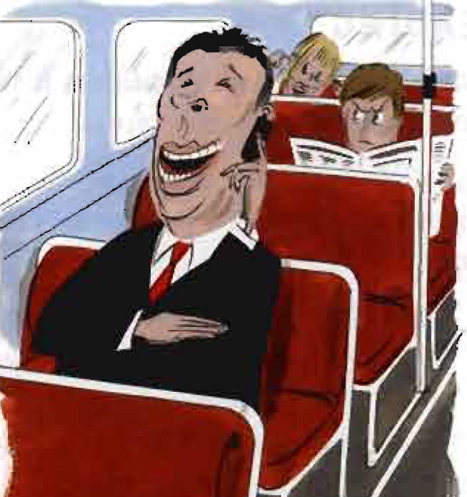
Must, have to, should (for obligation)
Look at the picture and answer the questions.
What’s the man doing? Does it annoy you when people
do this?
Does this happen a lot in your country?
What other things do people do with mobiles that
annoy you?

Slide 7
Match these sentences with their meaning.
1. You shouldn’t answer the phone if you’re talking to a shop assistant. ____ 2. You have to switch off your mobile when you fly. ____ 3. You mustn’t use your phone until you get off the plane. ____ 4. You don’t have to shout - the other person can hear you. ____ 5. You should talk really quietly if you are in a public place. ____ | A You don’t need to do this. It isn’t necessary. B Don’t do this. It isn’t allowed /permitted C Do this because it’s a rule or the law. D I think it's a bad thing to do this. E I think it’s a good thing to do this.
D
C
B
A
E

Slide 8
Must / have to / should for obligation
You have to wear a seatbelt in a car.
Do you have to work on Saturdays?
I had to wear a uniform at my primary school.
I’ll have to get up early tomorrow. My interview is at 9.00.
I must remember to phone Emily tonight - it’s her birthday.
You must be on time for class tomorrow - there's a test.

Slide 9
Must and have to have a very similar meaning.
Have to is more common for general, external obligations, for example rules and laws.
Must is more common for specific (i.e. on one occasion) or personal obligations.
Compare:
I have to wear a shirt and tie at work (It’s the rule in this company).
I must buy a new shirt - this one is too old now (It's my own decision).
Have to is a normal verb and it exists in all tenses.
Must is a modal verb. The only forms are must and mustn't.
You can also use have to or must for strong recommendations, e.g. You have to / must see that film - it’s fantastic.

Slide 10
No obligation / necessity: don’t have to
You don't have to pay for the tickets. They're free.
You don’t have to go to the party if you don't want to.
Prohibition: mustn't (+ infinitive)
Don't have to and must not are completely different.
Compare:
You mustn’t drive along this street. = (It’s prohibited) against the law.
You don’t have to drive - we can get a train. = You can drive if you want to but it's not necessary / obligatory.
You can often use can’t or not allowed to instead of mustn’t:
You mustn’t park here.
You can't park here. You’re not allowed to park here.
Have got to is often used instead of have to in spoken English, e.g. I've got to go now.
It's very late.

Slide 11
Advice or opinion: should / shouldn’t (+ infinitive)
You should take warm clothes with you to Dublin. It might be cold at night.
I think the government should do something about unemployment.
Should is not as strong as must / have to. We use it to say if we think something is the right or wrong thing to do.
Should is a modal verb. The only forms are should and shouldn’t.
You can also use ought to and ought not to instead of should / shouldn’t
You should take an umbrella with you. /You ought to take an umbrella with you.

Slide 12
Underline the correct form.
1. You shouldn’t / mustn’t drink that water. It’s not safe.
2. We mustn't / don't have to hurry. We have plenty of time.
3. You must/ should remember to write the report. The boss will be furious if you forget.
4. The exhibition was free so I hadn’t to / didn’t have to pay.
5. Do you have to/ Should you wear a uniform at your school?
6. We must / had to wait two hours at security and nearly missed our flight.
7. Had you to / Did you have to do a lot of homework when you were at school?
8. I think people who live in flats mustn’t / shouldn’t have dogs.
9. She's allergic to dairy products so she mustn’t / doesn’t have to eat anything made from milk.

Slide 13
Complete the second sentence with two or three words so it means the same as the first.
1. Smoking is prohibited here.
You smoke here.
2. It isn’t a good idea to go swimming after a big meal.
You swimming after a big meal.
3. Was it necessary for them to pay cash?
Did pay cash?
mustn't
shouldn’t go
they have to

Slide 14
Complete the second sentence with two or three words so it means the same as the first.
4. The meeting isn’t obligatory.
You go to the meeting.
5. It's bad manners to talk loudly on a mobile on a train.
People quietly on their mobile on a train.
6. Lorries are not allowed to go on this road.
Lorries on this road.
don’t have to
should talk
mustn't go /drive

Slide 15
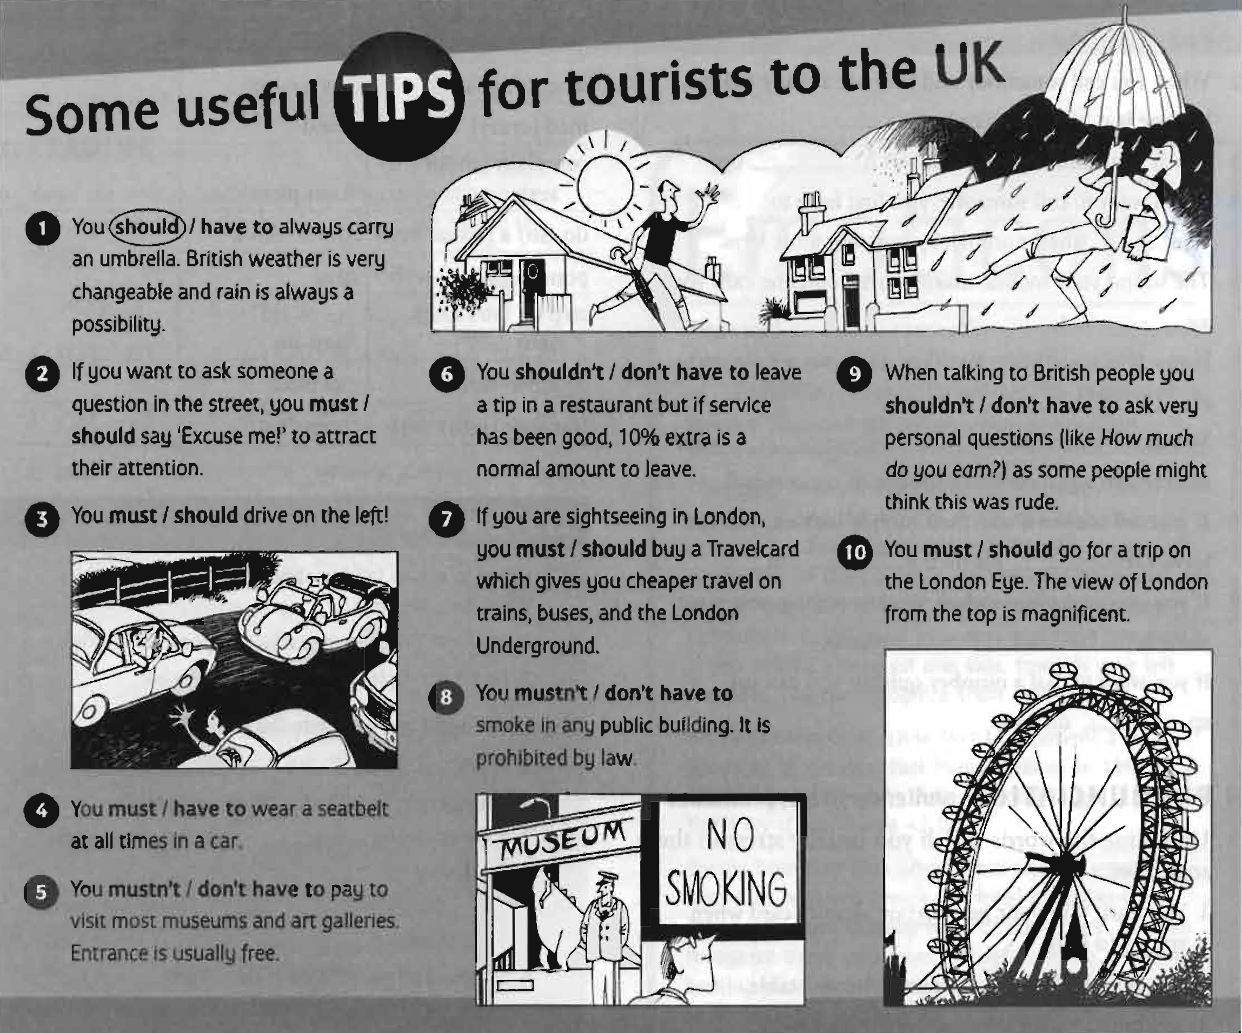

Slide 16
Unit 3
Part A
3 READING

Slide 17
Read Culture shock and answer the questions.
Good manners are always good manners. That's what Miranda Ingram, who is English, thought until she married Alexander, who is Russian.
When I first met Alexander and he said to me, in Russian, 'Nalei mnye chai - pour me some tea’, I got angry and answered, 'Pour it yourself'. Translated into English, without a 'Could you...?' and a 'please', it sounded really rude to me. But in Russian it was fine - you don't have to add any polite words.
However, when I took Alexander home to meet my parents in the UK, I had to give him an intensive course in pleases and thank yous (which he thought were completely unnecessary), and to teach him to say sorry even if someone else stepped on his toe, and to smile, smile, smile.
Another thing that Alexander just couldn't understand was why people said things like, 'Would you mind passing me the salt, please?' He said, 'It's only the salt, for goodness sake! what do you say in English if you want a real favour?’

Slide 18
He also watched in amazement when, at a dinner party in England, we swallowed some really disgusting food and I said, 'Mmm...delicious'. In Russia, people are much more direct. The first time Alexander's mother came to our house for dinner in Moscow, she told me that my soup needed more flavouring. Afterwards when we argued about it my husband said, 'Do you prefer your dinner guests to lie?’
Alexander complained that in England he felt 'like the village idiot' because in Russia if you smile all the time people think that you are mad. In fact, this is exactly what my husband's friends thought of me the first time I went to Russia because I smiled at everyone, and translated every 'please' and 'thank you' from English into Russian!
At home we now have an agreement If we're speaking Russian, he can say 'Pour me some tea', and just make a noise like a grunt when I give it to him. But when we're speaking English, he has to add a 'please', a 'thank you', and a smile.

Slide 19
According to the article, are the sentences T (true) or F (false)?
Miranda got angry because her husband asked her to make the tea. ____
Miranda had to teach him to say sorry when something wasn’t his fault. ____
Her husband thinks English people are too polite. ____
Alexander wasn’t surprised when people said they liked the food at the dinner party. ____
The food was delicious. ____
Miranda didn’t mind when her mother-in-law criticized her cooking. ____
Alexander thought his mother was right. ____
In Russia it isn’t normal to smile all the time when you speak to someone. ____
His Russian friends thought Miranda was very friendly because she smiled a lot. ___
Alexander never says thank you for his tea when he and Miranda are speaking in Rurssian. ____
F
T
T
F
F
F
T
T
F
T

Slide 20
Complete the sentences with words from the article.
1. _____________on someone's foot or toe (by accident)
2. _____________ some wine into a glass or tea into a cup
3. _____________ a noise, like a grunt
4. _____________ food (so that it goes from your mouth to your stomach)
5. _____________ a word from English into Russian
Step
Pour
Make
Swallow
Translate

Slide 21
{{ Thank You }}

