Slide 1

New English File
Intermediate
Session 7

Slide 2
Unit 2
Part C
1 READING

Slide 3
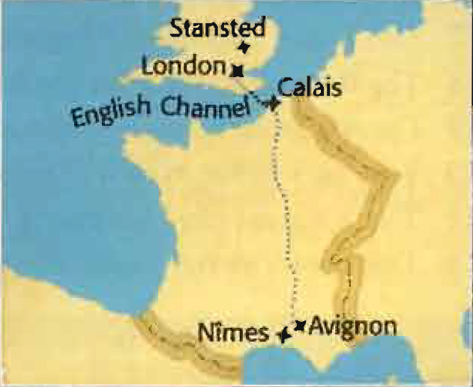
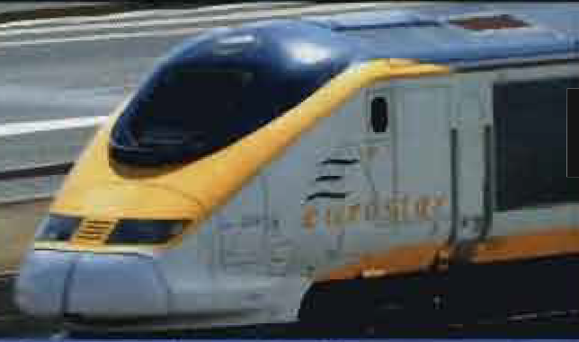
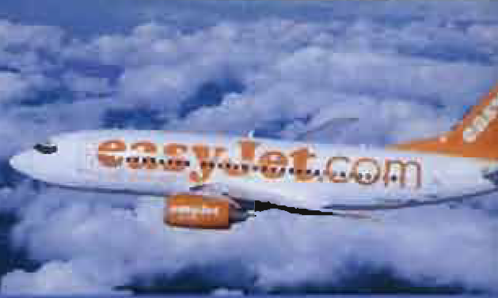
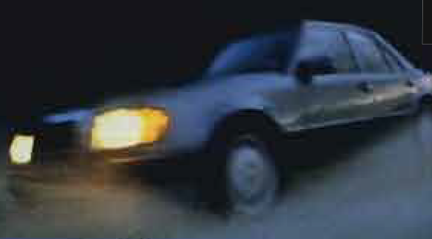
Race to the sun
Every year thousands of British tourists travel to the South of France for their summer holiday. But what is the best way to get there by car, by train, or by plane? A British newspaper sent three of its journalists to find out. They had to travel from their homes in London to Avignon.
All three travelers set off one Saturday morning in July.
Charles went by train (the Eurostar). Rosemary flew with a ‘cut price’ airline. Martin travelled by car.

Slide 4
By Plane
At 4.15 a.m. a taxi picked me up and took me 32 miles to Stansted airport. Although it was early morning, there was a lot of traffic and I arrived later than I had planned. I took my luggage to check in and asked for a window seat but the woman said there were no seat numbers.
When I got to security I saw that there was an enormous queue. I began to worry that I might miss my flight because the boarding limit is 40 minutes before take-off. I had to run to gate 40 and I arrived completely out of breath.
We boarded. Because there are no seat numbers on these flights, everybody tries to get on as quickly as they can. I sat next to a friendly Frenchman. We took off and soon I was looking down on London. There was no meal, not even coffee, but we landed 10 minutes ahead of schedule.
I only had to wait twenty minutes for my luggage. Then I walked outside into bright sunshine and waited for the bus to Avignon, about 40 kilometres away. I didn't have to wait long and the bus took 45 minutes. It was only 11.00* and I had the whole day in front of me. My ticket cost £63, and I gave the journey 5/10 for comfort and 5/10 for convenience.

Slide 5
By Train
At 7.10 a.m. I arrived at Waterloo station by taxi. It took me just 30 minutes from home. I bought the papers and walked to the platform. I got on and found my seat. As soon as we started moving, I went to find the buffet car and had a cup of coffee.
I looked out of the window. Although we were moving at 540 kilometres an hour, the journey was smooth and relatively quiet. The part where we travelled under the English Channel took just 22 minutes. Soon I was looking at the fields and farmhouses of France. The sun was shining. I closed my eyes and went to sleep.
I arrived on time! I picked up my suitcase and followed the Exit signs. It was great not to have to wait ages for my luggage or to worry about getting a bus or taxi to the city centre.
Just outside the station I looked up and saw the medieval walls of Avignon's historic city centre. It was 2.20* in the afternoon and I was just in time for a late lunch! My ticket cost £65.80, and I gave the journey 8/10 for comfort and 9/10 for convenience.

Slide 6
Read the text and answer the questions with T (Train) or P (Plane).
On which journey …?
1. did the traveller have to get up earlier ____
2. could the traveller have something to eat or drink ____
3. was the traveller more stressed ____
4. could the traveller see beautiful scenery ____
5. did the traveller have a meal when he arrived ____
6. did the traveller arrive earlier than expected ____
Which journey was …?
7. Quicker ____
8. Cheaper ____
9. more comfortable ____
10. more convenient ____
P
T
P
T
T
P
P
P
T
T

Slide 7
How words work
The bus took 45 minutes.
It took me just 30 minutes from home.
How long does it take you to get to school?
Use take (+ person) + time (+ to get to)... to talk about the duration of a journey.
How long does it take you to get to work by bus?
It takes half an hour to get to work by bus.
How long does it take you to get from your house to work on foot?
It takes me about an hour.

Slide 8
Unit 2
Part C
2 GRAMMAR

Slide 9
Comparatives & Superlatives
Read the sentences. Are the highlighted phrases right or wrong? Put a tick (✓) or a cross (X), and correct the wrong sentences.
What's the quicker way to get to the South of France?
Driving is more boring than going by train.
Petrol isn’t as cheap in Britain than in France.
Does the plane cost the same as the train?
Going by train is less expensive as flying.
It was the more comfortable hotel I've ever stayed in.
The worst month to travel through France is August.
Do the British drive more carefully than the French?
X
quickest
✓
X
as in France
✓
X
than flying
X
Most comfortable
✓
✓

Slide 10
Comparing two things (or actions)
My sister is a bit taller than me.
London is more expensive than Edinburgh.
This test is less difficult than the last one.
Olive Oli is better for you than butter.
You drive more slowly than me.
Liverpool played worse today than last week.
Flying isn’t as comfortable as going by train.
He doesn’t smoke as much as she does.
Her new car looks the same as the old one.

Slide 11
Regular comparative adjectives / adverbs:
hard < harder, big < bigger, easy < easier, modern < more modem,
difficult < more difficult, carefully < more carefully
Irregular comparative adjectives / adverbs:
good/well < better, bad /badly < worse, far < further
After than or as we : use an object pronoun : me, him, her, etc. or a subject pronoun (I, he, she) + auxiliary verb> e.g. She’s taller than me OR She’s taller than I am but She’s taller than I.

Slide 12
Superlatives
He’s the tallest player in the team.
Oslo is the most expensive capital city in Europe.
This book is the least difficult to understand.
She's the best student in the class.
Who drives the most carefully in your family?
That’s the worst they've ever played.

Slide 13
Form superlatives like comparatives but use -est instead of
–er and most/ least instead of more/ less.
You normally use the before superlatives, but you can also use possessive adjectives, e.g. my best friend, their most famous song.

Slide 14
Complete with one word.
She's much ______ intelligent than her brother.
He’s not as clever ______ he thinks he is.
It’s ______ best book I’ve read for a long time.
The Journey took longer ______ we expected.
I think it was the saddest film I’ve ______ seen.
Is Texas the biggest state ______ the USA?
He’s the ______ selfish person I’ve ever met.
Your watch is the same ______ mine.
My father speaks ______ quickly than I do.
We don’t go swimming ______ often as we did before.
Her brother’s about 10 and she’s a year younger than ______ .
more
as
the
than
ever
in
most
as
more
as
him

Slide 15
Complete with the comparative or superlative of the bold word.
1. Mexican food is much _________ than American food. spicy
2. It’s __________ than it was this time last year. hot
3. Jan's _____________________of all my sisters. competitive
4. He’s _________ person in the office. lazy
5. He looks much _________ with shorter hair. good
6. I sat next to _________________ person at the party! boring
7. Could we meet a bit _________ tomorrow? early
8. It was _________ film I've seen this year. bad
9. Sue is ___________________member of my family. ambitious
10. The _________ way to travel is by train. safe
11. The beach was _________ from the hotel than we expected. Far
spicier
hotter
the most competitive
the laziest
better
the most boring
earlier
the worst
the most ambitious
safest
further

Slide 16
Unit 2
Part C
3 VOCABULARY

Slide 17
transport and travel
Put the words into the correct column.
buffet car check in gate motorway platform
rush hour speed limit station take off
Train | Car | Plane
buffet car
platform
station
motorway
rush hour
speed limit
check in
gate
take off

Slide 18
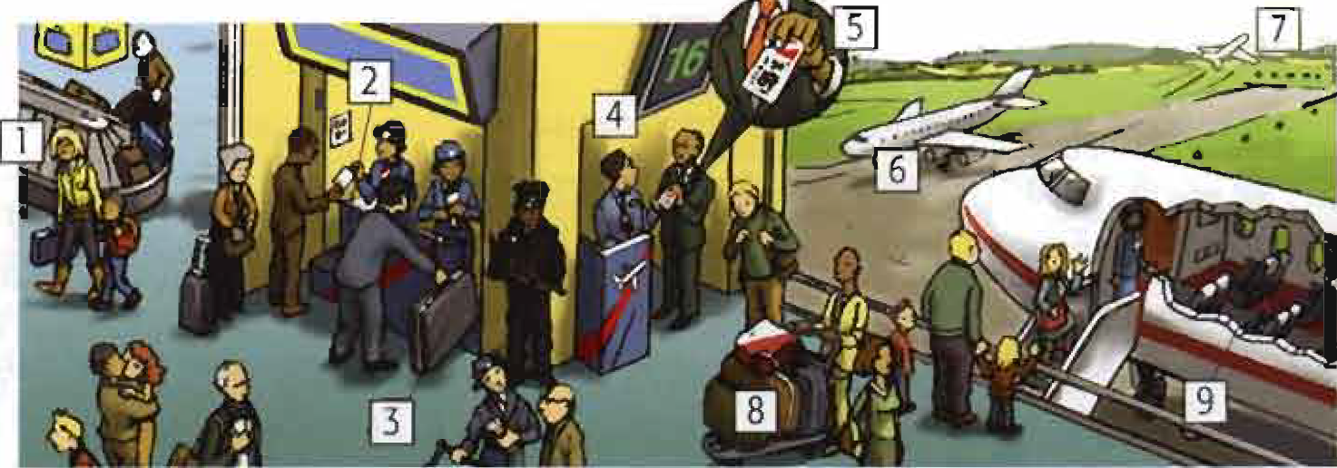
Plane
Match the words and pictures.
____ land (verb)
____ luggage
____ boarding card pass
____ baggage reclaim
____ check-in desk
____ gate
____ suit case
____ take off
____ aisle /ail/
6
8
5
1
2
4
3
7
9

Slide 19
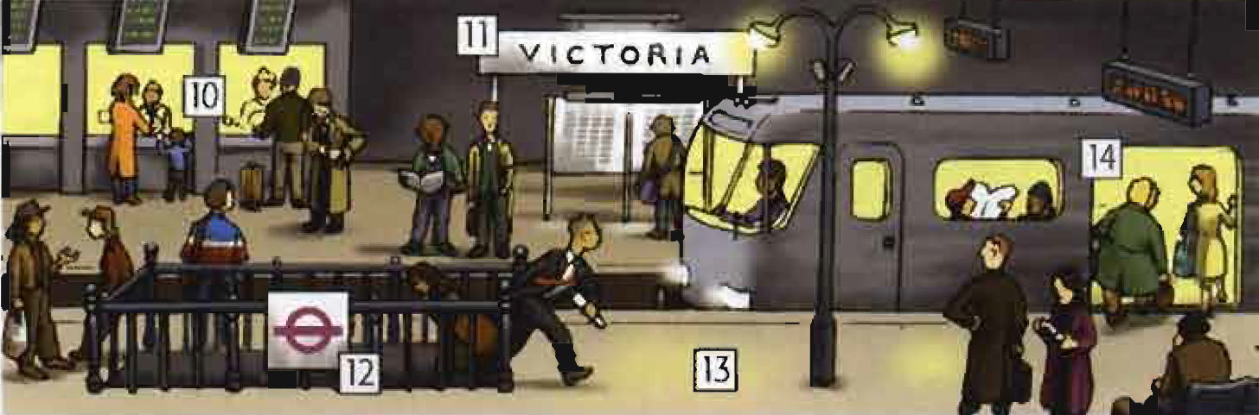
Train
Match the words and pictures.
____ railway station
____ platform
____ carriage
____ ticket office
____ the underground
11
13
14
10
12

Slide 20
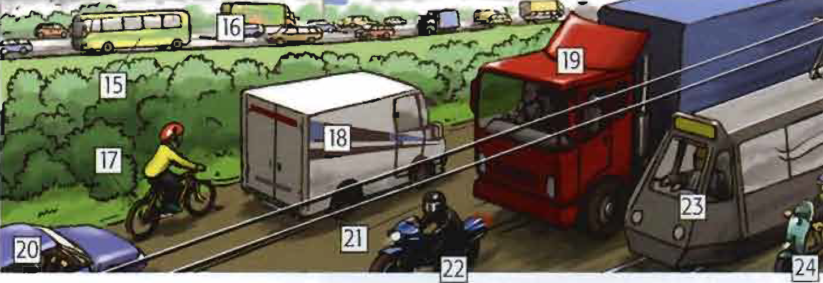
Road
Match the words and pictures.
____ coach
____ lorry
____ van
____ motorbike
____ helmet
____ bike
____ car
____ scooter
____ tram
____ motorway
15
19
18
22
21
17
20
24
23
16

Slide 21
Complete the compound nouns.
area belt crash fine hour jam lane lights
limit park rank station transport works
-petrol ______ -pedestrian ________
-traffic ____ -cycle _____
-seat _____ -road _____
-rush _____ -taxi _____
-car _____ -car ____
-traffic ____ -parking _____
-speed ____
-public ________
station
area
jam
lane
belt
works
hour
rank
crash
park
light
fine
limit
transport

Slide 22




Match the definitions and pictures with the compound nouns.
1. a place where you can get petrol, often with a shop or café __________
2. _______________
3. _______________
4. the time of day when there is a lot of traffic __________
5. when two or more cars hit each other __________
6. money you have to pay for parking illegally __________
7. when there is so much traffic that cars can’t move __________
8. _______________
9. buses, trams, trains, etc. _____________
10. a place where you can't drive ________________
11. a narrow part of the road for bicycles only ____________
12. ________________
13. where taxis park when waiting for costumers ________________
14. A place where you can leave your car _________________
Petrol station
Traffic light
Seat built
Rush hour
Car crash
Parking fine
Traffic jam
Speed limit
Public transport
Pedestrian area
Cycle lane
Road works
Taxi rank
Car park

Slide 23
Travel
flight journey trip travel
1. A __________ is when you travel from one place to another by car, train, plane, etc.
2. ________ is normally used as a verb, e.g. I _________ a lot.
3. A _________ is when you go somewhere by plane.
4. A _________ is when you go somewhere, either for a holiday or on business, stay there, and come back again.
journey
Travel
travel
flight
trip

Slide 24
{{ Thank You }}

